Slide 1
Authorised Shared Access
An evolutionary spectrum authorisation scheme for sustainable economic growth and consumer benefit
Presentation at the WG FM – 17th May 2011

Slide 2
Contents
2
Introduction
The internet going mobile and the European policy response
The scope of Authorised Shared Access
The economic benefits of ASA in Europe

Slide 3
The route to Authorised Shared Access (ASA)
3
The development of mobile broadband is a pre-requisite to European economic recovery, prosperity, green development and social inclusion
Ensuring the timely availability of harmonised spectrum
for mobile broadband remains a critical objective for
policy-makers to achieve the Single Digital Market
If adopted at European level, ASA will act as a key enabler to unlock access to spectrum identified for IMT already by earlier WRCs or by future conferences e.g. WRC-16 while taking into account specific national circumstances

Slide 4
What is ASA?
4
Definition:
Dynamic use of spectrum whenever and wherever it is unused by incumbent users:
  on a shared and non-interference basis
  subject to individual authorisation (i.e. licensed)
  in bands allocated to the Mobile Service by the ITU (and identified to IMT)
  using cognitive radio techniques i.e. geolocation databases complemented, if required, by sensing
Effect:
ASA enables Timely Availability and Licensed Use of Harmonized Spectrum for Mobile with Predictable Quality of Service

Slide 5

ASA Dynamic Sharing in Geographic Domain
Today
ASA
Incumbent
ASA licensees (discrete, identifiable)

Slide 6
ASA Dynamic Sharing in Time Domain
Today
ASA
f3
f3
f2
f2
f1
f1
Time
Time
Incumbent
ASA licensees (discrete, identifiable)

Slide 7
The industry can help push ASA forward, but will require Europe-wide efforts on policy and technical harmonisation
7
Member States, European Commission, Parliament, CEPT involvement will be key and will have each a role to play in the definition and implementation of ASA
CEPT technical harmonisation work will be of key importance:
  Identify Mobile bands in which ASA can be a tool to enable their timely availability and release for mobile broadband in Europe
  Conduct compatibility studies between ASA users and incumbent users to ensure operation on a shared and non-interference basis
  Definition and certification of harmonised geolocation databases

Slide 8
There are many different categories of potential sharer
8
High
QoS hierarchy of applications, e.g.:
Mobile broadband
Overflow mobile broadband
Download apps (e.g. Kindle)
Non-time sensitive machine-to-machine
Defence
Aeronautical
Public safety
Sensitivity
Broadband & Mobile
Other public
& commercial
Low
Unlicensed
Low
Level of crowding
High

Slide 9
Contents
9
Introduction
The internet going mobile and the European policy response
The scope of Authorised Shared Access
The economic benefits of ASA in Europe

Slide 10
The democratisation of mobile broadband creates an unprecedented challenge for spectrum policy in Europe
10
Growth rate of mobile broadband traffic predicted to be more than 100% p.a.
The ITU predicts that by 2020 Europe will need to almost double the spectrum currently allocated to mobile
1,400
Thousands of TB/month
Large cost implications
1,200
Central & Eastern Europe
ILLUSTRATIVE
1,000
800
600
1.7 GHz of spectrum required (ITU)
400
Western Europe
200
0
2009
2010
2011
2012
2013
2014
Additional traffic in Europe to 2020
Spare capacity (inc. 800 MHz & 2.6 GHz)
New air interface technologies
Network densification
Future needs
(Also: smartphone sales will outstrip combined desktop and laptop sales in 2012)
Sources: Cisco Visual Networking Index; Morgan Stanley, ITU

Slide 11
European approaches to spectrum management have been successful to date…
The evolution of institutional and policy approaches in Europe has been successful in handling growth in demand for mobile spectrum thus far
  Policy leadership from the Member States and the Commission and technical leadership from CEPT
  Pragmatic evolution: from pure command-and control to a combination of command-and-control and market-based approaches (technology neutrality, harmonised technical conditions and band plans etc.)
  Enabled Europe to take a leadership position in unlocking harmonised spectrum for mobile broadband (900MHz, 2.1GHz, 2.6GHz, 800MHz)

Slide 12
…but policy will need to evolve further to accommodate the level and nature of demand
Freeing up spectrum is a costly and lengthy process
We are starting to witness delays in harmonised spectrum availability across Europe, which impact innovation and investment in Europe (see next slide)
Parts of the spectrum below 6 GHz are lightly used
A further evolution in policy is necessary to unlock more harmonised spectrum for mobile broadband to meet market demand in a timely and dynamic manner

Slide 13
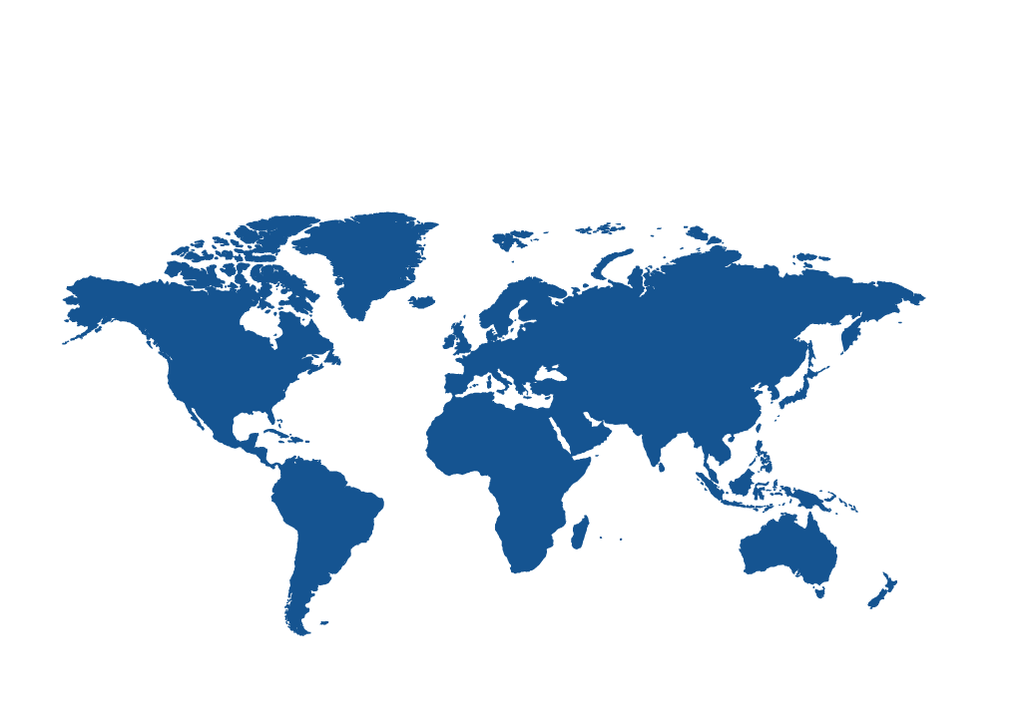
A new Paradigm is Required for Granting Spectrum Access and Use Rights
Increasing delays in making harmonized spectrum available for mobile broadband*
US/Canada
700, 850 MHz
1.7/2.1, 1.9, 2.5 GHz
Asia-Pacific
450, 700, 850, 900 MHz
1.7, 1.8, 1.9/2.1, 2.3, 2.5 GHz
Spectrum band | 6 years | 8 years | 10 years | more
900 MHz
2.1 GHz
2.5/2.6 GHz
2.3 GHz
Europe
800, 900 MHz
1.8, 1.9/2.1, 2.5 GHz
Africa & Middle E.
450, 800, 850, 900 MHz
1.8, 1.9/2.1, 2.5 GHz
Latin America
450, 700, 850, 900 MHz
1.7/2.1, 1.8, 1.9, 2.5 GHz
* In Europe (timeline between spectrum identification and European wide availability

Slide 14
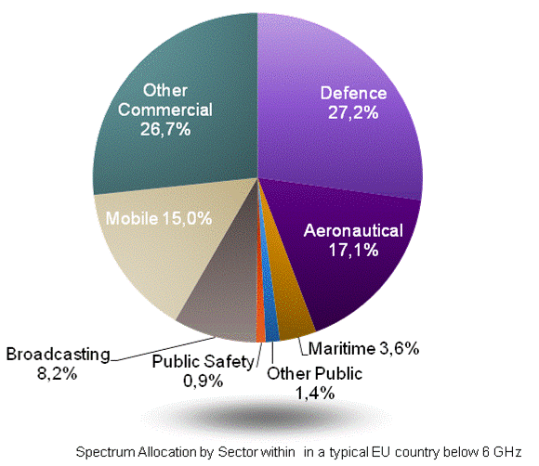
Both military and civilian users resist being fully cleared from prime bands, for valid reasons
Military
Large contiguous holdings coordinated and harmonised across countries
Reluctant to clear spectrum completely:
  Has already given up spectrum
  Invested in specific frequency equipment
  Has increasing needs for spectrum
  National security: requires flexibility
Civilian (public and private)
Public actors (e.g. aviation authorities, emergency services) and private actors (e.g. broadcasters, businesses, maritime users)
Difficult to clear these users fully:
  Have expectations of continued use
  Investments in specialised equipment
  Often narrowband users. Needing to relocate many users is a challenge
Source: WIK-Consult

Slide 15
Contents
15
Introduction
The internet going mobile and the European policy response
Why a third category of spectrum rights would be beneficial
The scope of Authorised Shared Access
The economic benefits of ASA in Europe

Slide 16
Authorization options
= facilitated or enhanced
by cognitive radio
Exclusive
access
e.g. Cellular networks,
broadcasting
Authorized
primary
use
Individual
authorizations
(= Licensed)
Shared
Primary Access
e.g. operated DECT
and PHS
Authorized
secondary
use
Shared
Secondary Access
NEW
ASA
e.g. unlicensed
TV White Space
General
authorizations
(=license exempt
= unlicensed)
Horizontal shared
secondary access
Use under
general
authorization
E.g. WLAN,
Bluetooth
Horizontal shared
access

Slide 17






ASA Can Unlock A Number of Prime Bands for 3G/4G Services Requiring QoS
800
MHz
900 MHz
1800 MHz
2.1
GHz
2.3
GHz
2.4
GHz
2.6
GHz
3G/4G
3.6
GHz
2.6
GHz
3.6
GHz
3.8
GHz
5 GHz
Licensed
ASA with military/wireless cameraa
Unlicensed
wifi
Licensed
ASA with satellites
Unlicensed
wifi
Incumbent prohibits ASA spectrum
Licensed + ASA spectrum
Licensed spectrum
3G/4G services
(predictable QoS)
3G/4G services
(predictable QoS)
Best effort services
unlicensed
Device use bands (licensed, ASA, unlicensed)
based on apps, QoS, tariff, bandwidth requirements
* Example of ASA bands (IMT) in Europe

Slide 18
How Does The System Work Today
Spectrum licensee
grant/award of spectrum rights
Administration/Regulator
Compensation and timeline to free up the spectrum
Incumbent
Licensed Spectrum
Base station controls device access to licensed spectrum
Base station
Base station
Multi-bands
Device
Base station controls device access to licensed spectrum

Slide 19

How Does ASA work?
ASA licensee
grant/award of ASA rights
Administration/Regulator
ASA Database
Agreement/compensation/ sharing conditions
ASA spectrum and
award rules
where/when ASA spectrum is available (Dynamic)
Incumbent
Permitted ASA spectrum
Base station controls device access to spectrum (licensed, ASA)
Base station
Base station
Incumbent
Multi-bands
Device
Base station controls device access to spectrum (licensed, ASA)

Slide 20

Smarter radios do not negate the need for harmonisation! Spectrum Harmonisation remains Key
Favourable regulatory environment
Every different spectrum band supported adds cost to a device
Benefits of scale as important to an agile radio than to a dumb radio
Piecemeal approaches in individual countries will not enable investment and market emergence
Competition between service providers
Global/Regional harmonised mobile spectrum
Affordable device and
service costs for end users
Well defined global standards

Slide 21
Relative to licence-exempt, ASA could have benefits for sharers and incumbent users
The incumbent will not receive harmful interference, and flexibility of sharer allows evolution of incumbent’s use
The sharer (ASA rights holder) can be held responsible for managing interference according to pre-defined/agreed criteria, giving additional security to the existing user
Sharers can receive assurances over the level of capacity and the operating conditions in the band
  Guarantee quality of service, key for mobile broadband
  Makes ASA spectrum attractive to future mobile broadband businesses, potentially diversifying access to spectrum
Potential for synergies between incumbent user and sharer, e.g. infrastructure sharing
Potential for collaboration and compensation – incumbent right holders can gain from ASA

Slide 22
Contents
22
Introduction
The internet going mobile and the European policy response
Why a third category of spectrum rights would be beneficial
The scope of Authorised Shared Access
The economic benefits of ASA in Europe

Slide 23
ASA could also create significant economic value
The benefits of ASA would be substantial and would accrue to a variety of stakeholders
  Network and service providers would benefit from enhanced mobile broadband at a lowered cost
  Economies of scale would enable more affordable and more capable devices and networks for consumers
  Better broadband access would strengthen Europe’s competitiveness in all sectors, and interoperability would contribute to the digital single market
  Unlocking extra spectrum to meet market demand in a timely and dynamic manner would foster competition

Slide 24
The magnitude of direct benefits from 200MHz of ASA have been modelled in Europe
Yearly network operator site costs for 2020-2025, different spectrum scenarios
€bn
9
No ASA
Low frequency ASA
8
High frequency ASA
High and low ASA
Two ASA bands gives 23% extra coverage for the same cost
7
6
5
4
3
Core assumptions:
200MHz of ASA spectrum, modelled at 380MHz and 2.3GHz
25% incumbent occupancy
Data demand based on Cisco forecasts
Operator with 30% share
Operator costs move in line with current trends
2
1
0
0%
10%
20%
30%
40%
50%
60%
70%
80%
90%
100%
Population coverage
Notes:
Operator modelled assumed to have 30% market share of whole of Europe. ASA availability for one operator – 2x10MHz of 380MHz, 40MHz of 2.3GHz (TD-LTE likely so unpaired). Equivalent to c. 200MHz of additional spectrum from ASA for the whole industry
Data demand based on Cisco, then steady growth, then declining growth after 2018 (i.e. this may be conservative – impossible to predict)

Slide 25
This suggests a potential increase in consumer surplus of over €50bn per year in Europe
Yearly increase in consumer surplus generated by ASA availability (200MHz)
€bn
60
Low frequency only
High frequency only
High and low
53
53
50
40
39
31
29
30
24
20
10
0
2020-2025*
2025-2030
* Period used for the modeling, ASA can deliver benefits earlier for Europe
Notes:
Note that the total consumer surplus increase is the same for the two periods, but the difference between 380MHz in the two periods shows the diminishing importance of low frequency spectrum as networks are increasingly built for capacity not coverage
Consumer surplus multiplier based on commentator consensus that annual incremental consumer surplus is roughly equal to total lifetime change in producer surplus. At a discount rate of 10% this gives a multiplier of 10

Slide 26
The total direct value is likely to be significant, in the region of €65bn per year and up to €125bn
Modelling also estimates productivity gains from 200MHz of ASA spectrum to be around €7bn a year, due to potential 0.6% growth in GDP from mobile broadband
This gives total direct benefits in the region of €65bn/year
This is, however, a conservative estimate:
  This assumes a modest allocation of c. 200MHz as ASA spectrum. Using ASA to fulfil the ITU’s estimate of Europe’s requirements (853MHz) increases this to over €125bn/year
  This assumes ASA with existing band occupation of 25%. If this is reduced to 15%, benefits rise by 22%
Source: Ovum Consulting
Notes:
Based on Ovum forecast – productivity gains from mobile BB in the US to be $860m over 10 years, equal to incremental GDP growth of 0.6%
Modelling shows that network without ASA will be able to cope with 10% less data traffic, jeopardising 10% of productivity gains
Lowering incumbent occupation to 15% seems reasonable based on utilisation surveys discussed earlier

Slide 27
Indirect benefits from innovation and efficiency will also be significant
Developing and implementing ASA would lead to investment in R&D and job creation in Europe
Deployment of mobile broadband expected to create 25m jobs worldwide, and to involve investment of $800bn over 5 years
  ASA could be a major part of helping Europe capture as much as possible of this
  Investment will be attracted to regions with pro-active regulatory frameworks – innovation and competition
Source: Mobile industry letter to G20 (2009)

Slide 28
The mobile industry can help push ASA forward, but its success depends on policy makers actions
28
The development of mobile broadband can be a stimulus to European economic recovery, prosperity, green development and social inclusion
Making the necessary harmonised spectrum available therefore must be a critical objective for policy-makers
If backed by CEPT and adopted at the EU level and in member states, ASA will act as a key enabler to unlock access to this spectrum
The industry can overcome the technical challenges, but the key institutions will have to get behind ASA and set up the right framework to make it happen

Slide 29
Next steps in CEPT
Following the presentation of the ASA concept at the ECC plenary , it is clear that the ASA concept would require further assessment by CEPT and it was thought that WG FM as a lead group on Frequency Management in Europe is the right place to conduct this assessment

