Slide 1
CEPT COM-ITU meeting
Copenhagen, Denmark, 30 November - 2 December 2011
World Conference
on International Telecommunications 2012
(WCIT-12)
Richard Hill
Secretary, CWG-WCIT12

Slide 2
ITRs: Setting the stage for
a connected world
[Content]
Background
Why the ITRs are important
The need to revise ITRs
Preparatory process
Expectations for WCIT-12
Useful information and links

Slide 3
Background
The International Telecommunication Regulations (ITRs) define the general principles for the provision and operation of international telecommunications
1865 2012
1879
1906
1932
1938
1949
1958
1973
1988
Regulations for international service of the Telegraph Convention
(1865- last modified on 1973)
Telegraph Regulations
(1932 - last modified on 1973)
ITRs
(came into force in 1990)
Telephone Regulations
(1932 - last modified on 1973)
Radio Regulations
(first version 1906 – last modified in 2007)
ITRs succeeded the Telegraph Regulations (1973) and Telephone Regulations (1973) in a new treaty adopted at WATTC-88 (Melbourne). [CS/Art. 4].
Source: ITU

Slide 4
Background
The current version of ITRs was adopted in 1988 in Melbourne, Australia, by WATTC-88
ITRs came into force in 1990, and are one of the four treaties of ITU.
Signed by 178 countries, ITRs are a truly global treaty applied around the world
Constitution | Convention | Radio Regulations | ITRs

Slide 5
ITRs: Setting the stage for
a connected world
[Content]
Background
Why the ITRs are important
The need to revise ITRs
Preparatory process
Expectations for WCIT-12
Useful information and links

Slide 6
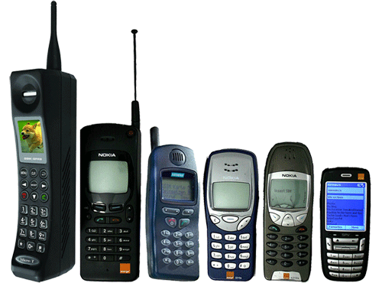


Why the ITRs are important
The ITRs …
Establish general principles relating to the provision and operation of international telecoms;
Facilitate global interconnection and interoperability;
Underpin harmonious development and efficient operation of technical facilities;
Promote efficiency, usefulness, and availability of international telecommunication services;
Treaty-level provisions are required with respect to international telecommunication networks and services.

Slide 7
ITRs: Setting the stage for
a connected world
[Content]
Background
Why the ITRs are important
The need to revise ITRs
Preparatory process
Expectations for WCIT-12
Useful information and links

Slide 8
The need to revise ITRs
The current version of the ITRS has remained unchanged since 1988.
  At that time:
  there were very few countries with a liberalized market;
  most operators were a monopoly regime, under government or state control;
1988 2012
ITRs
(came into force in 1990)

Slide 9
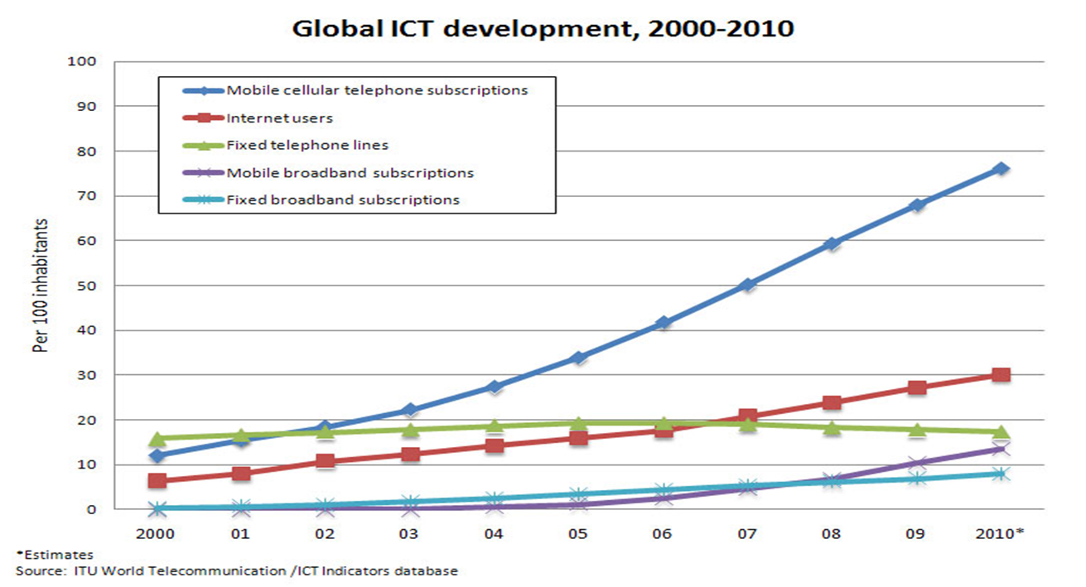
The need to revise ITRs
The international telecom environment has significantly evolved, both from the technical and policy perspectives, and that it continues to evolve rapidly;
Advances in technology have resulted in an increased use of IP-enabled infrastructure and relevant applications, presenting opportunities and challenges for the ICT sector;
As technology evolves, Member States are evaluating their policy and regulatory approaches to ensure an enabling environment.
Shift from
fix to mobile, from
voice to data
as the drivers of traffic and main sources of revenue

Slide 10
ITRs: Setting the stage for
a connected world
[Content]
Background
Why the ITRs are important
The need to revise ITRs
Preparatory process
Expectations for WCIT-12
Useful information and links

Slide 11
Preparatory process – Timeline
The revision of ITRs has been under discussion since 1998
C99, C00, C01
C03, C04, C05
C07, C08, C09, C10
C11
Res 1312, Res 1317
WCIT12
PP98
PP02
PP06
WTPF-09
PP10
Res 79
Res 121
Res 146
Op.6
Res 171
CWG-WCIT-12
Expert Group
CWG-ITRs
Expert Group
Res 1312, Res 1317
PP Res 171
C09 adopted Resolution 1312 , creating the Council Working Group to Prepare for the WCIT 12 (CWG-WCIT12) initiating the preparatory process towards WCIT-12. Its task was to draw up a consolidated report on all ITR issues, to be used to support the work of WCIT-12.
Following a report of the CWG-WCIT12, C10 adopted Resolution 1317 to fix the dates and agenda for the WCIT.
The working group also reported to the PP10, which adopted Resolution 171 (Guadalajara ) to guide the future work of the group.

Slide 12
Preparatory process – Current progress
CWG-WCIT12 held three meetings in 2010 and one in April 2011.
Last meeting established and published:
  The latest version of the compilation of all proposals;
  The structure of the WCIT-12;
  Dates of future meetings and work-plans.
Key issues brought up:
  What core principles should guide discussions?
  Do some provisions belong elsewhere? (e.g. ITU Constitution/Convention, ITU-T Recommendations)
  What provisions should be added to cover new issues?

Slide 13
Proposals made during the preparatory process
Proposals made could be grouped as follows:
2
1
3
6
5
7
8
4
Human right to access to communication
(including nation’s right to access intl. communication infrastructure and fair/equitable access/usage of network/services)
Security in the use of ICT (including privacy and unsolicited electronic communication), &
Protection of critical national resources
of national significance and interest, or of national public interest
International
frameworks
Charging and accounting- including Taxation
(Market-based costing, Liberalization of international gateways, Transparency obligations on ROAs)
Conformance and interoperability
Quality of Service
Convergence
Enforcement measures
(including possible binding effect of certain ITU Recommendations)

Slide 14
Preparatory process –Work Plan
Work Plan agreed by CWG-WCIT12
27-30 Sep 11 Discussion of proposals compilation of proposals, including new proposals. Review 1st draft of report to WCIT-12 | 27-29 Feb 12 1st draft of new ITRs Progress the report to WCIT-12 | 23-25 Apr 12 2nd draft of new ITRs Progress the report to WCIT-12 | 20-22 Jun 12 Final draft of the future ITRs Finalize report to WCIT-12 | 3-14 Dec 12 WCIT -12

Slide 15
Preparatory process – Regional preparation
It is expected regional preparation to take place back-to-back with the WTSA-12 regional preparations;
Some regions may organize their own regional preparatory meetings and invite ITU to participate;
For some regions, ITU would organise a preparatory meeting in collaboration with the regional organisation;
It is suggested that the regional meetings take place in the February-May 2012 timeframe.

Slide 16
ITRs: Setting the stage for
a connected world
[Content]
Background
Why the ITRs are important
The need to revise ITRs
Preparatory process
Expectations for WCIT-12
Useful information and links

Slide 17
Expectations for WCIT-12
  WCIT-12 presents key opportunities to increase good collaboration between countries;
  Help countries to reach new levels of economic and social development by means of efficient telecom services;
  Make ITRs relevant, and valuable to the full membership, so that they address and alleviate the many concerns that are out there.

Slide 18
ITRs: Setting the stage for
a connected world
[Content]
Background
Why the ITRs are important
The need to revise ITRs
Preparatory process
Expectations for WCIT-12
Useful information and links

Slide 19
Useful information and links
Further information available at:
CWG-WCIT12:
http://www.itu.int/council/groups/cwg-wcit12/index.html
2007 Background document:
http://www.itu.int/md/T05-ITR.EG-INF-0002/en

Slide 20
Thank you
Richard Hill
Secretary, CWG-WCIT
richard.hill@int.int

