Slide 1
CEPT portal and family websites: An overview
October 2011
CEPT portal: www.cept.org Committee sites: www.cept.org/<committee> ECO site www.cept.org/eco
Slide no |  | Showing
2 |  | Home page of web portal
3 |  | Set up profile and register as user
4 & 5 |  | Apply for membership of a group
6 |  | E-mail reflector for a group
7 |  | CEPT meetings, overview of meetings
8 & 9 |  | Display of meetings, meeting calendar
10 |  | Meeting documents
11 |  | Favourite groups
12 |  | Watch groups
13 |  | Overview of your groups
14 & 15 |  | Head of Delegation
16 |  | Where to find more info

Slide 2
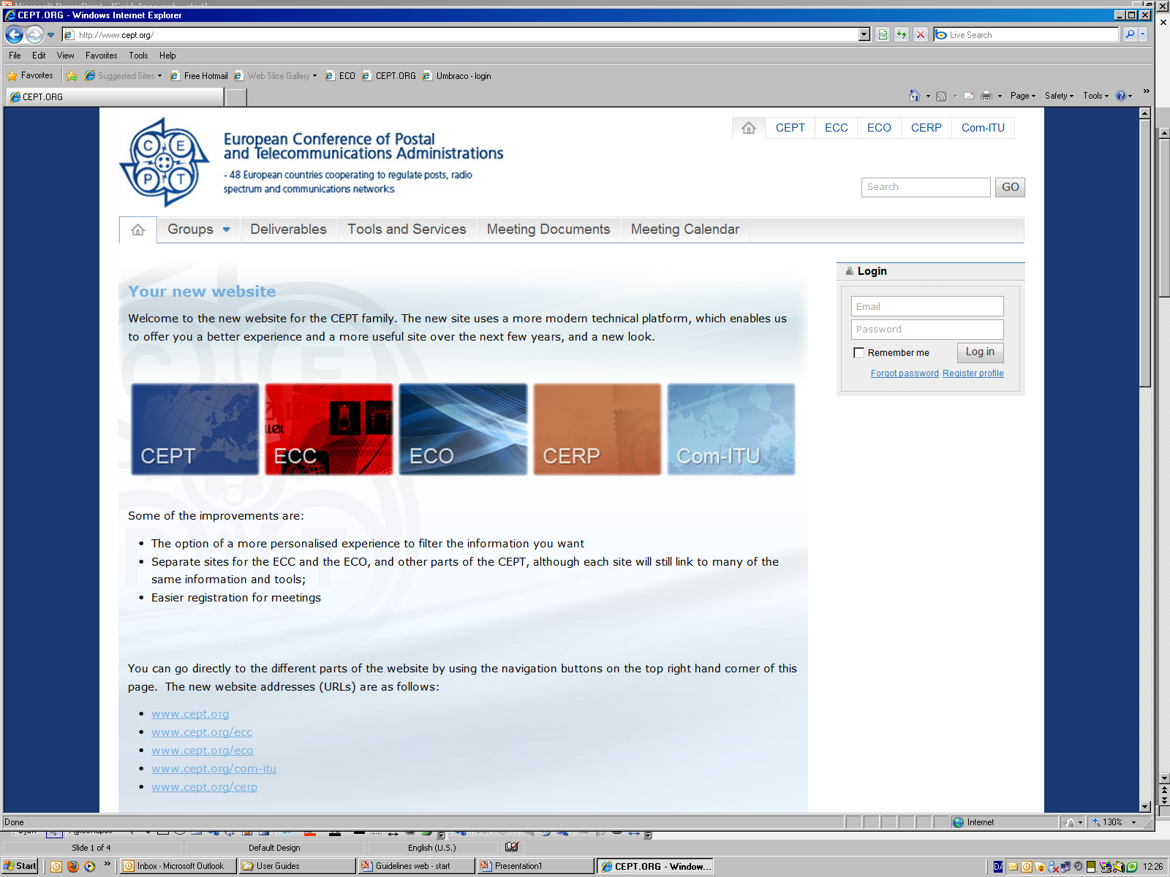
CEPT portal and family websites: How to ’get started’
November 2011
CEPT portal: www.cept.org Committee sites: www.cept.org/<committee> ECO site www.cept.org/eco
You can also navigate
between the sites by
clicking
here or
on the logos

Slide 3
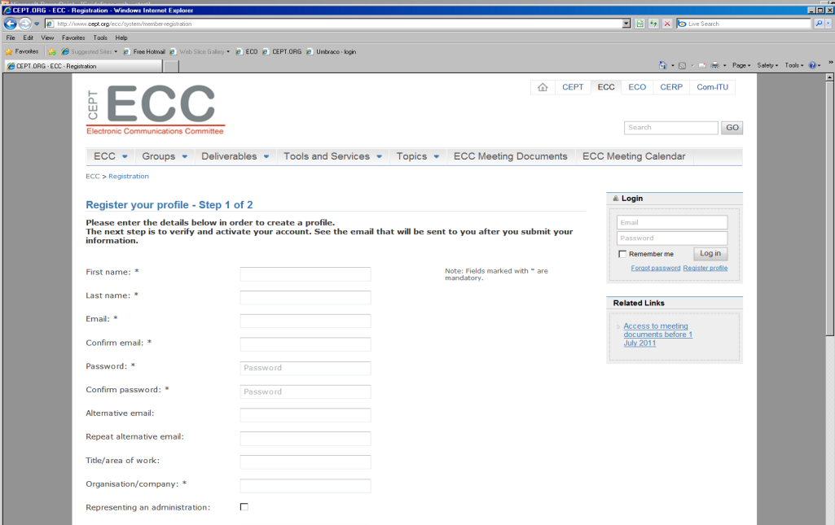
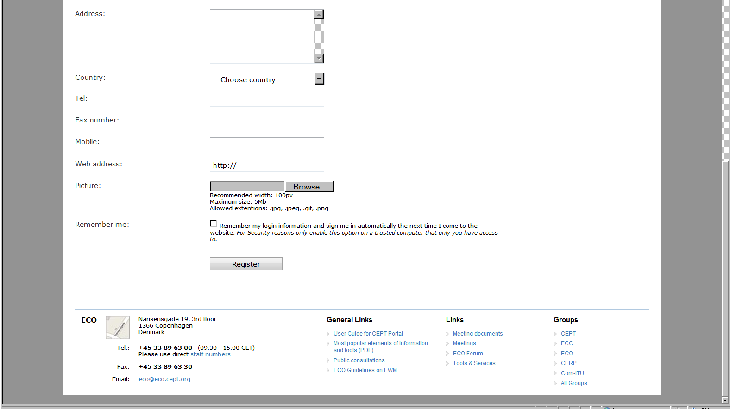
Set up profile and register as user
In ’Login’ box click on ’Register profile’
Fill in profile with your details
Submit by clicking ’Register’ at bottom of page
You will receive an e-mail within few minutes
containing an ’activation link’
Click on the ’activation link’
You are now registered as a user

Slide 4
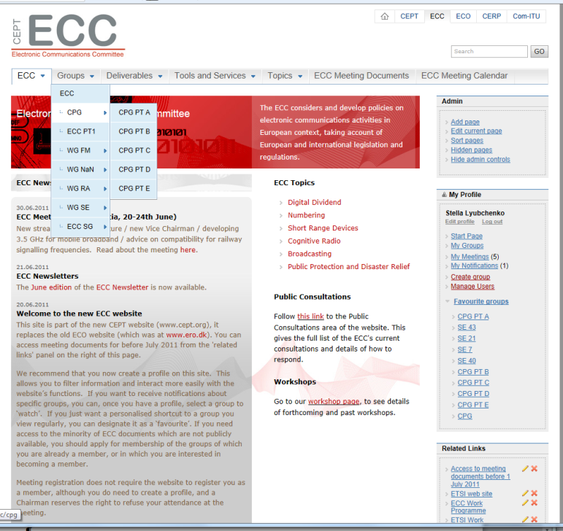
Apply for membership of a group:
Log in with your email address and your password (from your profile)
(you can log in from anywhere on the web portal)
Go to the relevant site (ECC in case of CPG)
Find the group of which you want to be a member under
’Groups’ in top menu and click on it

Slide 5
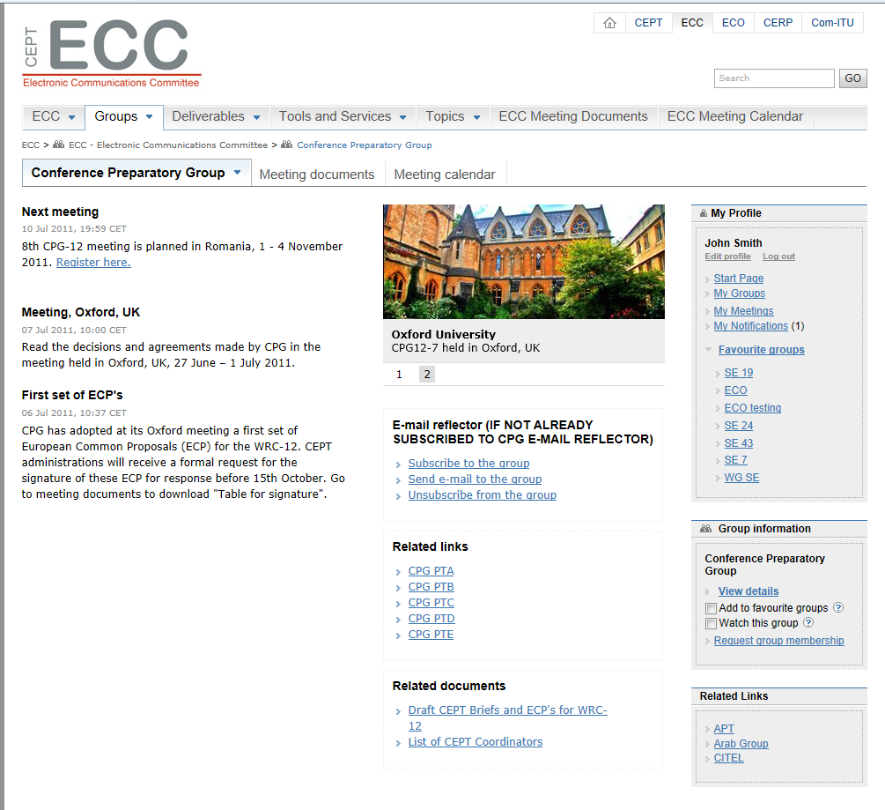
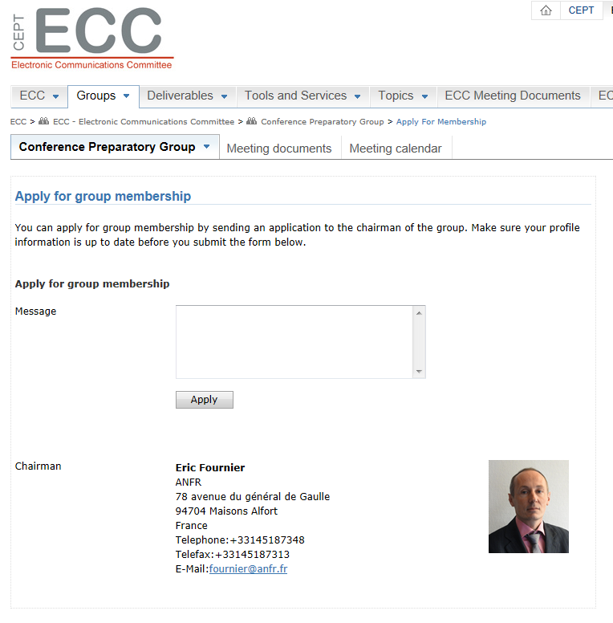
Apply for membership of a group: cont.
Under ’Group information’ click on ’Request group membership’
(here you may also add group to your ’favourite group’ or mark it
as a group you want to ’watch’, i.e. see news about)
5. ’Application page’ is displayed
Click on ’Apply’ (’message’ field is optional)
Your request will be mailed to the person responsible for approval/
rejection of applications for membership of the group
You will receive an e-mail when your application has been
dealt with (please note that this may take a few days)
Membership of the group gives a right to access passwd. protected documents.

Slide 6
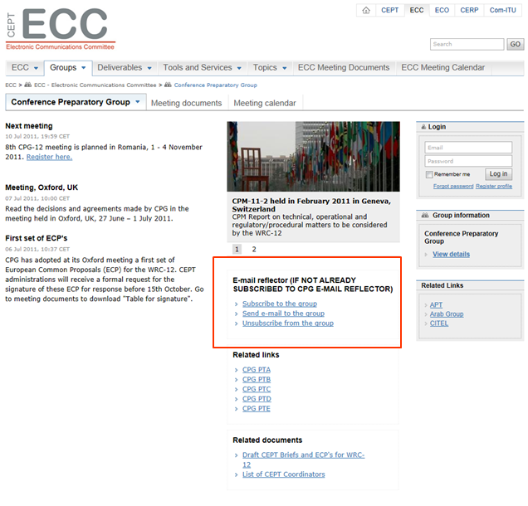
E-mail reflector for a group
Many groups in the CEPT family have an
e-mail reflector for easy electronic
communication between interested
parties of information related to the group.
You may subscribe to the e-mail reflector of
a group, send a mail to the reflector group
and unsubscribe from the reflector group
via the web portal.
Go to the relevant group page and click on the
relevant link.
PLEASE NOTE that the group (here the CPG)
and the e-mail reflector group for the CPG are
different things: you do not become a member
of the CPG by becoming a member of the
reflector group, and vice-versa.

Slide 7
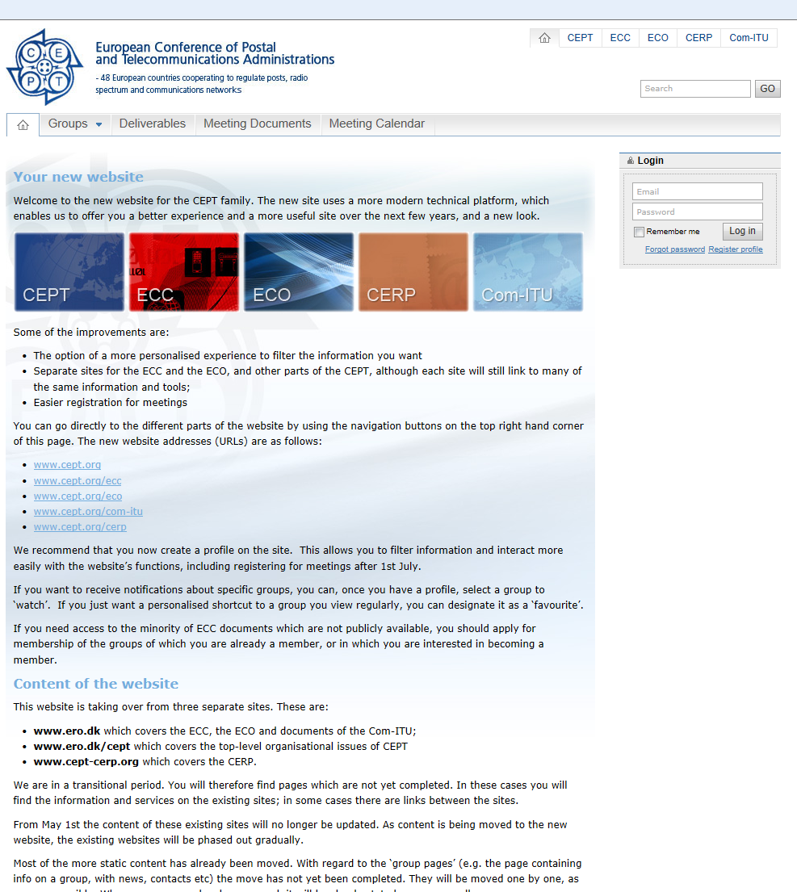
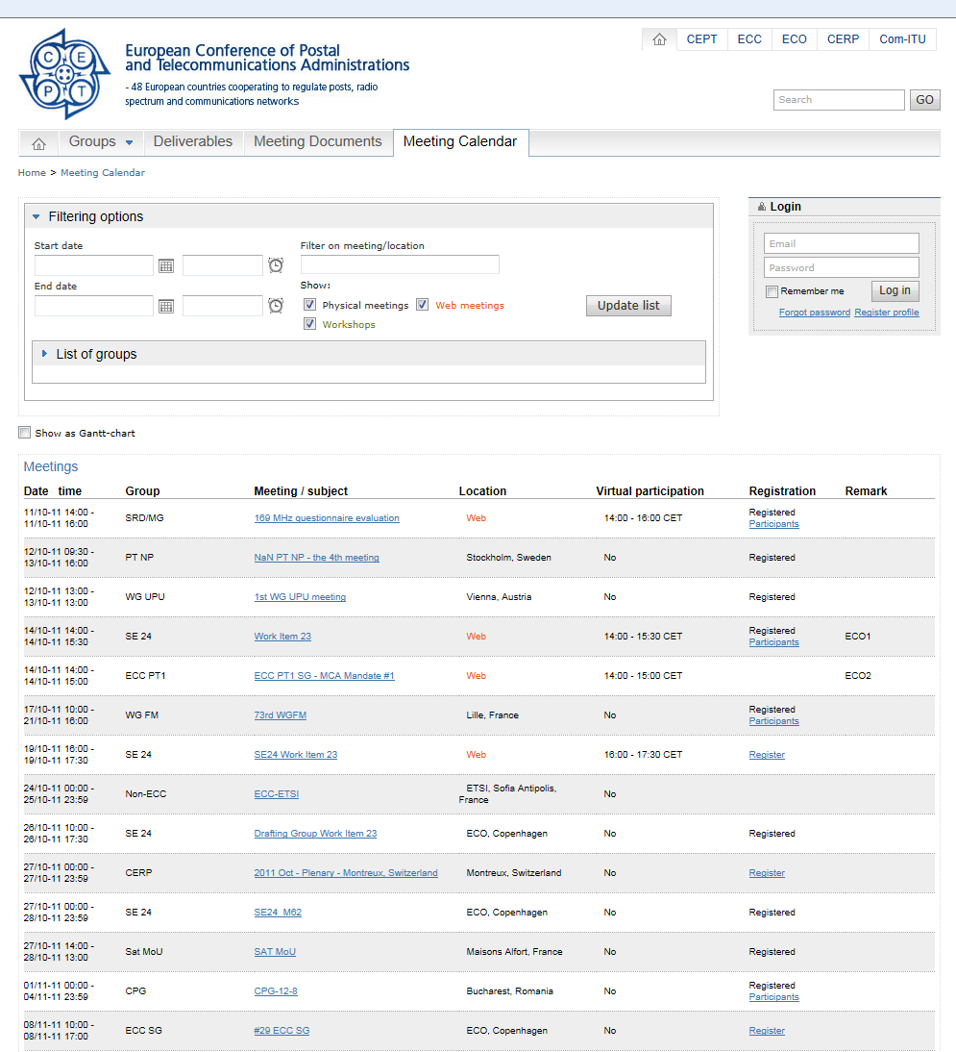
Meetings within the CEPT family
are all listed in the meeting calendars on
our web portal.
Overview of all meetings within CEPT:
Go to (home, www.cept.org) and click on
menu item Meeting Calendar.

Slide 8
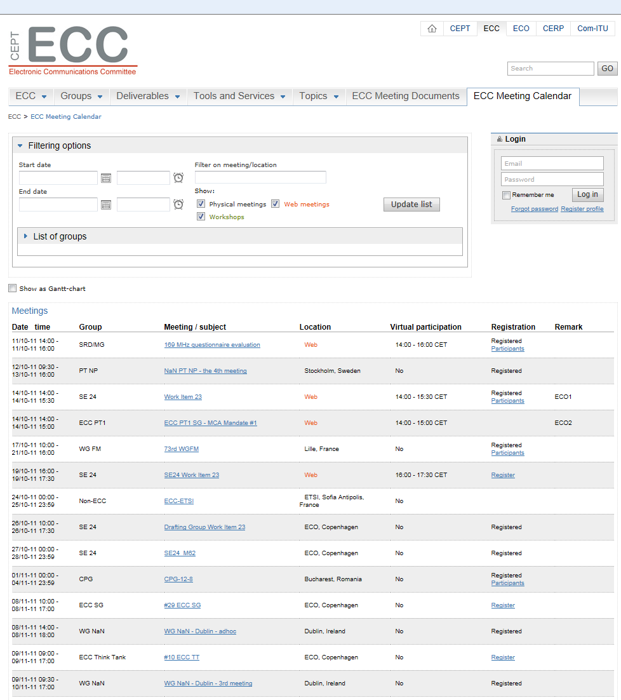
Display of meetings
The meetings of groups are displayed on the
relevant individual sites.
For example, CPG meetings are found
on the ECC site.
Go to www.cept.org/ecc and click on Meeting Calendar.
All meetings for the ECC and its subgroups
will be displayed.

Slide 9
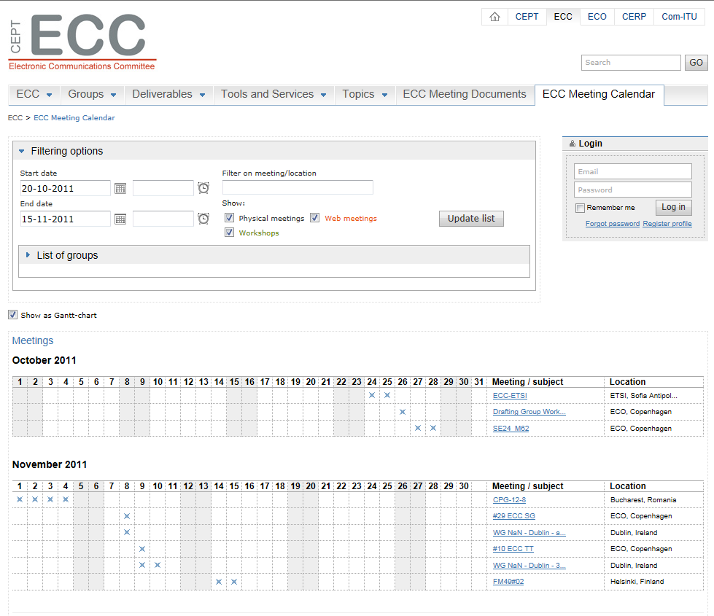
Display of meetings cont.
For the display of meetings you can define a
specific period, and you can choose to display the
list of meetings as a Gantt chart.

Slide 10
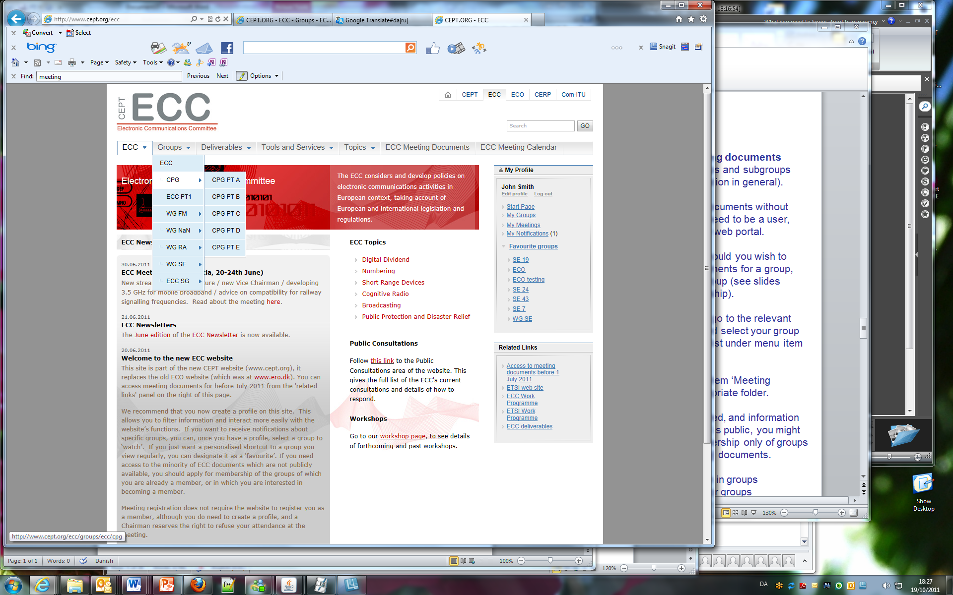
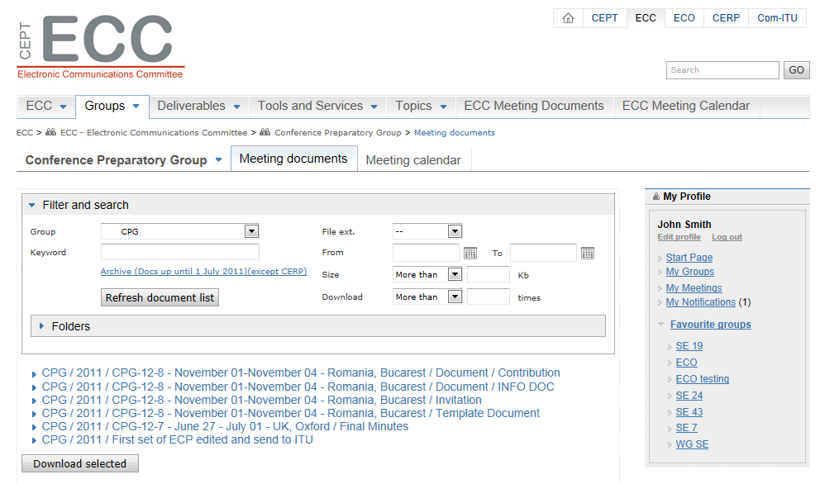
Meeting documents
By far the largest number of meeting documents
for the CEPT Committees, its groups and subgroups
are publicly available (as is information in general).
This means that you can access documents without
any special access code. You do need to be a user,
i.e. have a registered profile on the web portal.
A few documents are protected. Should you wish to
be able to see also protected documents for a group,
you need to be a member of the group (see slides
no 3 & 4: how to apply for membership).
To find the documents you want go to the relevant
Committee website (here ECC), and select your group
(here CPG) from the dropdown list under menu item
‘Groups’.
On the WG FM page select menu item ‘Meeting
Documents’. Then select the appropriate folder.
As very few documents are protected, and information
on groups and meetings in general is public, you might
want to consider to apply for membership only of groups
for which you do need access to all documents.
You can still follow what is going on in groups
by making them ‘favorite groups’ or groups
that you ‘watch’ (see next slides).

Slide 11
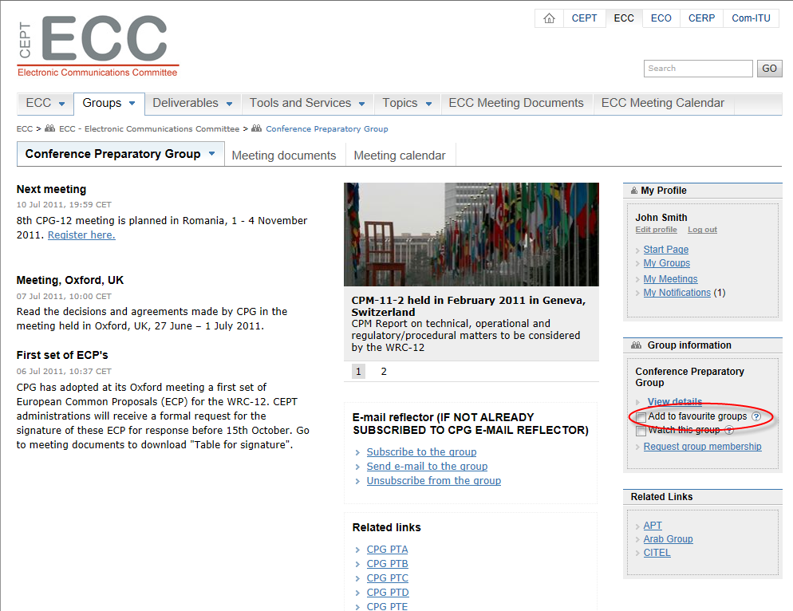
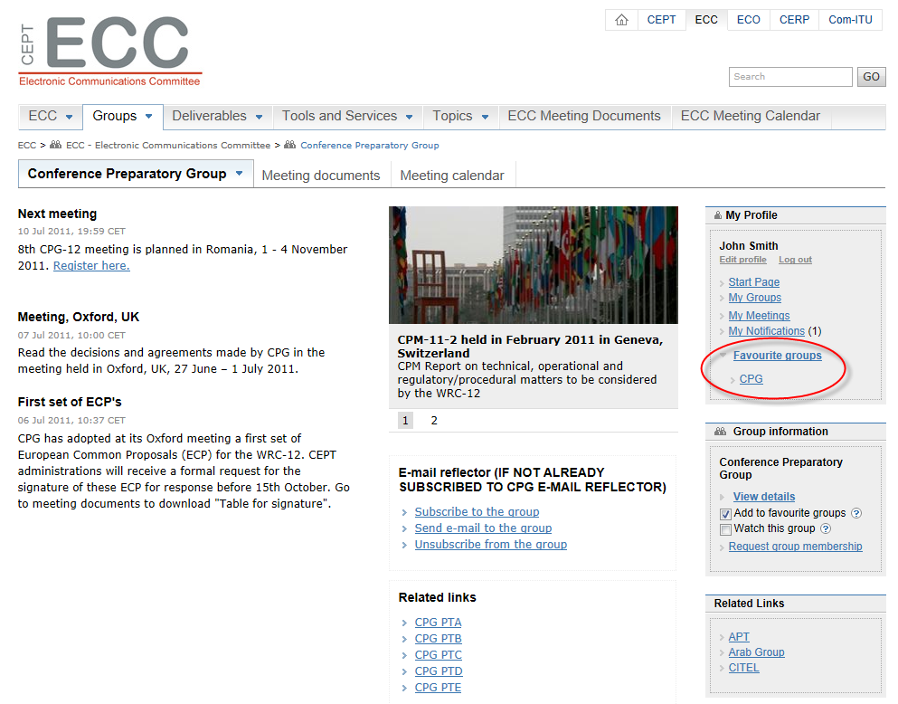
‘Favourite groups’
You may make your own list of ‘favourite groups’.
This gives you easy access to ‘your’ groups.
To do this: log in, select a group from the
menu item Groups, and then tick the box
‘Add to favorite groups’.
You will get a link in the ‘My profile’ box
for easy access to the group page.

Slide 12
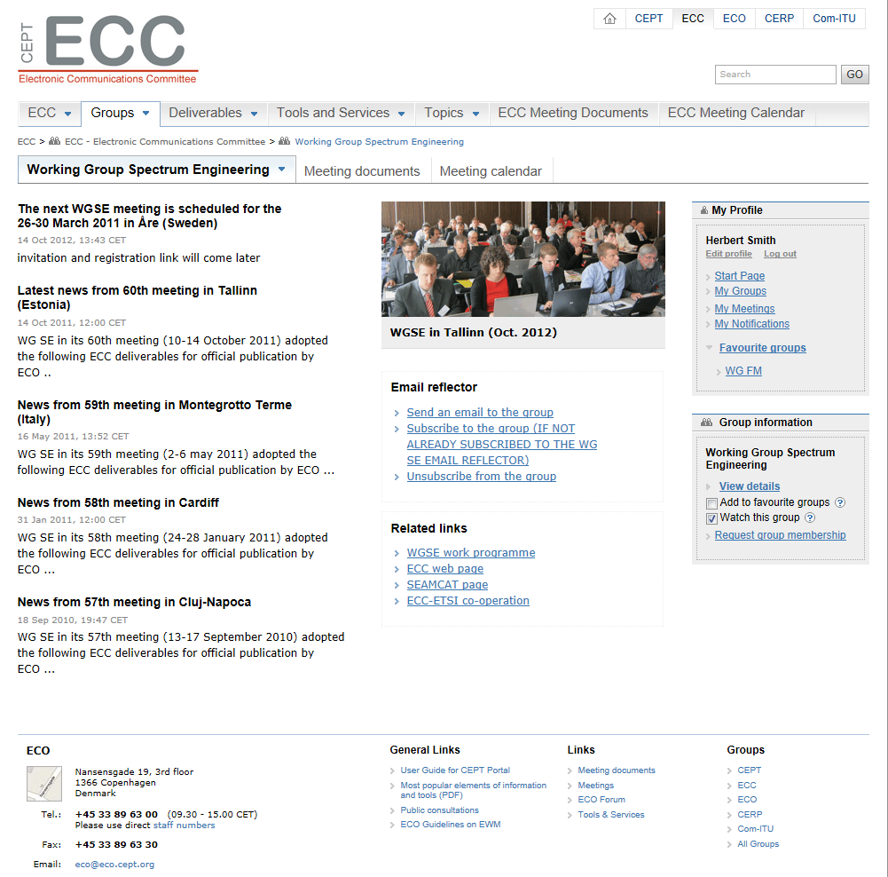
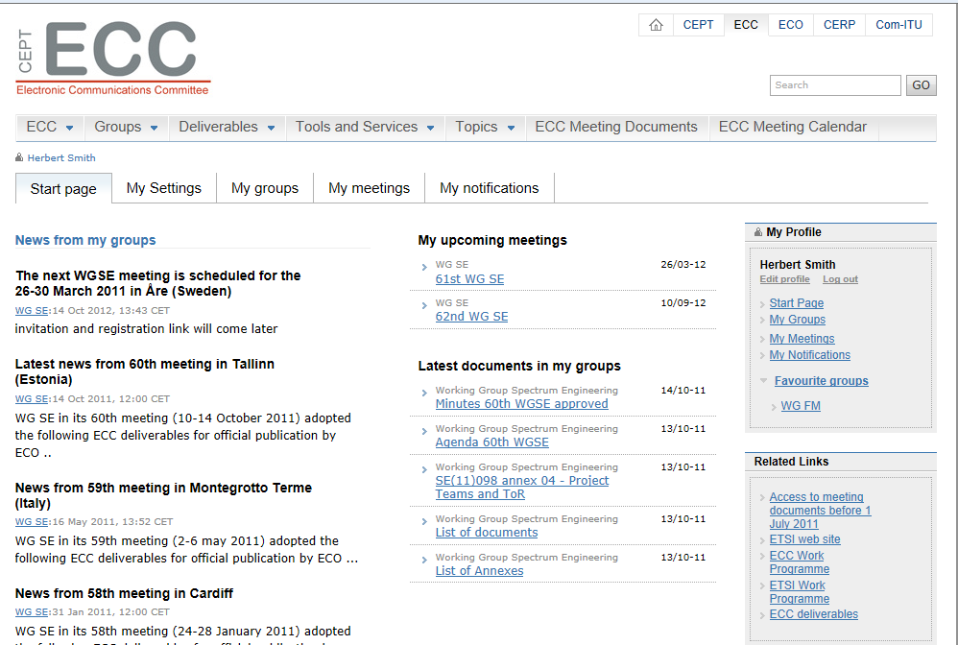
‘Watch this group’
If you ‘watch a group’ you will get news updates
from the group in your personal ‘Start page’.
To watch a group: log in, select the group from the
menu item ‘Groups’, and then tick the box
‘Watch this group’.
Go to your Start page – it is available in the
‘My Profile’ box. When you click on the link,
a page is displayed shows news from the
groups you are watching.

Slide 13
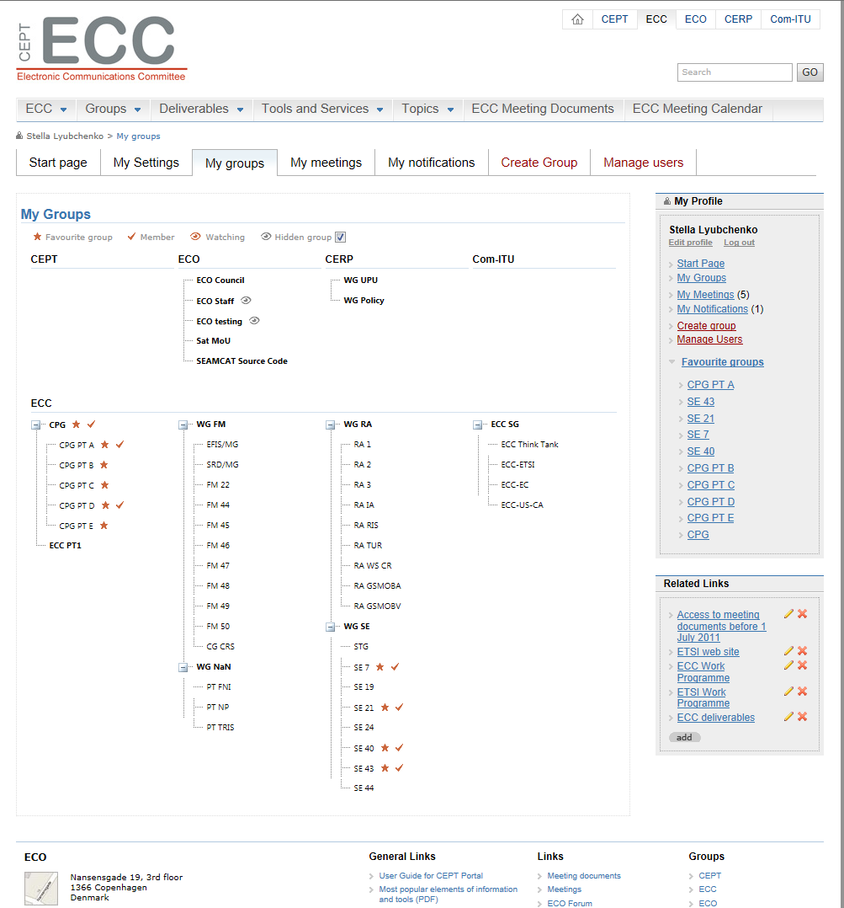
Overview of your groups
You can get an overview of all ‘your’ groups
with an indication of your ‘relationship’ with them
by clicking on menu item ‘Groups’ on the
home page when you are logged in,
or on ‘My groups’ in your ‘My profile’ box.
By using the features described above
(‘favourite groups’, ‘watch groups’)
you can ’personalise’ the user interface
to our web portal and decide yourself on
the nature of your ‘relationship’ with groups
and with the websites in general.
This will make access to information on
the various entities of the CEPT and their
activities quicker and easier.

Slide 14
Head of Delegation (HoD)
The Head of Delegation feature of the ECC website:
  Is part of the system for managing access to meeting documents
  Its intention is to put member administrations in control of the process
  The feature is equivalent to the process with the old website with its
  password-protected documents, and with passwords being passed
  on as required from the chairmen of the groups.
The new system does not use passwords, and has the advantage that an administration can keep up-to-date
the list of people which it wishes to have access to the few documents which are protected.
Access to protected documents requires a person to be a ‘group member’ of a particular group (ECC, WG or PT).
Membership of a group can be given by:
  A ‘Head of Delegation’
  The Chairman/Secretary of the group
  An ECO staff member
How does an HoD give membership to a person? The HoD:
  Logs in with his/her profile
  Goes to the relevant group
  Clicks on menu item ‘Invite member’
  Enters e-mail address and sends mail to the relevant person
The invitee receives an invitation e-mail with a link. When clicking on the link the invitation is accepted, and the
Invited person is now a member of the group.

Slide 15
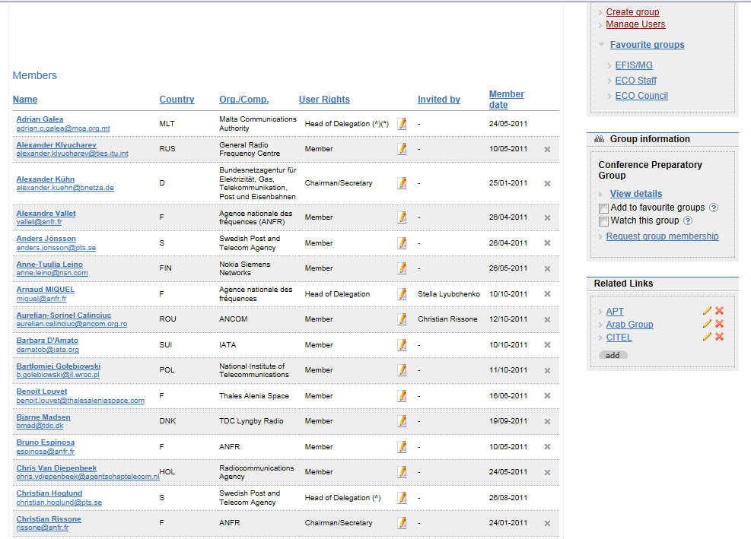
Head of Delegation status in one group is automatically inherited by its subordinate entities
(e.g. ECC to CPG, FM, SE, etc., and ECC and CPG to CPG A, CPG B etc.
Inherited HoDs are marked (^).
It is for each individual administrations to choose whether to name different people for
each group (ECC, WG, PT), or to nominate fewer people overall to manage the system.
HoD for this group (CPG)
Inherited HoD
(i.e. assigned at ECC level)

Slide 16
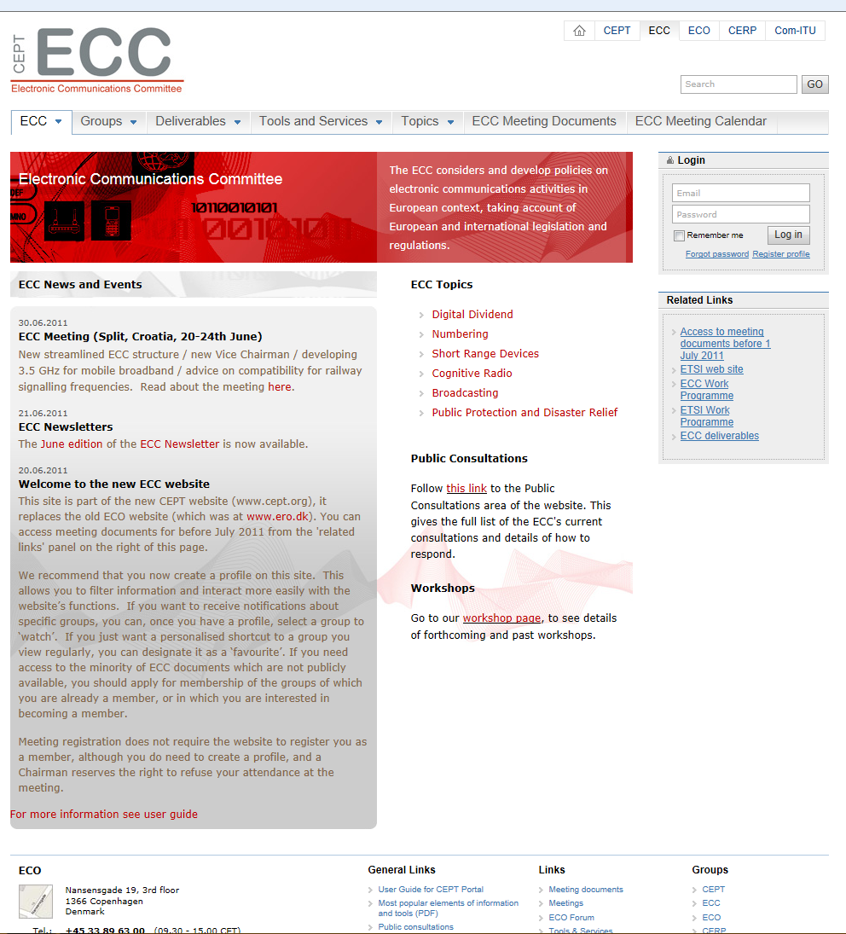
See also User Guide for the CEPT Portal
available on the ECC website ...
Contact the ECO:
ECO
Nansensgade 19,3.
Copenhagen
Denmark
Tel: +45 33 89 63 00
E-mail: eco@eco.cept.org
Contact ECO .......

