Slide 1


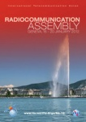
ITU Preparations for
WRC-12 and RA-12
1 November 2011
Fabio Leite
Deputy-Director
ITU Radiocommunication Bureau

Slide 2



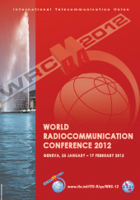



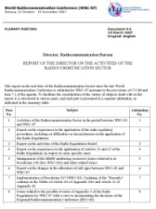


Overview of the preparations
Agenda: draft in WRC Res & final in Council Res
Informal Group
(Structure & Chairmanship)
Proposals
Proposals
Coordinated
common proposals
Member States
RA
WRC
Final Acts
CPM Report
Conference
Secretariat
(BR & GS)
Radio
Regulations
(CS89)
Director’s
Report
Regional preparation
Resolution 72 (Rev.WRC‑07)

Slide 3
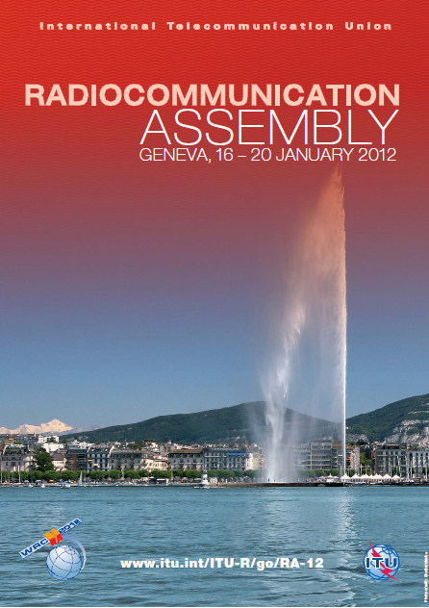
PREPARATION FOR RA-12
Web page at: www.itu.int/ITU-R/go/ra-12
CS No. 91: Provide necessary technical bases for WRC-12 and respond to WRC requests (CV135)
CV No. 136: Report to WRC-12 on progress in matters that may be included on agenda of future WRCs
Election of Ch. & V-Ch. for SGs, (CV242), incl. RAG, CPM and SC
See also §§ 1 & 1.6 of Res. ITU-R 1-5
Geneva, 16 – 20 January 2012, invitations:
ITU SG Circular Letter No. 24, DM-11/1002 and DM-11/1003
of 16 May 2011, at: www.itu.int/oth/R0C05000007 & www.itu.int/oth/R0C05000008.
BR CACE/543 of 22 June 2011, at: www.itu.int/md/R00-CACE-CIR-0543
BR CACE/547 of 22 August 2011 on Appointment of Chairmen and Vice-Chairmen of
ITU-R Study Groups, SC, CPM and RAG, at: www.itu.int/md/R00-CACE-CIR-0547/en
3
Notes:
3

Slide 4

PREPARATION FOR RA-12
Web page at: www.itu.int/ITU-R/go/wrc-12
CS No. 89: A world radiocommunication conference may partially or, in exceptional cases, completely, revise the Radio Regulations and may deal with any question of a worldwide character within its competence and related to its agenda; its other duties are specified in the Convention. (i.e. CV Article 7)
Agenda in Council Resolution 1291(MOD)
Geneva, 23 Jan. – 17 Feb. 2012, invitations:
SG Circular Letter No.11 and DM-11/1000 of 10 March 2011,
at: www.itu.int/md/S11-SG-CIR-0011 & www.itu.int/md/S11-DM-CIR-01000
BR CA/196 of 6 April 2011, at: www.itu.int/md/R00-CA-CIR-0196
Credentials, see SG Circular Letter No.19 of 20 April 2011
at: www.itu.int/md/S11-SG-CIR-0019
4
Notes:
4

Slide 5
Informal Group on WRC-12 Preparation
Next meeting in October or November 2011
(see: http://www.itu.int/ITU-R/go/wrc-12&related-activities=1)
Proposed WRC-12 structure, agreed at 4th meeting, 9 Jun’11
COM 1 Steering | COM 4 | COM 5 | COM 6
COM 2 Credentials | WG 4A (radiolocation issues): §§ 1.14, 1.15, 1.21, 3*, 5* | WG 5A (science issues): §§ 1.6, 1.11, 1.12, 1.16, 1.24, 8.1.1 (Issue C), 3*, 5* | WG 6A (general issues): §§ 1.2, 1.19, 1.22, 3*, 5*, 8.1(8.1.1 Issue A and other parts)
COM 3 Budget | WG 4B (aeronautical issues): §§ 1.3, 1.4, 1.7**, 3*, 5* | WG 5B (satellite issues): §§ 1.13, 1.18, 1.25**, 7, 8.1.1 (Issue B), 8.1.2 (satellite issues), 8.1.3, 3*, 5* | WG 6B (update regulations): §§ 1.1, 2, 3*, 4, 5*, 6, 8.1.2 (non-satellite issues)
COM 7 Editorial | WG 4C (maritime and amateur issues): §§ 1.9, 1.10, 1.23, 3*, 5* | WG 5C (fixed, mobile and broadcasting issues): §§ 1.5, 1.8, 1.17, 1.20, 3*, 5* | WG 6C (future work program): § 8.2
* relevant parts.
** meeting sessions of WG 4B and WG 5B and their respective SWGs
dealing with §1.7 and §1.25 shall not be carried in parallel.
5
Notes:
5

Slide 6
WRC Regional Preparation
Regional group meetings:
APG2012-4, 13 – 18 December 2010, Hong Kong, China
APG2012-5, 29 Aug. – 3 Sep. 2011, Busan, Korea (Rep. of)
Asia Pacific Telecommunity
14th ASMG, 28 Nov. – 2 Dec. 2010, Beirut, Lebanon
15th ASMG, 1-5 October 2011, Sharm Alsheek, Egypt
2nd meeting, 11-14 July 2011, Algiers, Algeria
3rd meeting, 9 November 2011, Geneva, Switzerland
African Telecommunications Union
CPG12-7, 27 June – 1 July 2011, Oxford, United Kingdom
CPG12-8, 1 – 4 November 2011, Romania
European Conference of Postal and Telecommunications Administrations
XVII PCC.II, 17 – 20 May 2011, Dominican Republic
XVIII PCC.II, 28 Nov. - 2 Dec. 2011, San Juan, Puerto Rico
Inter-American Telecommunication Commission
WG-7: 11 – 15 April 2011, Tashkent, Uzbekistan
COMs: 26 – 28 April 2011, Astana, Kazakhstan
WG-8 / COMs: 5 – 7 / 8 – 9 September 2011
Regional Commonwealth in the field of Communications
6
Notes:
6

Slide 7

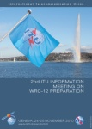
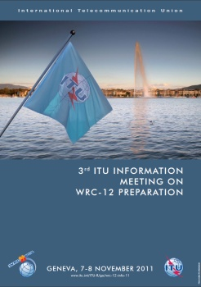
ITU Information Meetings
Web page at: http://www.itu.int/ITU-R/go/wrc-12-info
Organized in collaboration with ATU, 14 – 16 September 2009
Presentation of the organization, preliminary views,
priorities and positions of the 6 regional groups
Presentation and review of the ITU-R preparatory
studies by some Chairmen of the responsible groups
1st
2nd
24 – 25 November 2010, ITU Headquarters, Geneva
Presentation of the Draft CPM Report to WRC-12
Presentation and review of the regional groups’ draft
preliminary views, positions and common proposals
ITU Headquarters, Geneva
Up-to-date information on WRC-12 & RA-12 preparations
Brief presentation of CPM & BR Dir. Reports to WRC-12
Provide participants with the opportunity to
exchange views and better understand the Regional
Groups’ draft common proposals & positions
3rd
7
Notes:
7

Slide 8
Programme
3rd ITU Information meeting
Web page at: http://www.itu.int/ITU-R/go/wrc-12-info-11
(see CA/197 at: http://www.itu.int/md/R00-CA-CIR-0197)
Monday 07/11/11
09:30 | Opening by the Chairman, Mr. Albert Nalbandian
 | Status of ITU preparation for WRC-12 and RA-12
 | BR Director's Report to WRC-12
10:30 | Coffee break
10:45 | Session 1 - Review of the WRC-12 agenda items related to the aeronautical issues (agenda items 1.3, 1.4, 1.7)*
 | Presentation by Mr. John Mettrop
 | Panelists: Representatives of APT, ASMG, ATU, CEPT, CITEL, RCC, BR
12:00 | Lunch break
14:00 | Session 2 - Review of the WRC-12 agenda items related to the radiolocation, maritime and amateur issues (agenda items 1.9, 1.10, 1.14, 1.15, 1.21, 1.23)*
 | Presentation by Mr. Nikolay Varlamov
 | Panelists: Representatives of APT, ASMG, ATU, CEPT, CITEL, RCC, BR
15:30 | Coffee break
15:45 | Session 3 - Review of the WRC-12 agenda items related to the fixed, mobile and broadcasting issues (agenda items 1.5, 1.8, 1.17, 1.20)*
 | Presentation by Mr. Naser Al-Rashedi
 | Panelists: Representatives of APT, ASMG, ATU, CEPT, CITEL, RCC, BR
Tuesday 08/11/11
09:00 | Session 4 - Review of the WRC-12 agenda items related to the satellite issues (agenda items 1.13, 1.18, 1.25, 7)*
 | Presentation by Mr. Alexandre Vallet
 | Panelists: Representatives of APT, ASMG, ATU, CEPT, CITEL, RCC, BR
10:30 | Coffee break
10:45 | Session 5 - Review of the WRC-12 agenda items related to the science issues (agenda items 1.6, 1.11, 1.12, 1.16, 1.24)*
 | Presentation by Mr. John E. Zuzek
 | Panelists: Representatives of APT, ASMG, ATU, CEPT, CITEL, RCC, BR
12:00 | Lunch break
14:00 | Session 6 - Review of the WRC-12 agenda items related to the general and other issues (agenda items 1.2, 1.19, 1.22, 1.1, 2, 4, 8.2)*
 | Presentation by Mr. Aboubakar Zourmba
 | Panelists: Representatives of APT, ASMG, ATU, CEPT, CITEL, RCC, BR
15:30 | Coffee break
15:45 | Conclusion and closing session
 | Chairman
 | Panelists
 | * The order of consideration of the WRC-12 agenda items is indicative at this stage and may be subsequently modified as deemed appropriate.
Exchange of views and explanations to better understand the preliminary positions on WRC-12 agenda items
8
Notes:
8

Slide 9
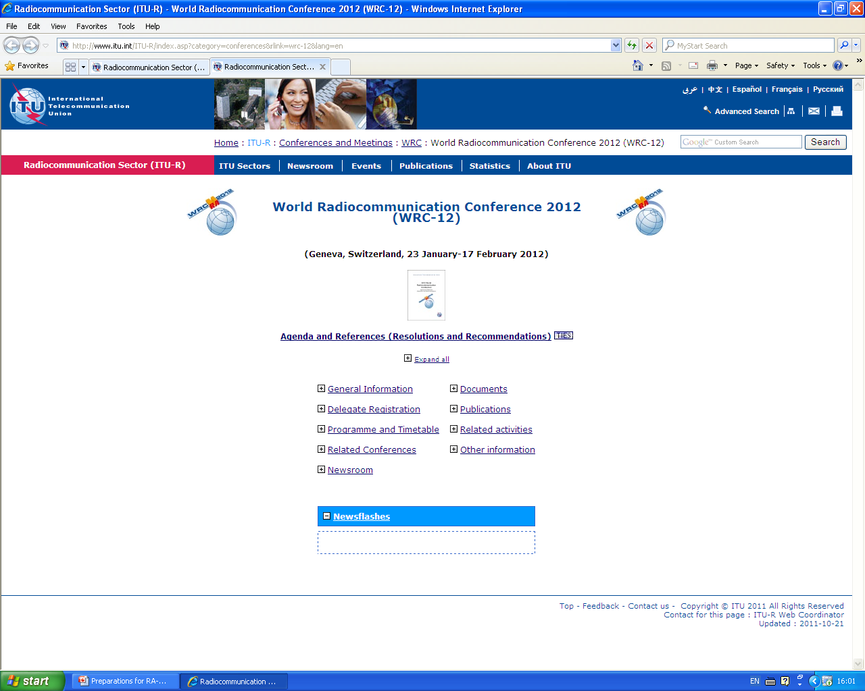

Slide 10
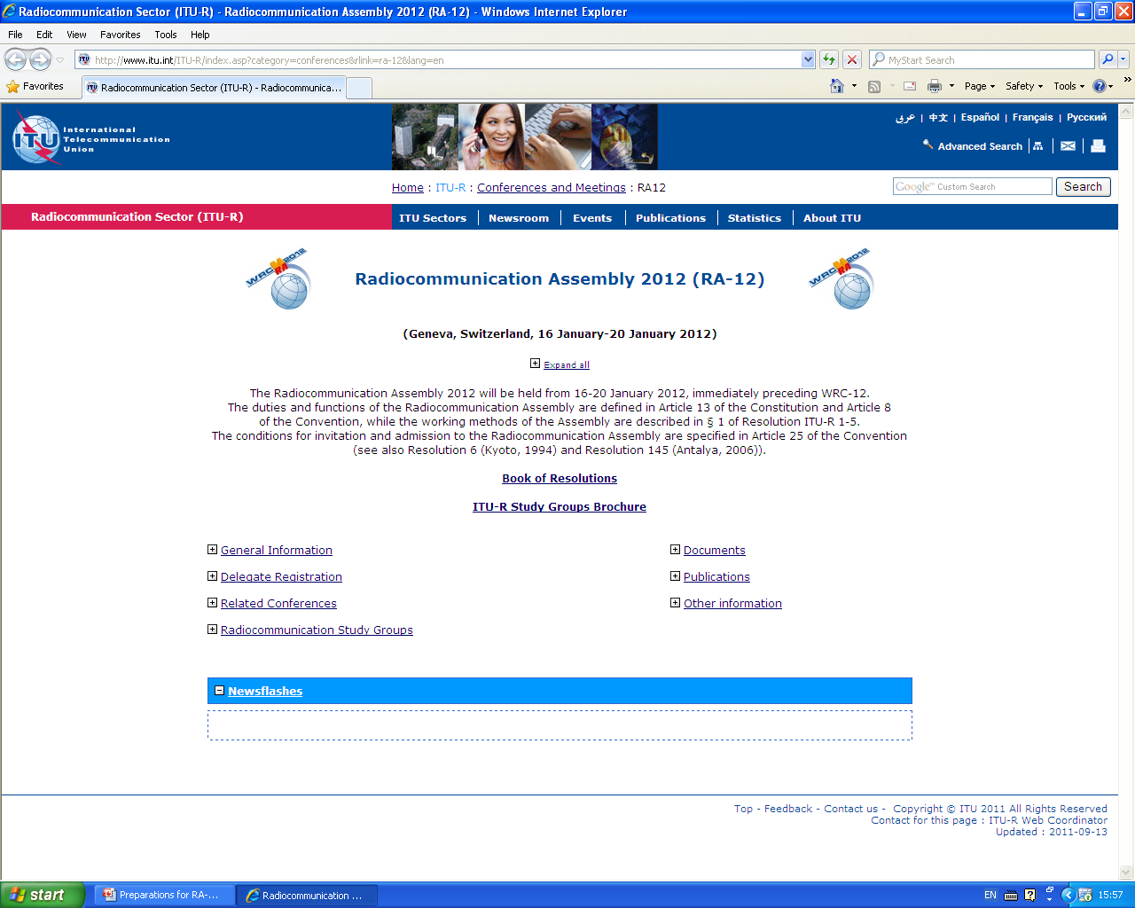

Slide 11
IT tools for delegates
Document Proposals Management System
Document Synchronization applications
Share Folders (through Share Point Sites)
Audio Webcast
Smartphone application

