Slide 1
ECO Frequency Information System (EFIS)
Information for ECC PT1, April 2012
Corrigendum 21 March

Slide 2
Overview and general info
41 countries - including all EU member states – are represented in EFIS
  The ITU-R Region 1 and the European Common Allocation (ECA) table are also available (ECA database now merged into EFIS)
EFIS contains the following data types:
  Allocations
  Applications
  Radio interfaces
  Documents
  Right of use info
All data types are searchable, and types 1 – 3 are comparable for the national tables as well as the ECA and ITU tables

Slide 3
Allocations and Applications
  for most countries extracted directly from National Tables of Frequency Allocations
  usually updated once or twice a year, with updates reported to ECO and EFIS/MG
  Commission Decision 2007/344/EC stipulates that this information (applies also to radio interfaces and individual rights of use) shall be updated twice a year by Member States
  ECA and ITU tables in EFIS are maintained by the Office.
Radio Interface Specifications:
Normative requirements for information on National Radio Interface Specifications in Annex 1 of 2007/344/EC: Member States shall provide either by reference to the relevant standard or descriptive text and any comments as necessary the following parameters:
    1. channelling
    2. modulation/occupied bandwidth;
    3. direction/separation;
    4. transmit power/power density;
    5. channel access and occupation rules
    6. authorisation regime;
    7. additional essential requirements according to Article 3(3) of Directive 1999/5/EC
    8. frequency planning assumptions
All other information provided is voluntary and purely informative. Additional information in EFIS could be:
Positive restrictions, if a country allows more bandwidth or power or has less stringent medium access rules for spectrum sharing than defined for the European harmonised usage of a radio application in either an ECC or EC Decision
Differences in the application of the regulations, e.g. PPDR where EU/EFTA countries themselves decide whether radio equipment is under the scope of the R&TTE Directive or specific usage regulation.
Different tuning ranges mandated in various countries, e.g. for PMR or PMSE equipment

Slide 4
Right of Use information
All EU countries have included right-of-use information in the EFIS database
Amount and scope of this information still varies significantly across the administrations (see table)
Intention of Commission Decision 2007/344/EC with regard to right of use information was to focus on bands of major economic interest or significance. Normative requirements for the information on rights of use as defined in the EC Decision are as follows:
  Information on rights of use may be limited to frequency bands used for the provision of electronic communications services which are tradable in accordance with Article 9.3 of Directive 2002/21/EC or which are granted through competitive or comparative selection procedures pursuant to Directive 2002/20/EC.
  For relevant frequency bands Member States shall provide (acc to requirements of Dir. 95/46/EC and Dir. 2002/58/EC and Community and national rules on business confidentiality, the following information:
    1. identity of the radio frequency right holder
    2. expiry date of the right or, in the case where there is none, the expected duration
    3. geographic validity of the right by at least providing the information whether the right is local (i.e. one station), regional or nation-wide
    4. an indication of whether or not the right is tradable
All other information related to rights of use provided by the regulatory authority in EFIS is voluntary and purely informative. It should be noted that the contact provided in EFIS for the right of use information can also be a contact point from the administration.
Specific national legislation or jurisdiction may make it difficult for a country to provide in specific cases more detailed information on rights of use.

Slide 5
Recent software enhancements
Major update to v. 4 22-23 Dec 2011; current software version: EFIS 4.0.4 impl. 17 February 2012
New layout (to reflect ECO web style)
Enhanced term selection: two ways of selecting allocation and application terms
New document types, informative/non-regulatory, linked to ECA:
  ‘ECC-ECO’, ‘ETSI SRdoc’, ‘Draft ETSI SRdoc’, ‘EU’ documents
  Also, document type ‘National’ spectrum evolution, uploaded by national administrations
Other new document types:
  ‘EC Decisions’, ‘RIS Models’ (both linked to ECA)
  RIS models and R&TTE subclasses use same format – RIS models are available now; R&TTE subclasses will be available soon
  ‘Licensing info’: for national administrations to upload general info on licence-exempt rulings or general licensing documents (e.g. PMR/PAMR)
  All documents can be selected/searched for by frequency band and/or application
Grouped document display (each doc appearing only once, related info displayed next to doc)
European Common allocations for the frequency range of any document linked to ECA are displayable via click on icon

Slide 6
Recent software enhancements (II)
New section/page in EFIS: ‘Spectrum inventory information’ (ECC/ECO initiative; outside the scope of EC Decision on EFIS)
  With non-regulatory information
  Explanation of new non-regulatory document types
  ETSI SRdoc information, requested by ETSI ERM chair, to be made available in ECA/EFIS
  Especially the sections ECC-ECO and ETSI are now fully in use and contain significant amount of information on the actual spectrum use, sharing and efficient use of spectrum
  ECO uploads SRdoc information when the documents become available to ECC fora
  (either NWI is adopted, stage 1 or stage 2 draft SRdoc was sent to ECC group or notice that SRDoc was published as TR by ETSI).
  ECC-ECO section contains all spectrum relevant ECC/ERC Reports , CEPT Reports, ECO Reports but also questionnaire results etc.
Improved export of data from EFIS - all data can be exported in table format (csv format)
ECC/ERC Decision/Recommendations shown in EFIS include link to European map showing implementation of the Decs/Recs
Tooltips (currently for main menu items; will be expanded in the near future)

Slide 7
Software enhancements – planned/under consideration
‘Third party’ documents (proposed by ECC/ECO partner, uploaded by ECO)
Investigation of the need to add “protected areas” in EFIS in connection with non-regulatory information: support confidential/restricted data in information collection processes (e.g. spectrum inventories)
Section for more detailed spectrum information: subset of the full EFIS application list will be used in line with requirements to collect data for purposes related to the spectrum inventory project
Establishment of spectrum inventory contact list

Slide 8
Development of new ECC Report in ECC WGFM (EFIS/MG)
Guidance, incl. structuring of the information for uploading national non-regulatory information on the evolution of spectrum use will be given in the new ECC Report which is under development in the EFIS/MG
The draft report was further developed by the EFIS/MG during its meeting 8-9 March; a web meeting has been scheduled to finalise the discussion, and it is planned to present the final draft to the WGFM at its April meeting
The bands (incl. application and requested format for the information) of interest for which National non-regulatory information is requested by ECC WGFM can be updated on demand
  The software, however, is more flexible and allows the collection of information also on other bands if available

Slide 9
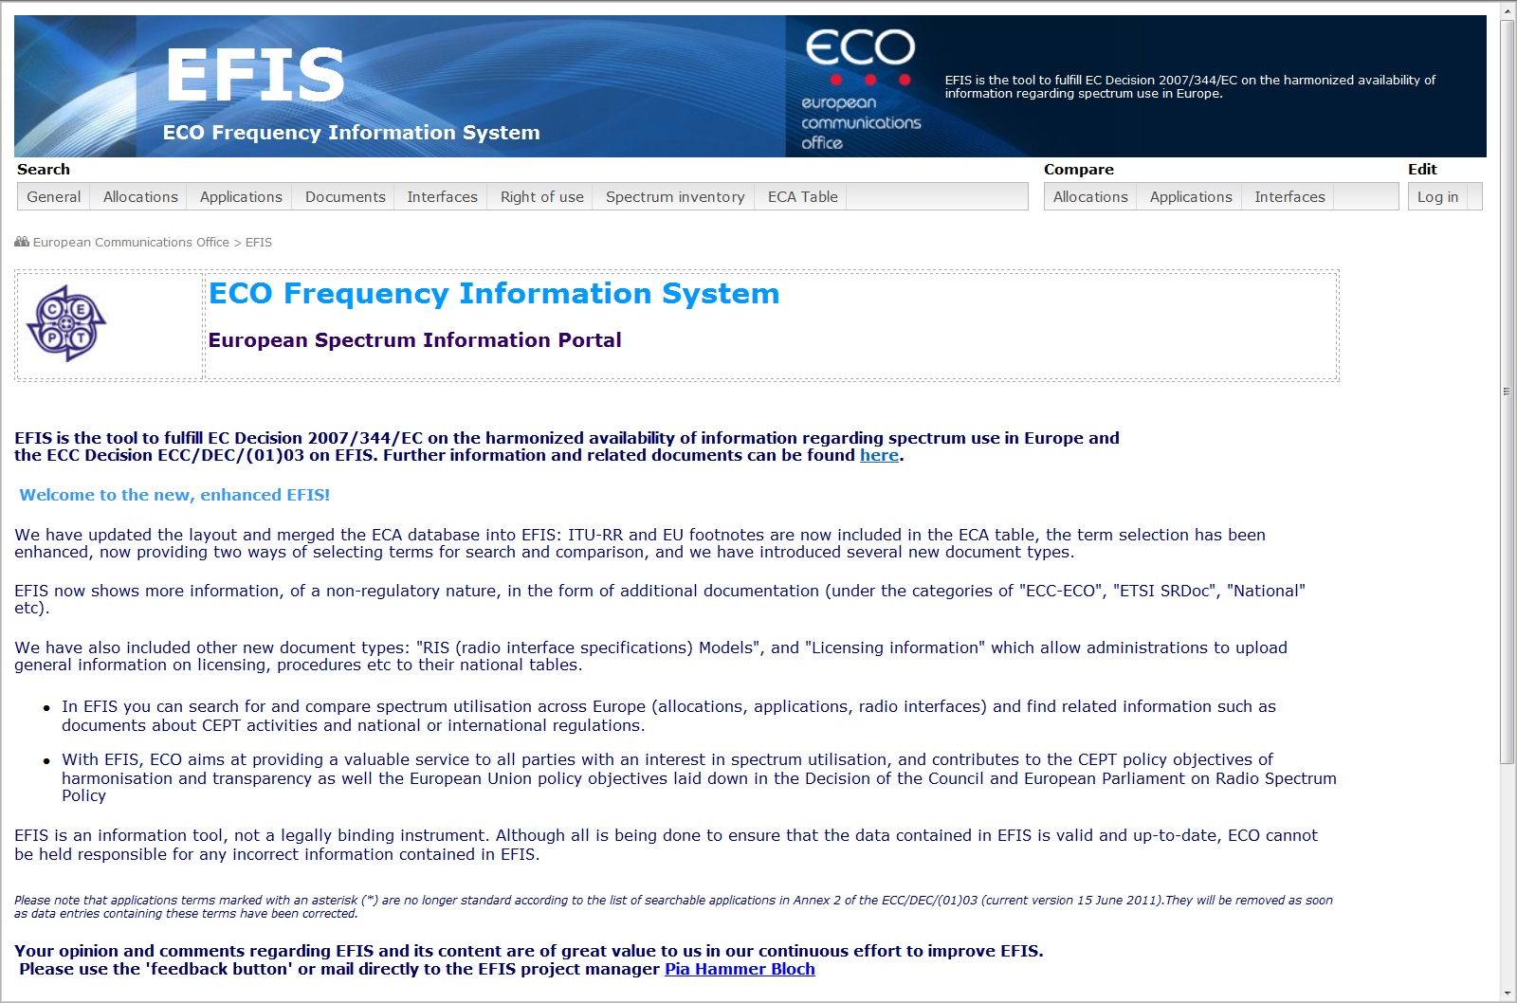
EFIS frontpage (www.efis.dk)

Slide 10
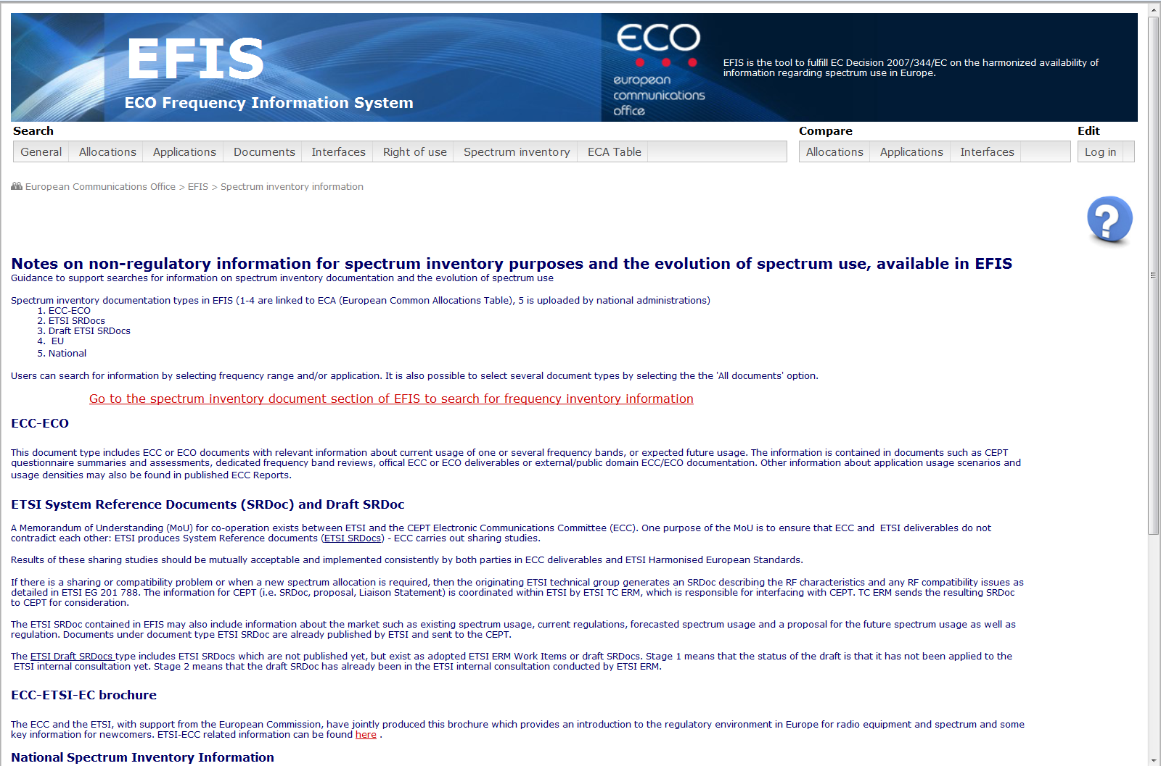
More detailed spectrum information page

Slide 11
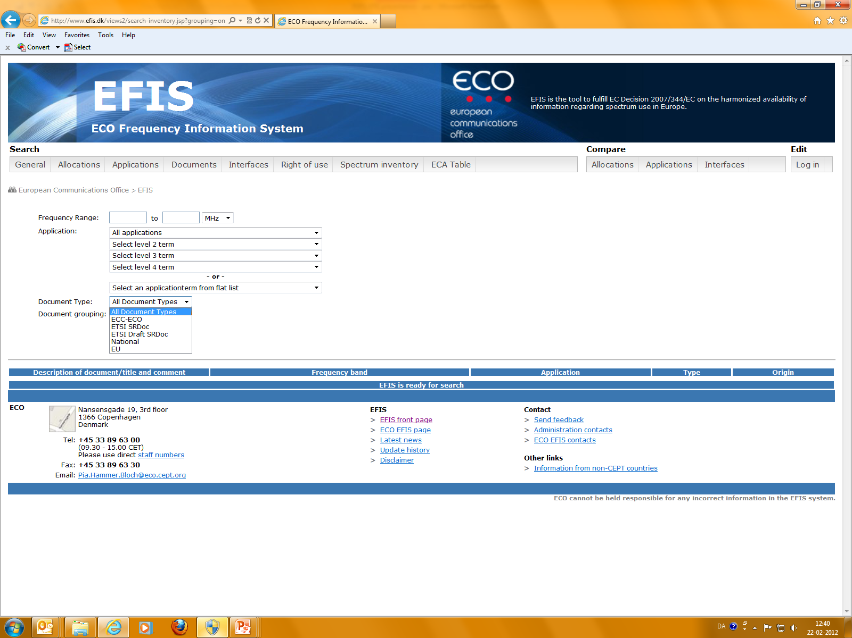
Non-regulatory document types

Slide 12
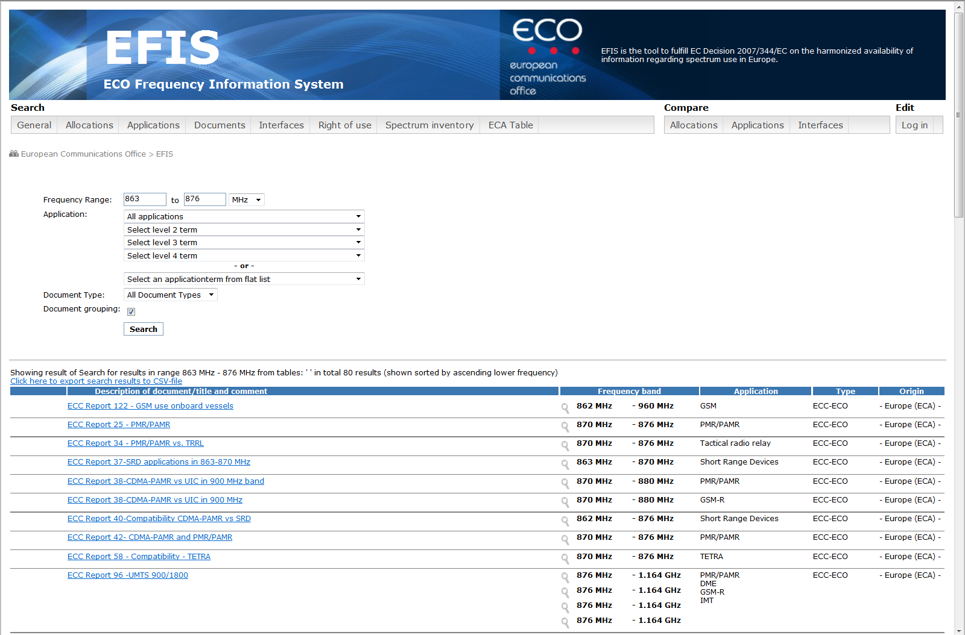
Example of document search for specific frequency band

Slide 13
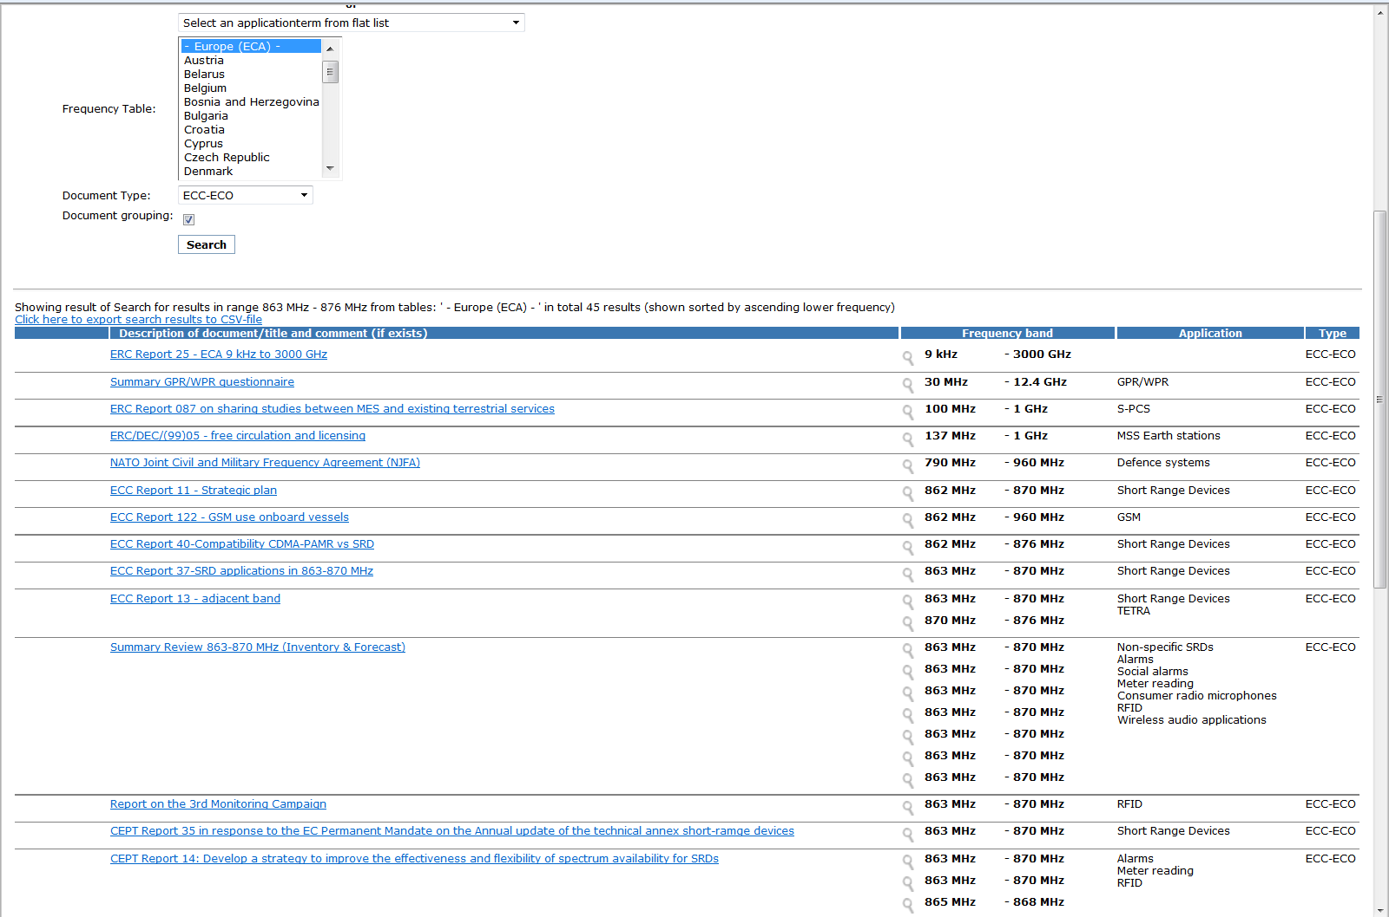
Grouped document display

Slide 14
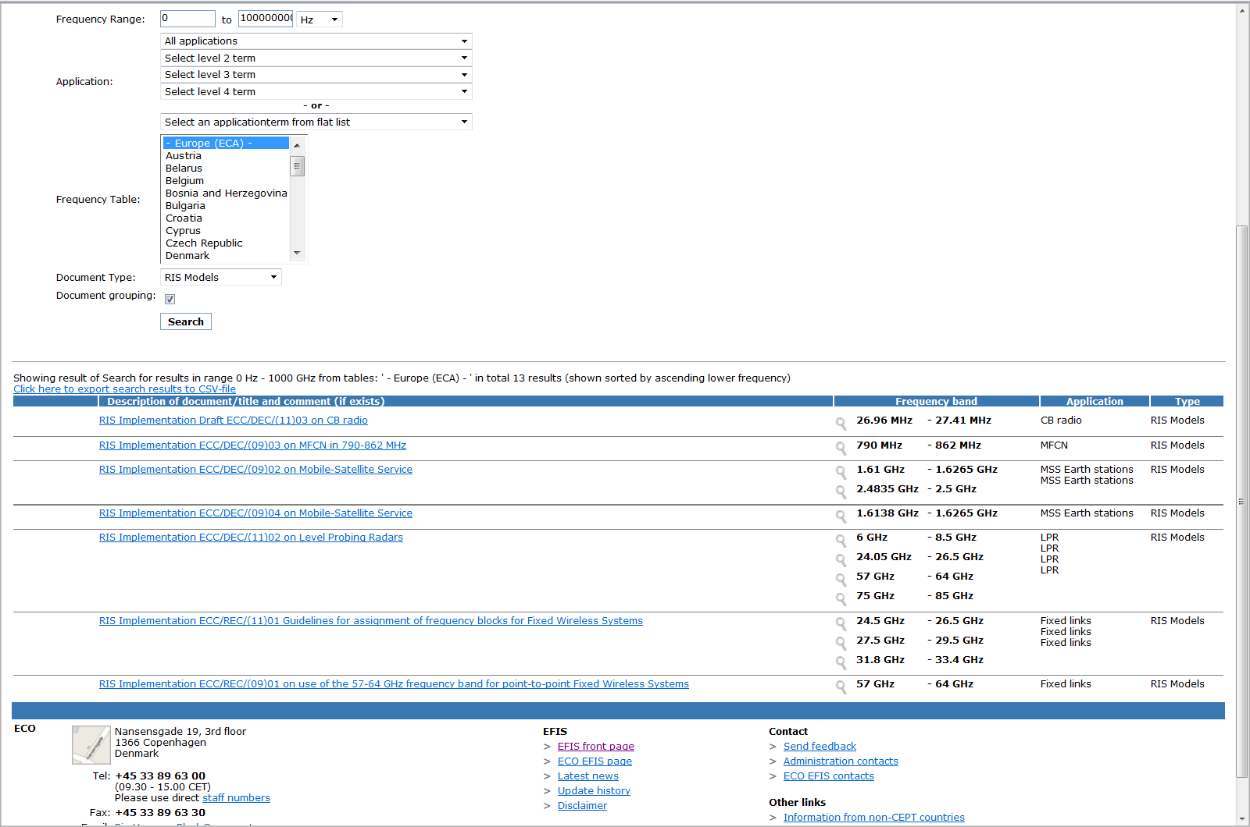
‘RIS Model’ document display

Slide 15
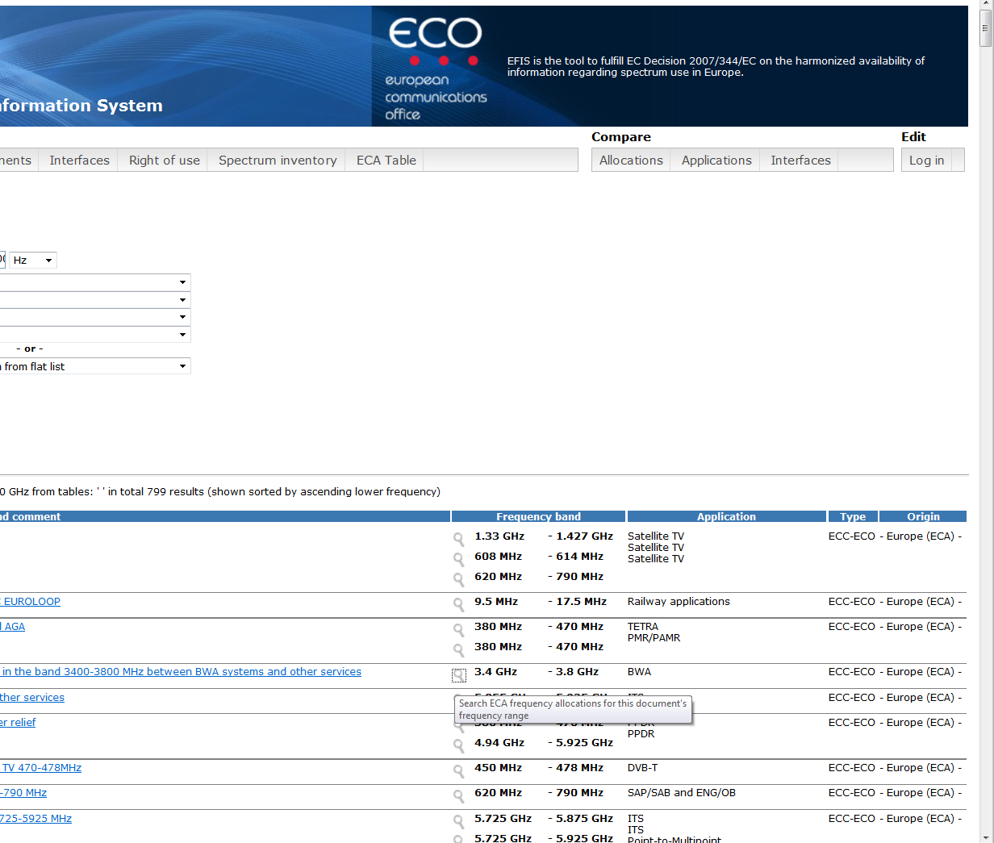
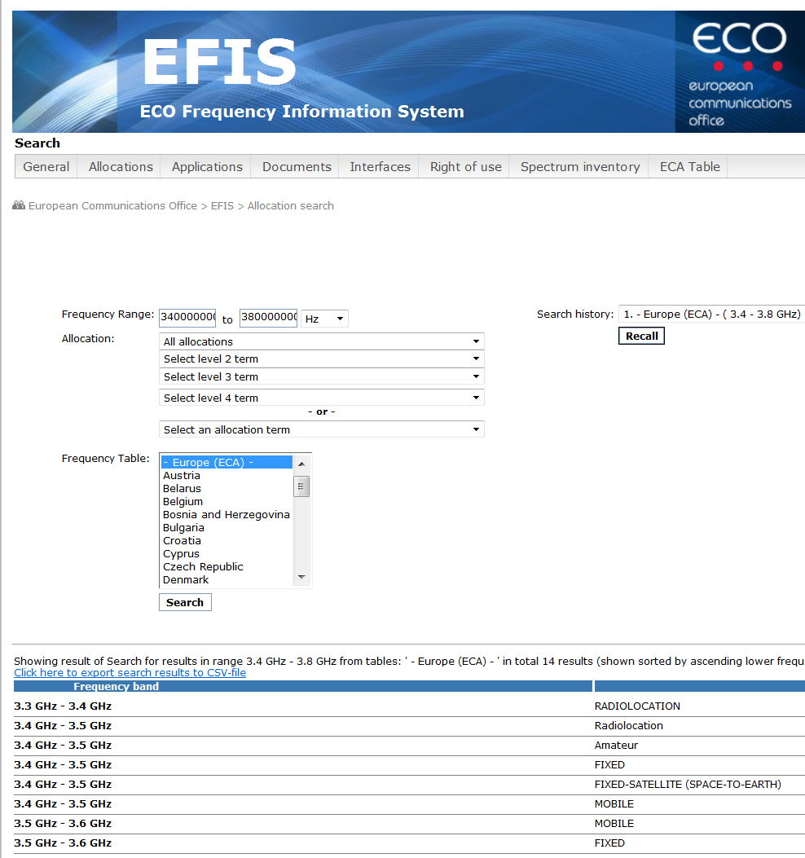
Display of European Common allocations for documents

Slide 16
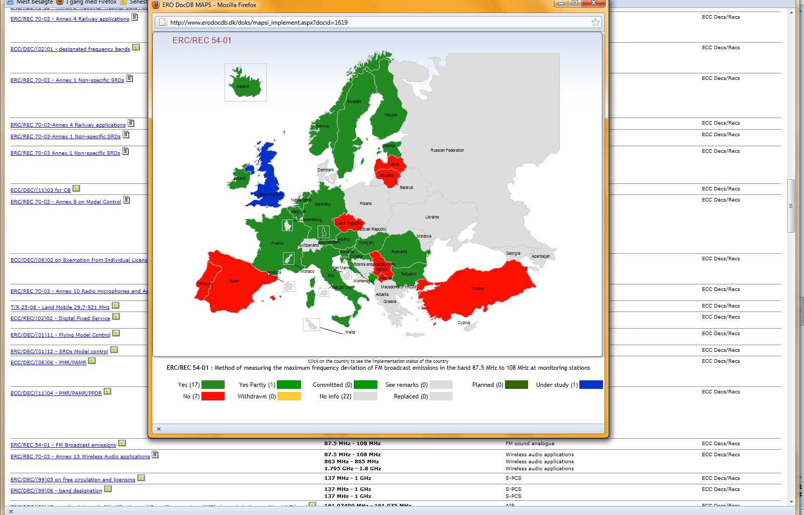
ECC Decs/Recs – implementation map

Slide 17
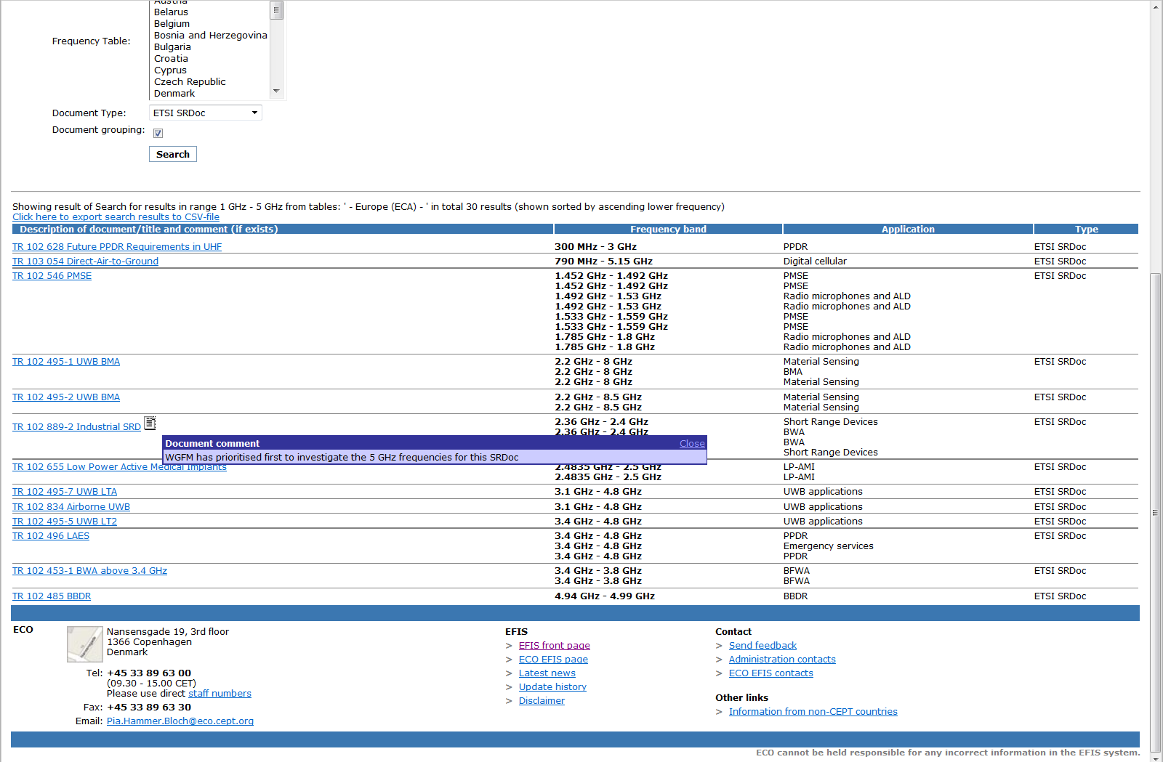
ETSI SRDocs in the detailed spectrum information section

Slide 18
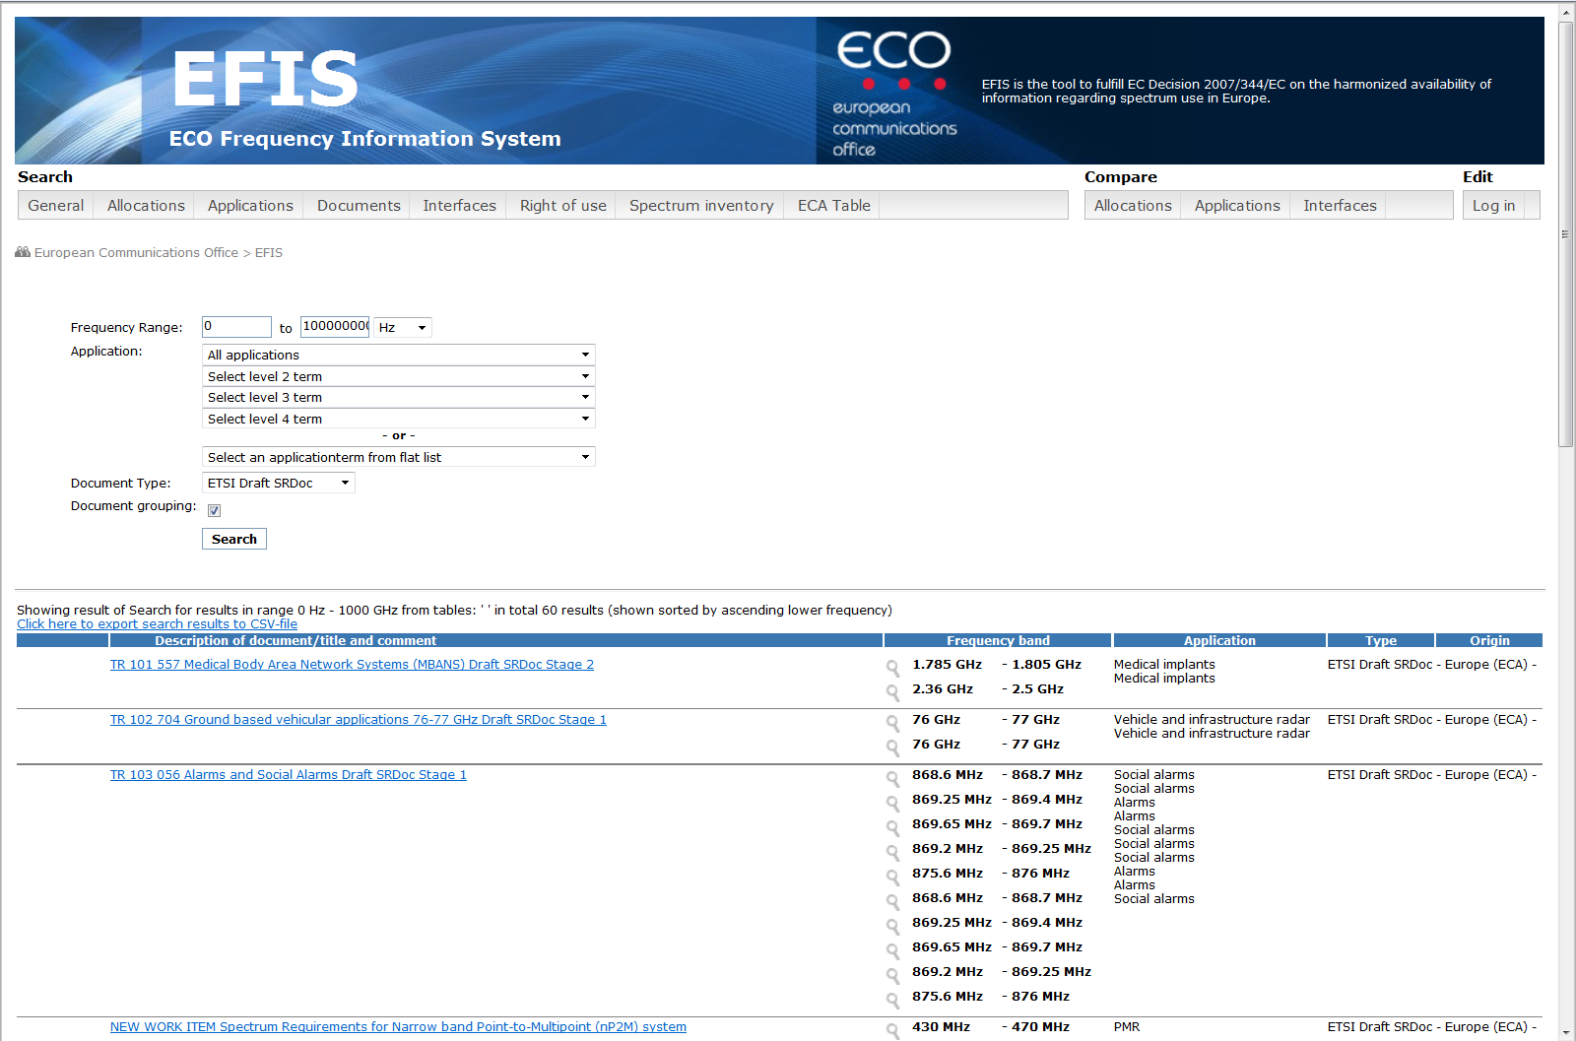
ETSI Draft SRDocs in detailed spectrum information section

Slide 19
Sources of information/relevant documents
www.efis.dk
EFIS website page
ECC/DEC/(01)03 on EFIS (current version June 2011)
  List of searchable allocations (Annex 1) is updated as required (after a WRC)
  List of searchable applications (Annex 2) is updated as required
Mandate to CEPT on the use of EFIS for publication and access to spectrum information (2005)
Commission Decision 2007/344/EC (16 May 2007) on harmonised availability of information regarding spectrum use within the Community
ECO!
ECO will answer questions, advise and help solve any problems administrations
might have, for example with regard to formatting of data and upload of
information to EFIS

Slide 20


EFIS CONTACTS in ECO
Pia Hammer Bloch
EFIS Project Manager
pia.hammer.bloch@eco.cept.org
Tel: +45 33 89 63 10
Thomas Weber
Spectrum Management
thomas.weber@eco.cept.org
Tel: +45 33 89 63 12
ECO
Nansensgade 19-3, 1366 Copenhagen, Denmark
Tel: +45 33 89 63 00
Fax: +45 33 89 63 30
eco@eco.cept.org

