Slide 1
Status report EFIS software
Doc EFISMG(12)12
29th EFIS/MG meeting, Copenhagen, 8-9 March 2012

Slide 2
Recent software enhancements
Major update (v. 4) Dec 2011; current software version: EFIS 4.0.4 impl. 17 February 2011
New layout (to reflect ECO web style)
Enhanced term selection: two ways of selecting allocation and application terms on all search pages
New document types, informative/non-regulatory, linked to ECA:
  ‘ECC-ECO’, ‘ETSI SRDoc’, ‘Draft ETSI SRDoc’, ‘EU’ documents
  Also, document type ‘National’ spectrum evolution, uploaded by national administrations
Other new document types:
  ‘EC Decisions’, ‘RIS Models’ (both linked to ECA)
  ‘Licensing info’: for national administrations to upload general info on licence-exempt rulings or general licensing documents (e.g. PMR/PAMR)
Grouped document display (each doc appearing only once, related info displayed next to doc)
European Common allocations for the frequency range of any document linked to ECA are displayable via click on icon

Slide 3
Recent software enhancements (II)
New section/page in EFIS: ‘Spectrum inventory information’
  With non-regulatory information
  Explanation of new non-regulatory document types
  ETSI SRDoc information, also requested by ETSI to be made available in ECA/EFIS)
  Especially the sections ECC-ECO and ETSI are now fully in use and contain significant amount of information on the actual spectrum use, sharing and efficient use of spectrum
Improved export of data from EFIS - all data can be exported in comma separated format
ECC/ERC Decision/Recommendations shown in EFIS include link to European map showing implementation of the Decs/Recs
Tooltips (main menu items)

Slide 4
Software enhancements – planned/under consideration
Third party documents (proposed by ECC/ECO partner, uploaded by ECO)
Investigation of the need to add “protected areas” in EFIS in connection with non-regulatory information: support confidential/restricted data in information collection processes (e.g. spectrum inventories)
Section for more detailed spectrum information: subset of the full EFIS application list is proposed to be used in line with requirements to collect data for purposes related to the spectrum inventory project
Two document type selection windows: for regulatory and non-regulatory doc types
Establishment of spectrum inventory contact list
Test system for administrations

Slide 5
Development of new ECC Report in ECC WGFM
Guidance, incl. structuring of the information for uploading national non-regulatory information on the evolution of spectrum use will be given in the new ECC Report which is under development in the EFIS/MG
The bands (incl. application and requested format for the information) of interest for which National non-regulatory information is requested by ECC WGFM can be updated on demand
  The software, however, is more flexible and allows the collection of information also on other bands if available

Slide 6
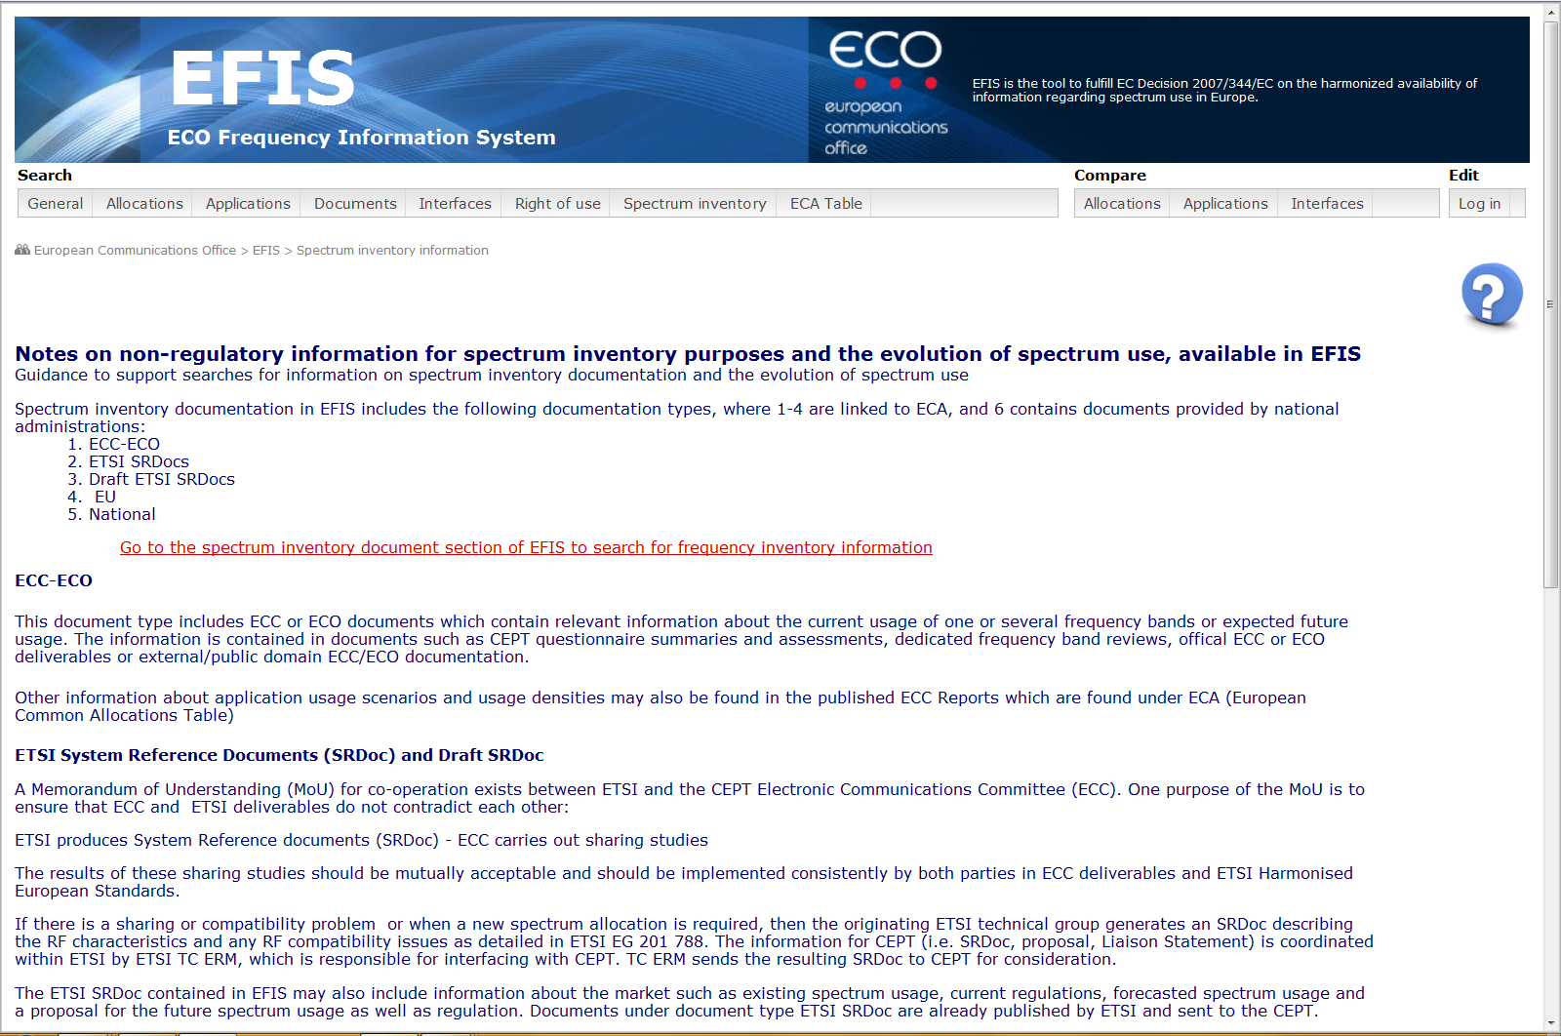
More detailed spectrum information page

Slide 7
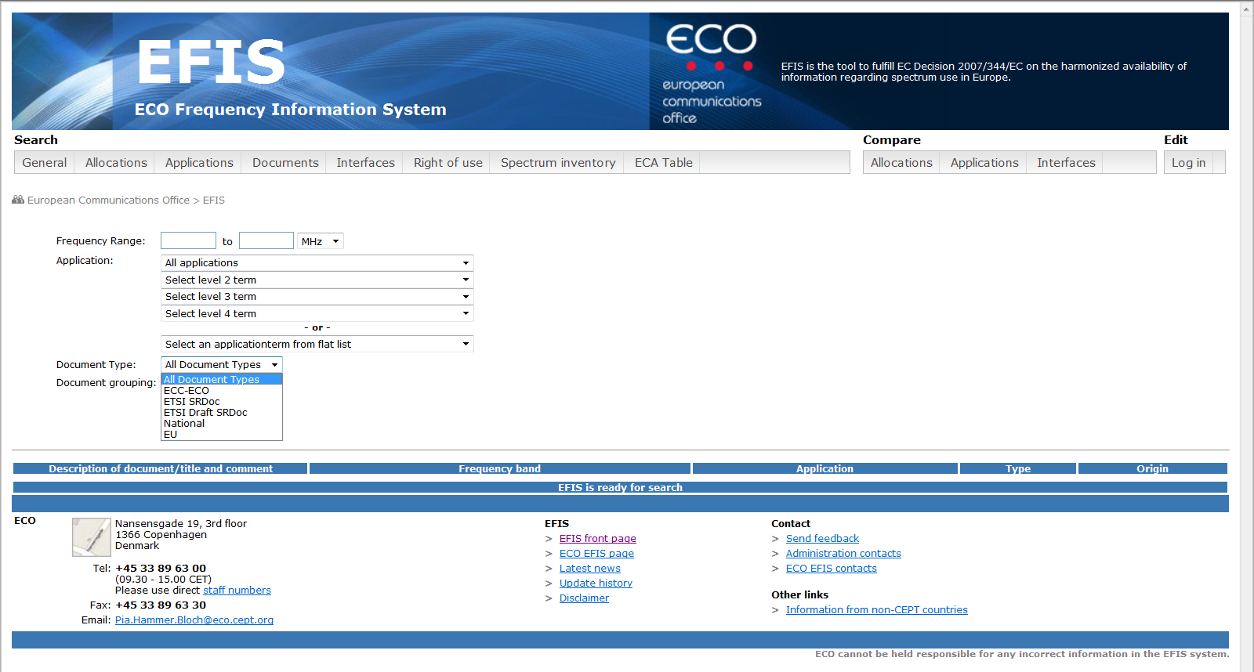
Non-regulatory document types

Slide 8
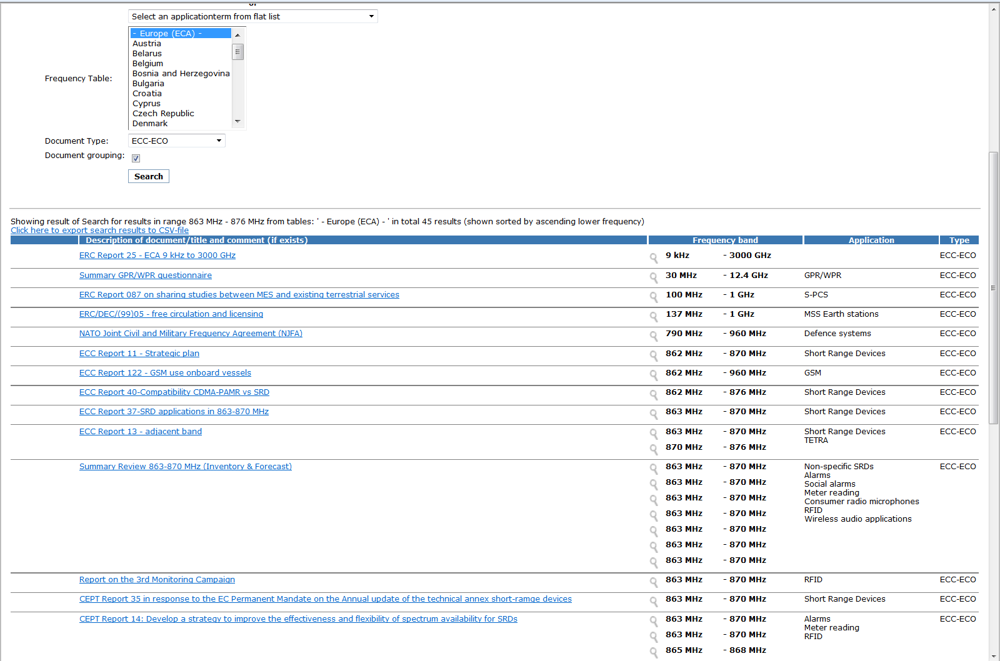
Grouped document display

Slide 9
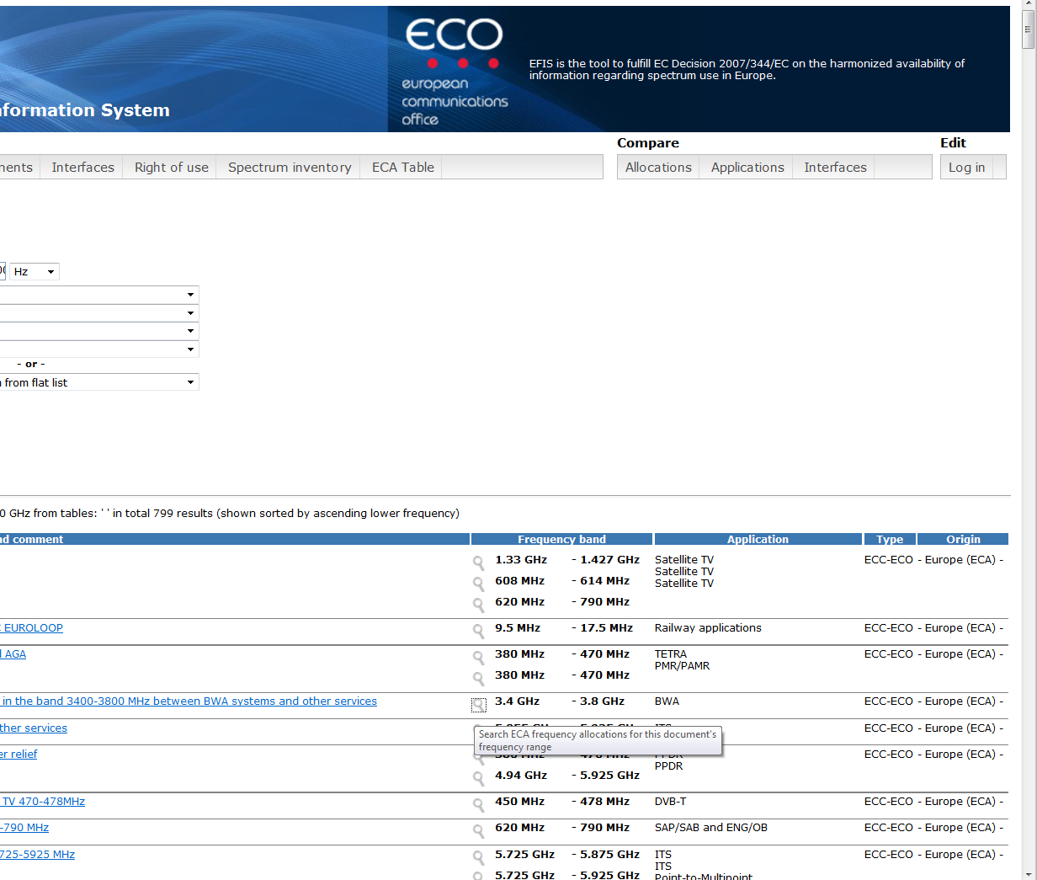
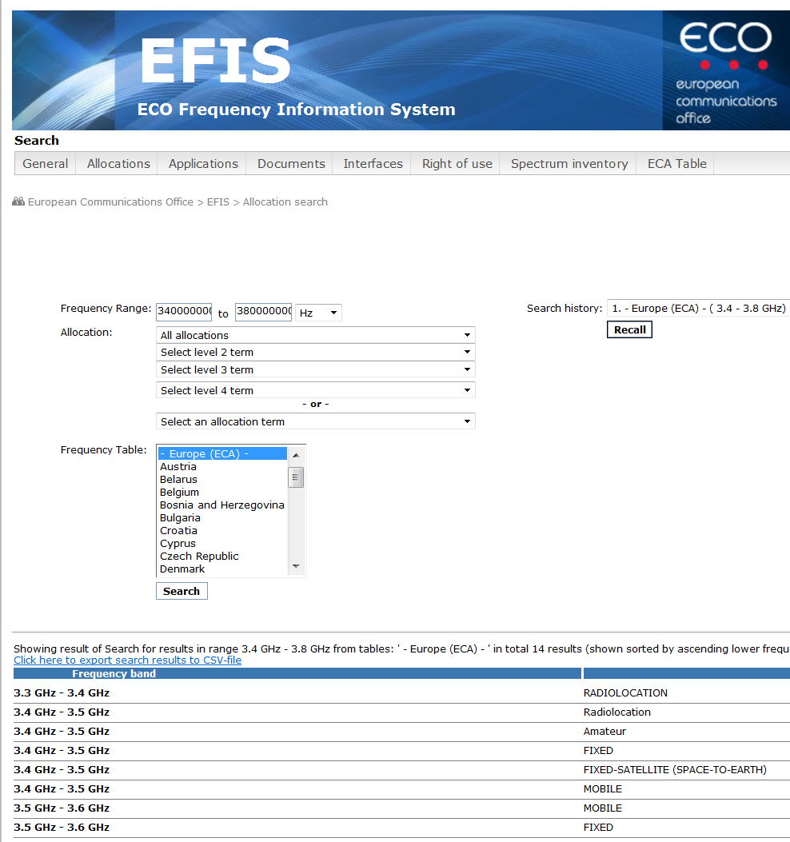
Display of European Common allocations for documents

Slide 10
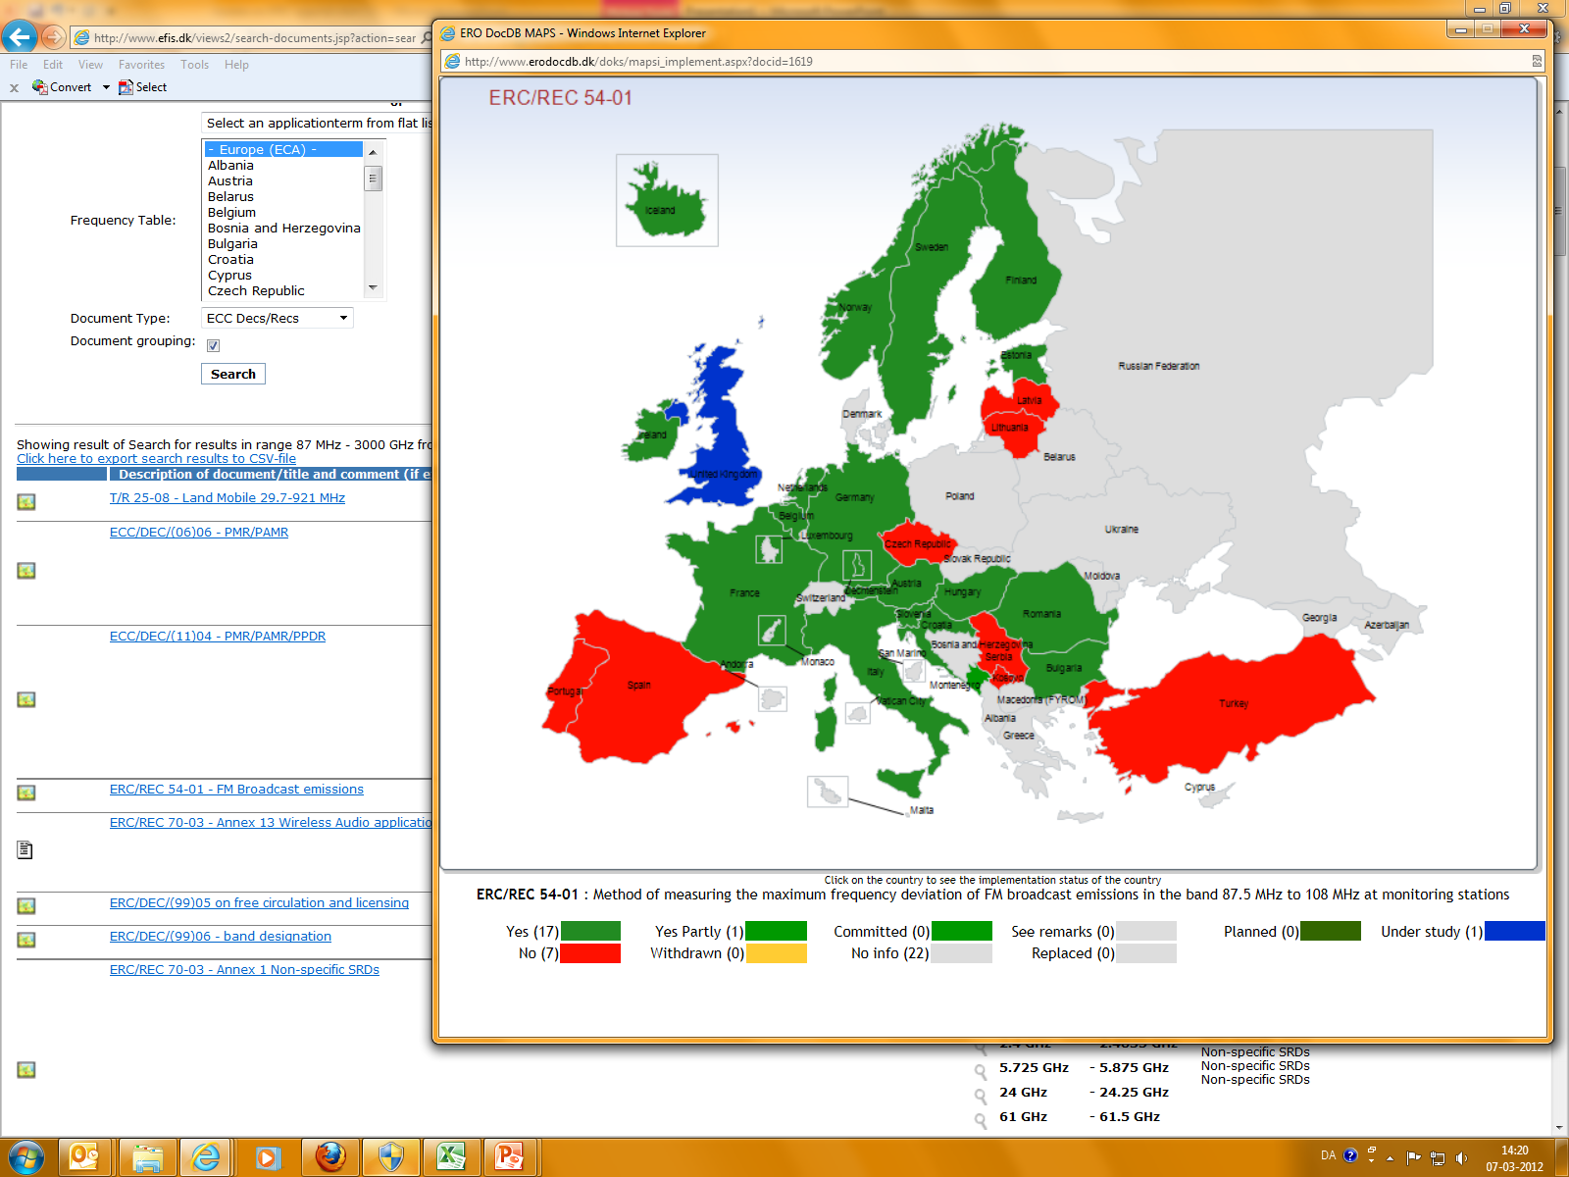
ECC Decs/Recs – implementation map

