Slide 1
HARMFUL INTERFERENCES FROM ITALY

Slide 2
Introduction
During the last few decades people living in Croatian costal area are having problems with harmful interferences caused by Italian FM or TV operators
HAKOM preforming measurements at frequencies which are assigned and used for BC in Croatia according to international agreements:
  Geneva 2006 agreement for DTV frequencies
  Geneva 1984 agreement for FM frequencies
Measurement results are analyzed in accordance to protection ratios described in Recommendation ITU-R BS.412-9 for FM frequency band, and in Recommendation ITU-R BT.1368-4 for DTV frequencies.
After that HAKOM sends Reports of harmful interferences to Italian administration, according to RR Article 15

Slide 3
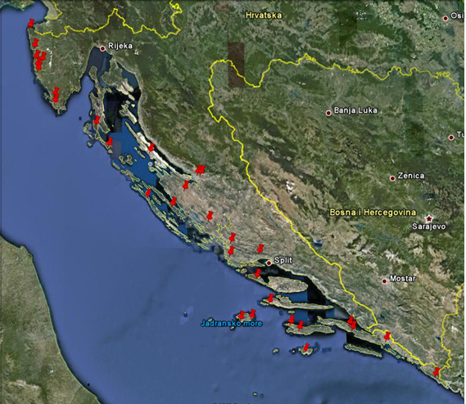
Measurement locations

Slide 4
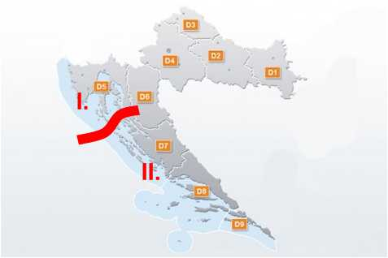
TV frequency band
Problem with harmful interferences in TV frequency band should be discussed in two parts:
Problems in Croatian areas that suffer harmful interferences from Italian fully digitalized regions
Problems in Croatian areas that suffer harmful interferences from Italian not yet fully digitalized regions

Slide 5
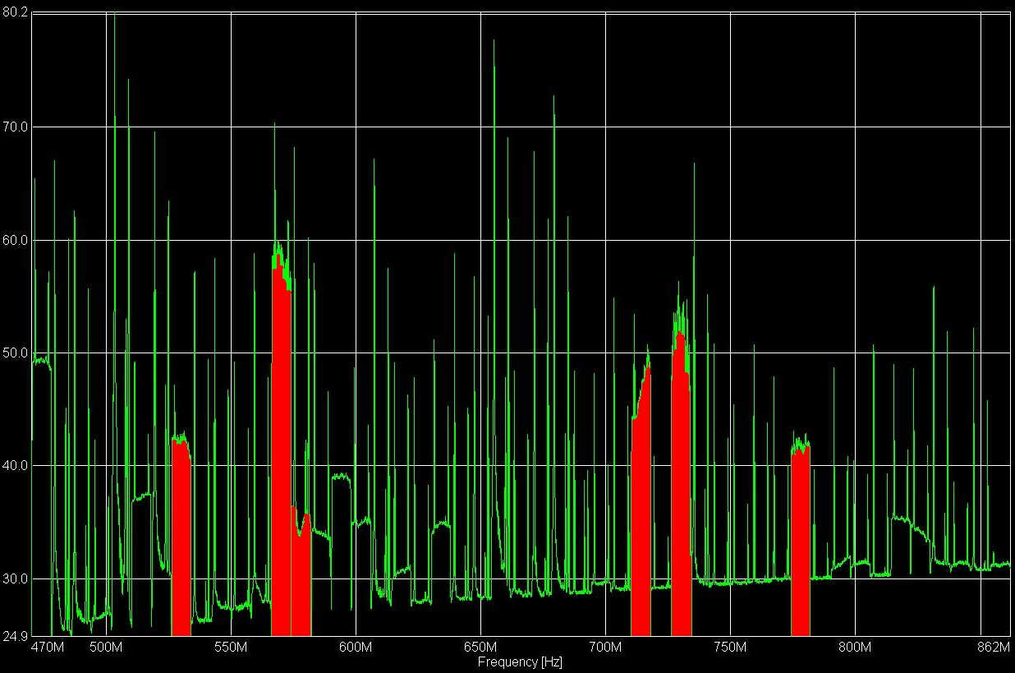
UHF spectrum – south of Croatia
Situation where Italian ASO is not completed
Measured with directional antenna on Pelješac, direction 190 degrees (Bari – Italy)
5

Slide 6
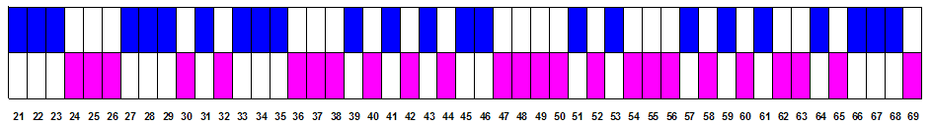
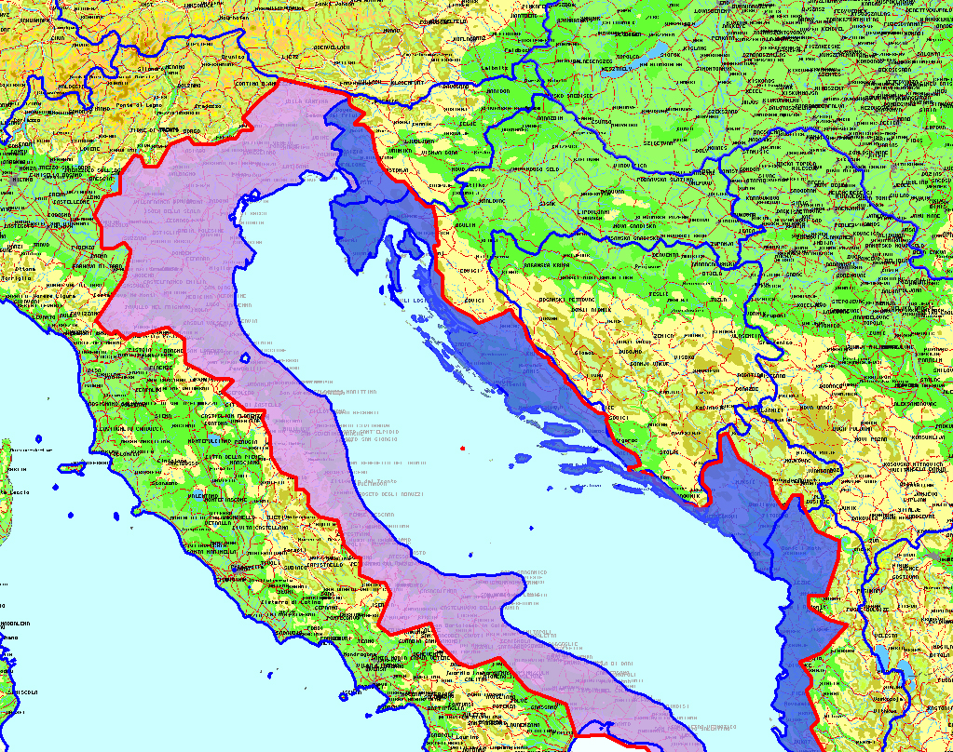
28th channel in Istria
GE06 plan: full compatibility in Adriatic region
Croatian MUX A in large part of Istria.
6

Slide 7
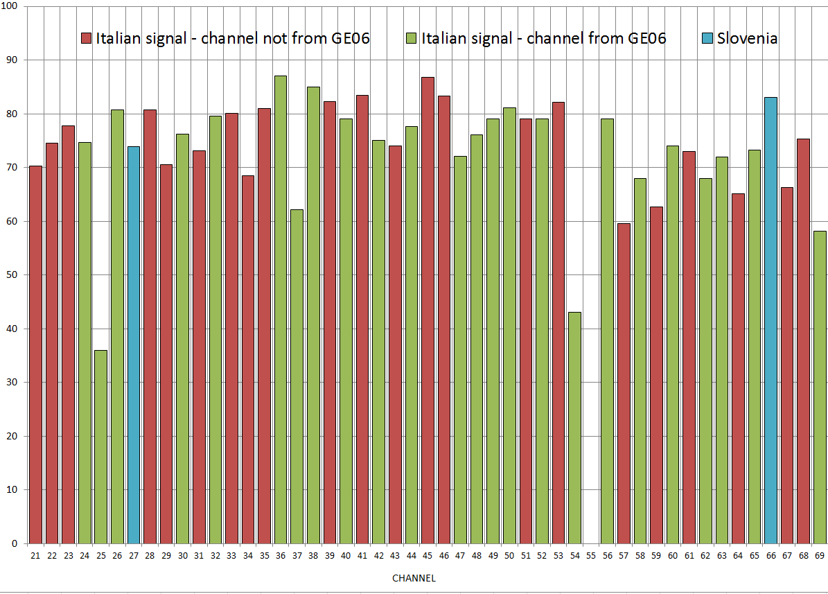
UHF spectrum – Istria
Italian ASO is completed
Measured on 29th September, 2011. in Istria
7

Slide 8
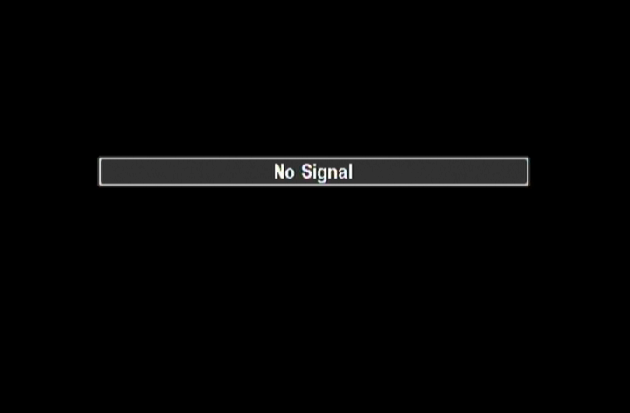
Impact on reception

Slide 9
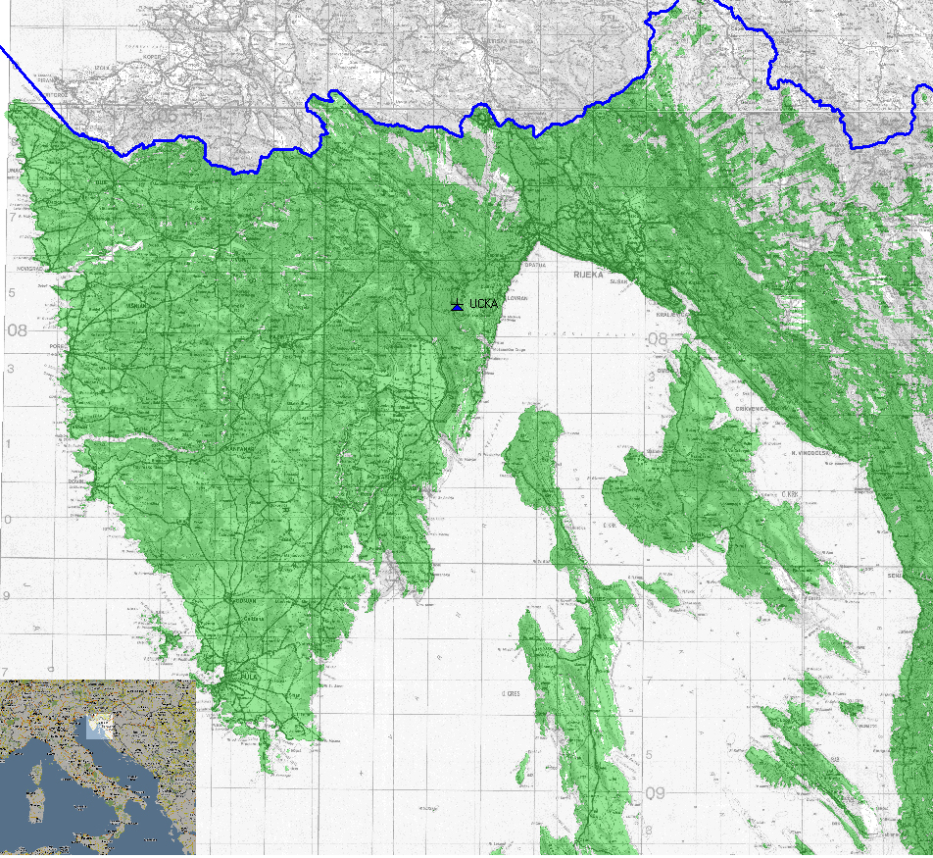
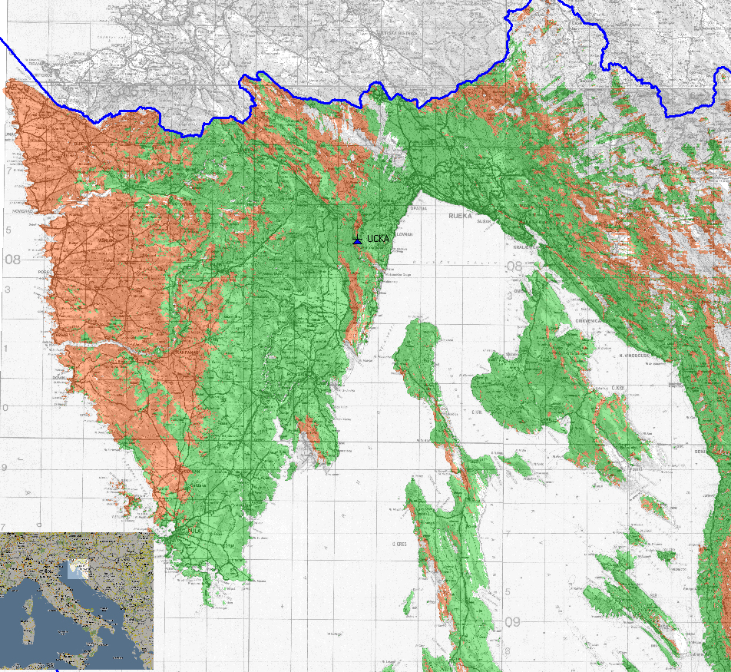
Coverage of Croatian MUX A in Istria (ch 28)
Situation on 28th channel before December 2010.
Situation on 28th channel after December 2010.
Red – area with strong influence of harmful interference from Italy, and without possibility to watch Croatian TV program on MUX A
Green – territory with good coverage of Croatian DVB-T signal according to international ITU recommendations, which is confirmed with more then 500 measurement
9

Slide 10
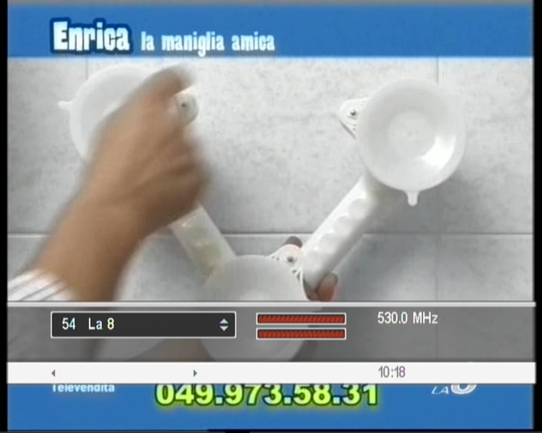
Italian TV service on 28th channel (MUX A) in Istria
Meanwhile on the same channel in Croatia…
10

Slide 11
Problems in FM frequency band
Situation also very critical
Almost a half of Croatian territory affected
On each frequency in Croatian FM frequency band, minimal one Italian FM radio station is being heared and measured, although it is not rare that on some locations even several Italian FM stations are measured on the same Croatian frequency
Example : Radio Pula at frequency 101,3MHz - GE84 (UCKA 84006147, MIFR 094006239)
According to Recommendation ITU-R BS.412-9* minimum usable field strength for stereophonic FM signal in rural areas is 54 dBµV/m, in urban areas 66 dBµV/m and in large cities 70 dBµV/m
Protection ratio for FM stereophonic signal and tropospheric interference at the same frequency is 37 dB
11

Slide 12
Measured interferences from ITA
82,4 dBµV/m
Radio Punto Zero
Permitted field level | 17 dBµV/m for rural areas | 29 dBµV/m for urban areas | 33 dBµV/m for large cities
Higher then permitted field level | 65,4 dBµV/m | 53,4 dBµV/m | 49,4 dBµV/m

Slide 13
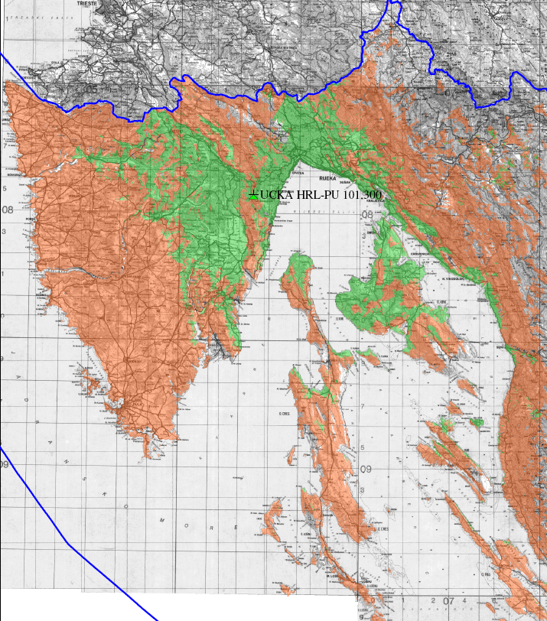
Coverage of Radio Pula
Coverage of Radio Pula
Red – area with harmful interferences from Italy (Radio Punto Zero), and without possibility to listen to program of Radio Pula
Green – territory with good coverage of Radio Pula according to international ITU recommendations
13
Notes:
Slika pokrivanja Radio Pule pod utjecajem smetnji

Slide 14
Interference reports sent to ITA administration
FM : 351 different report with 504 S10 appendix
DTV : 79 reports with 100 S10 appendix for GE06 channels on which we are working, and more 91 reports for GE06 channels on which we are not working yet
14

Slide 15
Consequences of harmful interferences from Italy
People who can’t watch it’s own TV or radio program
TV and FM providers
Operators who provide TV and FM signal
HAKOM who can’t ensure interference-free operation of radiocommunications services

Slide 16
Conclusions
Italian Administration:
  ignores ITU rules and relevant frequency agreements,
  is not solving existing harmful interference cases.
Result = usage of frequencies in accordance with RR is not possible
16

Slide 17
Thank You!
17

