Slide 1
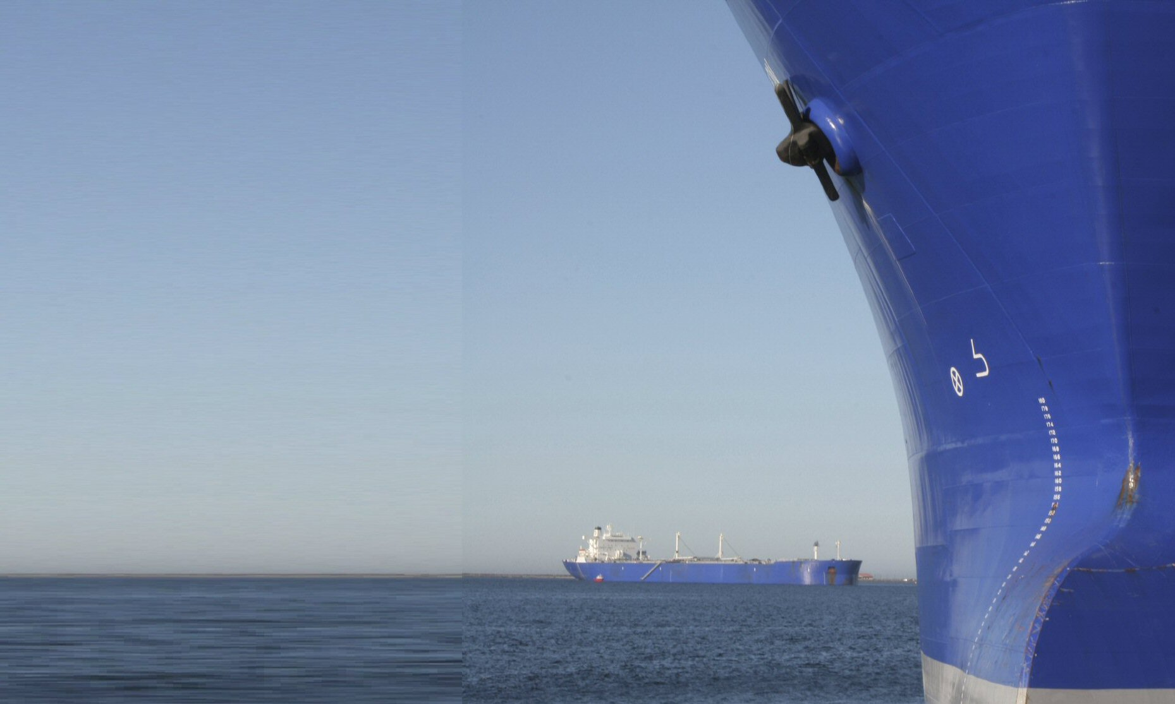


Radio Technical Commission for Maritime Services
RTCM Update
U.S. Regulatory Developments
Bob Markle
RTCM
Arlington, VA USA
Rmarkle@rtcm.org
+1 703 527-2000
Spring meetings 2011

Slide 2
Federal Communications Commission Regulations
Rule entered into force 25 March 2011:
  All fixed VHF radios imported, sold, or installed must be IEC Class D DSC
  (Similar rule for handhelds goes into force 25 March 2015)
Proposed Rule 4 August 2010
  Would prohibit Personal Radio Service radios from also operating on Maritime VHF frequencies
  - RTCM supports Maritime VHF radios to optionally have PRS frequencies
Proposed Rule 29 October 2010
  Would simplify operators licenses:
  First Class Radiotelegraph Operator
  Second Class Radiotelegraph Operator Radiotelegraph Operator
  Third Class Radiotelegraph Operator

Slide 3
Federal Communications Commission Waiting for Final Rules
Standards for ship radar equipment
Add IEC standards / Remove RTCM standards
RTCM supports - noting IEC 62388 and IEC 62288
Delete Inmarsat-E EPIRBs
Spectrum for ship station facsimile communications and the transmission of data on VHF maritime voice channels
Number of frequencies assigned to private coast stations
Daily testing of GMDSS radiotelephone equipment
Comment period ended 6 February 2007 – Final Rule not published

Slide 4
Federal Communications Commission Waiting for Proposed Rules
Data over maritime voice channels
RTCM petition of 24 July 2009
Relates to
  RTCM 12301.1 - VHF-FM Digital Small Message Services (VDSMS)
  ITU-R M.1842.1 - Characteristics of VHF radio systems and equipment for the exchange of data and electronic mail in the maritime mobile service RR Appendix 18 channels
Assignment and management of Maritime Mobile Ship Identity (MMSI) numbers to resolve registration and access discrepancies.
Periodically validate the database to pave the way for large increases in MMSI registrations expected

Slide 5
Federal Communications Commission Issues needing clarification
FCC now requires that AIS static data AIS, including MMSI, be entered by sellers and professional installers of Class B AIS devices, not end users.
What is a “professional installer?”

Slide 6
U.S. Coast Guard New Legislative Authority
May now approve lifesaving equipment not required by law or regulation
May require “emergency locator beacons” on recreational boats

Slide 7
U.S. Coast Guard Waiting for Final Rules
Expansion of AIS carriage requirements to
all vessels over 65 ft (20 m)
towing vessels over 26 ft and 600 hp
vessels carrying 50 or more passengers
high-speed vessels with more than 12 passengers for hire
certain dredges & floating plants
vessels moving certain dangerous cargoes
  Could affect 17,442 vessels

Slide 8
U.S. Coast Guard Waiting for Final Rules
Spell out AIS ‘effective operating conditions’ including:
• ability to reinitialize the AIS
• ability to access AIS from conning position
• accurate broadcast of an official MMSI
• accurate input, upkeep, and updating
AIS (& input sensors) shall remain on when:
  - underway
  - at anchor, or
  - moored in or near a channel or fairway;
  - except if it would compromise safety or security
    - which must be logged & reported to CG

Slide 9
U.S. Coast Guard Waiting for Final Rules
Use of CG type-approved Class B is permissible, however, not recommended on vessels that are:
• highly maneuverable
• navigate at high speed
• routinely operate in congested waters, or
• operate in close-quarter situations
    Comment period closed 15 April 2009

Slide 10
U.S. Coast Guard Waiting for Proposed Rules
Law requires electronic chart carriage
Implementation by 1 January 2007
Same vessels as AIS coverage in domestic services
Expected to require recording capability in lieu of VDR
SOLAS ECDIS requirements
Codification of navigation equipment approval program

Slide 11
Federal Communications Commission LightSquared Waiver
  26 January 2011 - LightSquared given conditional approval to build out its ground-based wireless network (referred to as an ancillary terrestrial component, ATC) by reusing its authorized mobile satellite service (MSS) spectrum
  Potential interference threat to adjacent L-band services
  Spectrum swap resolves Inmarsat issues
  Out-of-band emissions threaten GPS receivers near LS ground stations
  LS can not begin commercial operation until FCC satisfied that harmful interference concerns have been resolved
  Evaluation and testing currently underway

Slide 12
Department of Transportation / Department of Homeland Security Future of Loran
7 February 2008 - DHS announces adoption of eLoran as National Backup system to GPS
Responsibility for Loran to transition from USCG to DHS National Protection and Programs Directorate (NPPD). (Vetoed by Congress)
7 January 2010 – USCG announces termination of Loran-C service
Decision on eLoran not officially made
Two Alaska Loran-C towers demolished
DHS and FAA still looking at GPS vulnerabilities

Slide 13
U.S. Coast Guard Nationwide AIS (NAIS)
NAIS is an integrated network of AIS receivers, AIS transmitters, data processing and storage centers
Phase 1 Receive-only network in place
Phase 2 Receive and transmit – awarded to Northrop Grumman
NAIS will share some Rescue 21 and other existing VTS and prototype assets
Ultimately cover up to 2000 mi from shore
Total cost estimate $276.8M
Scheduled completion 2014
However – zero funding for FY 2010, 2011 - also for 2012?

Slide 14
RTCM Special Committee 110 Emergency Beacons
Cospas-Sarsat EPIRB standard
In revision –
    Reference and align EPIRB Standard with IEC 61097-2
    Test of embedded GPS under various situations
      (Requires anechoic chamber and GPS simulator)
      (NASA simulation testing for pitch and roll)
    Inadvertent activation testing
    Labelling improvements
    Single-hand carriage and operation wearing immersion suit
    Not possible to incorrectly position in bracket
    NTSB has recommended position-encoding for all beacons
    AIS locator in place of 121.5 MHz for domestic service vessels?
    121.5 MHz duty cycle reduction for SOLAS EPIRBs with 406 MHz/121.5 MHz/AIS transmitters?

Slide 15
RTCM Special Committee 110 Emergency Beacons
“Second generation beacon” MEOSAR preparations
Begins with SAR payload on Galileo satellites
  GPS and GLONASS satellites will follow
  Fully operational 2017 (?)
  Graceful transition from present LEOSAR system
  Return link capability
  Changes to Beacon Encoding and Location Accuracy
  Transmit valid message within [3] seconds after activation?
  False alert implications?
  Phase stability less critical → lower cost?

Slide 16
RTCM Special Committee 110 Emergency Beacons
Cospas-Sarsat JC-25 Issues (13-21 June 2011)
TCXO Medium Tern Stability
MTS Residual and Mean Slope Aging
GNSS Receiver testing using simulators
Data on short term carrier phase stability under thermal shock
More involvement with ELTs
  Internal vs. external secondary antennas
  ELT Activation on Indication of Emergency

Slide 17
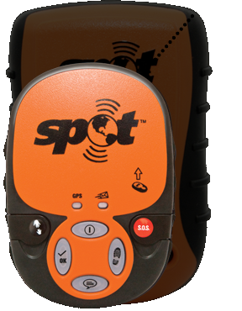
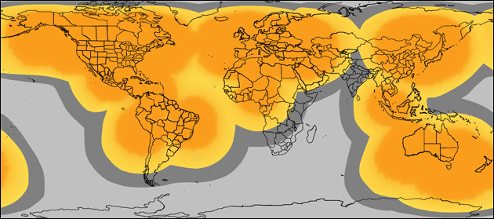
RTCM Special Committee 128 Satellite Emergency Notification Devices (SEND)
Requested by U.S. Coast Guard in response to SPOT and others
Develop standard for performance of user device
  (Based on RTCM PLB standard)
  Expect to approve final this summer
Issues
  SEND vs. Satphone w/ emergency function
  Back-end services
US National Search and Rescue Committee Working Group on SEND
Iridium-sponsored ProTECTS Alliance now under RTCM

Slide 18
RTCM Joint Special Committees 101/110 GPS-equipped Portable VHF-FM Radios
USCG/FCC propose GPS-equipped portable VHF radios
For small commercial vessels
  w/o installed VHF
  w/o EPIRB
RTCM comments that standards are required
GPS performance – SC110 PLB/EPIRB experience (complete)
DSC simplification (complete with ITU Class D revisions)
Battery performance
RTCM should publish standard this Summer – now in ballot

Slide 19
RTCM Joint Special Committees 101/110 GPS-equipped Portable VHF-FM Radios
Current version
  Class 3 – meets SOLAS Survival Craft Radio stds
    2 receivers
      Ch 70 Rx on all of the time
      Receive all DSC calls
      Other Rx can sleep – wake up every 2 sec to detect signal on 16
  Class 2 – floats
  Class 1 – non-floating
    2 receivers (like Class 3)
    1 receiver
      Rx all DSC distress calls
      Monitor 16 (every 2 sec) and 70 (every 3 sec)
      Can sleep other times

Slide 20
RTCM Joint Special Committee 119 Maritime Survivor Locating Devices
“Man Overboard Devices”
  New revision of standard will
  Provide for optional AIS location
  Allow “all ships” alarm after 30 minutes with GPS position

Slide 21
RTCM Special Committee 123 Digital Messaging over Maritime Frequencies
Use “white space” in VHF Maritime Spectrum to transmit digital messages
“Polite” use of data link
CSTDMA technique like IEC AIS Class B CS standard
TETRA Enhanced Data System (TEDS) – higher data rate
  ETSI Standard
  Can use 25 kHz channels – No need for channel consolidation
  π/8 D8-PSK at 43.2 kbit/s
9.6 kbit/s AIS-like transmissions – no slots
ITU-R M.1842.1
RTCM has petitioned FCC to allow in U.S.

Slide 22
RTCM Special Committee 123 Digital Messaging over Maritime Frequencies
495-505 kHz band by the maritime mobile service
Shore-to-ship digital broadcasting of safety and security information
ITU Report ITU-R M.2201
Harris low-cost design for Loran-C towers
Enables efficient broadcasts at 500 kHz
Does not interfere with Loran signal at 100 kHz
To be tested at Wildwood, NJ Loran site

Slide 23
RTCM Joint Special Committee 127 Enhanced Loran (eLoran)
eLoran
Precise timing enables unified Loran network
Data channel enables improved performance
Receiver standard for eLoran required
Receive and use data channel
  US signal specification
  Eurofix
  Others?
GNSS backup
GNSS receiver integration / automatic fail-over
U.S. Coast Guard discontinuing Loran-C signal
No decision on eLoran – but not encouraging
Committee adopting a more European focus

Slide 24
RTCM Special Committee 121 Automatic Identification Systems and Digital Messaging
Undertaken at U.S. Coast Guard request -
Recommend new/revised AIS transmit (broadcast/addressed messages) suitable for regional and international implementation
3 Application Specific Messages (ASM) messages identified and specified
  Environmental (met/hydro) message
  Area message
  Waterway management message
Messages included in AIS International Application (IA) Catalogue
  Adopted at IMO NAV 55
Problems with message structure have returned work to new WG on Application Specific Messages (ASM)

Slide 25
RTCM Special Committee 109 Electronic Charting Technology
Undertaken at U.S. Coast Guard request -
Supplement IEC 62376 & IEC 61174 for non-SOLAS vessels in domestic service
Committee Draft out for review
Voyage Data Recorder functions
Screen size and resolution
Route planning
Acceptance and output of certain NMEA sentences

Slide 26
RTCM Special Committee 112 Ship Radar
RTCM Special Committee 129 Portrayal of Navigation-Related Information on Shipboard Displays
Will take on work related to Electronic Charts for non-SOLAS vessels
Will be based on IEC standards

Slide 27
RTCM Special Committee 130 Night Vision Systems for Commercial Maritime Applications
Being proposed for Board approval
Issues related to integration with other eNavigation systems

Slide 28
RTCM Joint Special Committee 104 Differential GNSS Systems
RTCM 10401.2 - Differential Navstar GPS Reference Stations and Integrity Monitors (RSIM)
Will require revision for GLONASS and Galileo
RTCM 10402.3 - Differential GNSS (Global Navigation Satellite Systems) Service, Version 2.3 + Amendment 1
RTCM 10403.1 - Differential GNSS (Global Navigation Satellite Systems) Services - Version 3 + Amendments 1, 2, 3, and 4
Amendment 5 in ballot
RTCM 10410.0 - Networked Transport of RTCM via Internet Protocol (Ntrip)

Slide 29

RTCM 2011
Annual Assembly Meeting and Conference
15 – 20 May 2011
TradeWinds Island Hotel
St. Pete Beach, FL,USA
www.rtcm.org

