Slide 1
Maritime Broadband Radio
Kongsberg Seatex AS

Slide 2
Overview
Existing radio solutions
MBR – Maritime Broadband Radio:
Design
Specifications
Types
Test Program
Applications

Slide 3
Existing radio solutions
Existing solutions: E.g. Ruggedized Wi-Fi, WiMax provide limited
  Reliability
    Availability not guaranteed in difficult conditions
    No real-time capabilities
    Drop outs
    Fading and signal nulls over water
  Capacity
    Problem in network with multiple vessels
    Inadequate control of priority
    Low bandwidth efficiency, around 50%
  Functionality
    Not suitable for mixing time critical data with non critical data
    Many settings and tuning parameters
Notes:
Wi-Fi: Wireless communication based on IEEE 802.11 standards, as used in home and offices. Contention oriented.
WiMax: Wireless communication based on IEEE 802.16 standard, longer range than Wi-fi. Connection-oriented, requires base station
Parabolic solutions are only point to point
Does not handle combination of short/long nodes
Reliability
Availability not guaranteed in difficult conditions → Problem with vessels both near and far
No real-time capabilities → No guarantee for low latency transfer of time critical data
Drop outs → No safe transfer of data that must reach its destination, real 24/7 availibility
Capacity
Problem in network with multiple vessels → multiple access lowers bandwidth with increasing number of vessels
Inadequate control of priority → No easy solution for divide between high priority data and low priority (e.g. file transfer)
Low bandwidth efficiency, around 50% → Bandwidth lost in overhead and multiple access (nodes jam each other) Standard WLAN 802.11x has 50% link eff. 54Mbps→27Mbps
Functionality
Not suitable for mixing time critical data with non critical data → Not suitable for different data streams in same network
Many settings and tuning parameters → Hard to set up a configuration suiting all needs

Slide 4
MBR – Maritime Broadband Radio
Broadband radio solution developed by Kongsberg Seatex
Smart Antenna with no moving parts
Tailored MAC and PHY layer
High dynamic range with near and far capability and long range
High degree of reliability, real 24/7 availability
High capacity for large networks
Functionality tailored for maritime operations
Capable to operate where existing solutions fail
Notes:
Bradband radio solution developed by Kongsberg Seatex AS → Started pre-project in 2008
Smart Antenna → No moving parts, radio lobe (pointing direction) is controlled by controlling phase of each antenna element (both Tx and Rx)
Tailored MAC and PHY layer → PHY is the physical part which is the radio design, MAC is the Media Access Control which is the low level communication control channel of the network
High dynamic range with near and far capability → High dynamic range means sensitive to both weak distant signals and full strength close up signals
Gives high degree of reliability → High link margin guarantees safe delivery of data in difficult conditions and over long range
High capacity for large networks → Supports multiple vessels (30 or more) due to high bandwidth and multiple access protocol
Functionality tailored for maritime communications → Both radio technically with tested for over water communication and in software by supporting maritime networks like SIMOPS

Slide 5
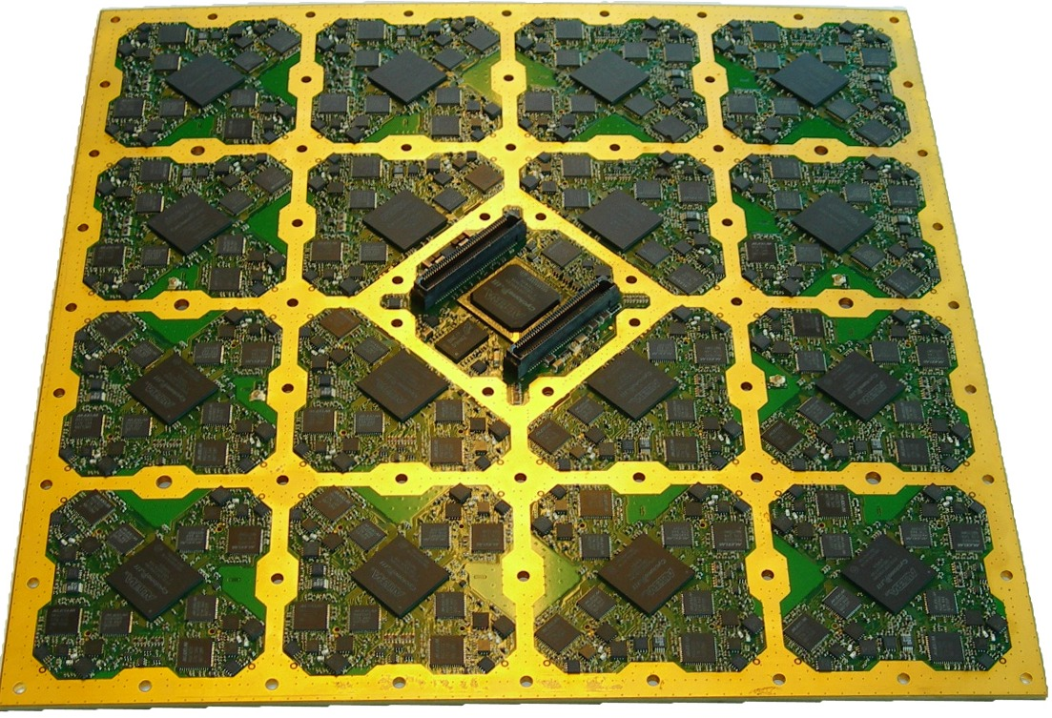
MBR – Design
Smart Antenna
  MBR has up to 60 transceivers controlled by 16 FPGA’s
  Beam forming performed in the signal processing domain
  High antenna gain and narrow beam
  Extended range
Tailored MAC / PHY
  Multipath mitigation
  Sea fading mitigation
  Near and far capable
  Priority channels
  Low latency
  Output power control
  Easy to configure and operate
Notes:
Smart Antenna
MBR has up to 60 transceivers controlled by 16 FPGA’s → As seen on the PCB. Around 7000 components.
Beam forming performed in the signal processing domain → No phase shifters
High antenna gain and narrow beam → Result from beam narrowing and control
Extended range → Result of concentrating emitted energy towards one point
Tailored MAC / PHY
Multipath mitigation → by beam controlling in Rx multipath is suppressed
Sea fading mitigation → same as over with added link margin in addition
Near and far capable → high dynamic range
Priority channels → self explanatory
Low latency → in area 5-20ms or better depending on configuration and data size
Output power control → self explanatory

Slide 6
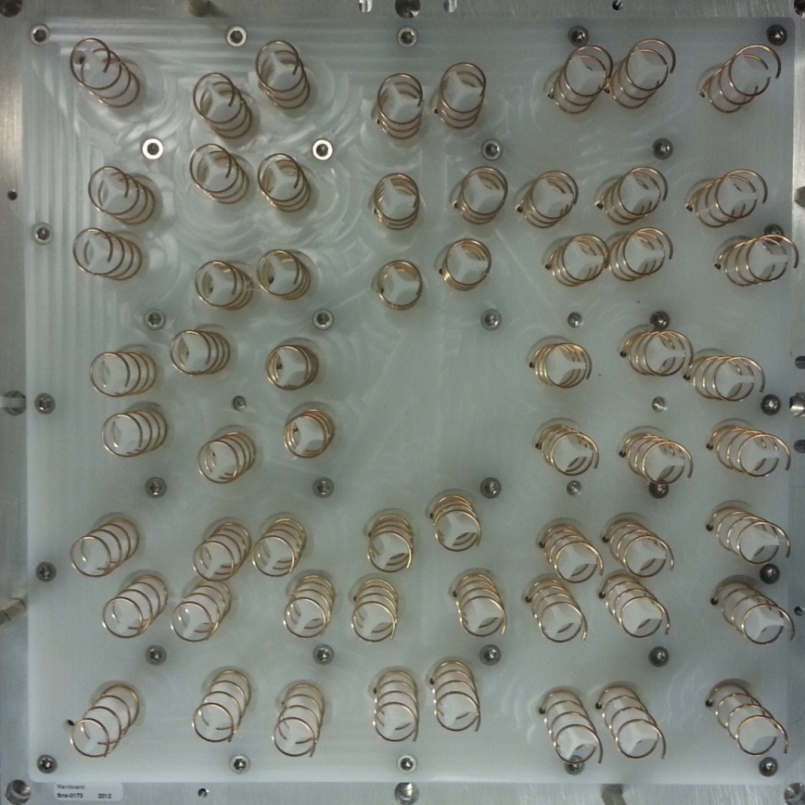
MBR – Design
Smart Antenna
  MBR has up to 60 transceivers controlled by 16 FPGA’s
  Beam forming performed in the signal processing domain
  High antenna gain and narrow beam
  Extended range
Tailored MAC / PHY
  Multipath mitigation
  Sea fading mitigation
  Near and far capable
  Priority channels
  Low latency
  Output power control
  Easy to configure and operate

Slide 7
MBR – Specifications
Frequency: 4.900 – 5.875 GHz
Bandwidth: 20MHz
Max Tx power: 6W
Max EIRP: 2.5kW
Beam: +/- 4.5° (3dB beam width)
Beam control: +/- 45° H/V or omnidirectional
Data rates: 0.5 – 10 Mbps
Max nodes: > 30
Notes:
Why 5GHz: legislation/frequency authorities, availability of IC
User Datarates vs. Raw Datarates
EIRP: Equivalent Isotropically Radiated Power
PHY: ACCM (special variant of DSSS with rotating m-ary code book. Improved performance for long ranges (improves immunity vs reflections)
Number of chips/symbol is varied with data rate. For the lowest rate 6 bits is coded into 128 chips
MAC: EMBR can operate simultaneously on short/long range links. Impossible with WLAN (turn around time).

Slide 8
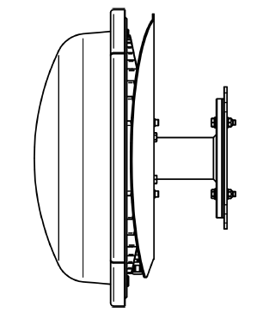
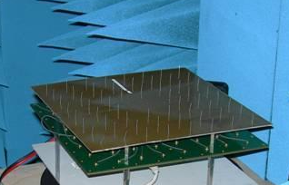
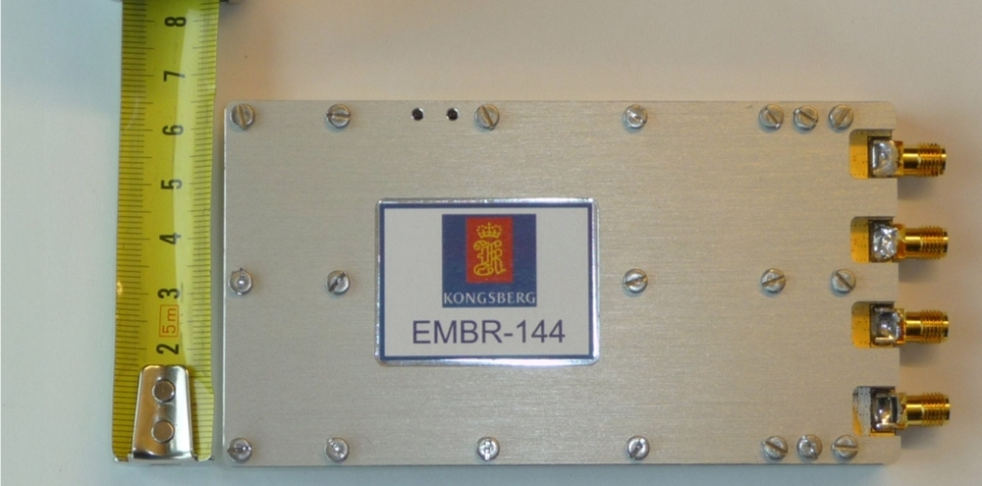
MBR – Types
MBR 189
MBR 179
MBR 144

Slide 9
MBR – Three types
 | Number of Transceivers / Antenna type | Tx power [W] | Antenna gain [dBi] / Max EIRP [W] | Range [km] | Operational Area
MBR 189 | 60 / Helix | 6 | 26 / 2500 | > 50km | 90° Horizontal and Vertical
MBR 179 | 60 / Monopole | 6 | 21 / 800 | > 25km | 360°
MBR 144 | 4 / Monopole | 2 | 9 / 31 | > 12km | 360°
Notes:
System gain = Transmitted power + Transmitter antenna gain + Receiver antenna gain – Receiver sensitivity, EMBR system gain calculated for lowest bitrate
MBR 189 – System gain: 189, faced towards horizon, Tx power: 60 x 100mW = 6W
MBR 179 – System gain: 179, faced upwards, omnidirectional, Tx power: 60 x 100mW = 6W
MBR 144 – System gain: 151, antennas upwards, omnidirectional, designed for Seatrack, Tx power: 4 x 500mW = 2W
MBR 144 is an OEM module and can have different antenna types connected.

Slide 10

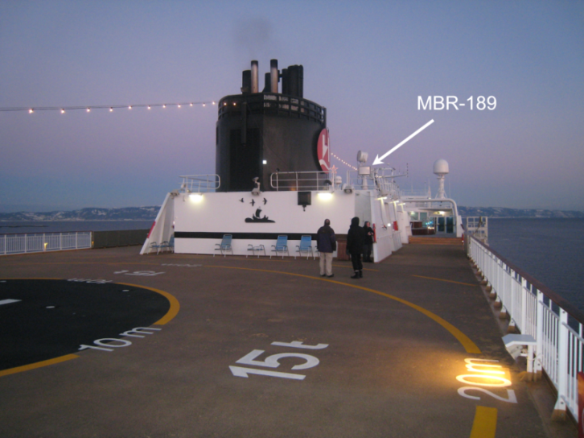
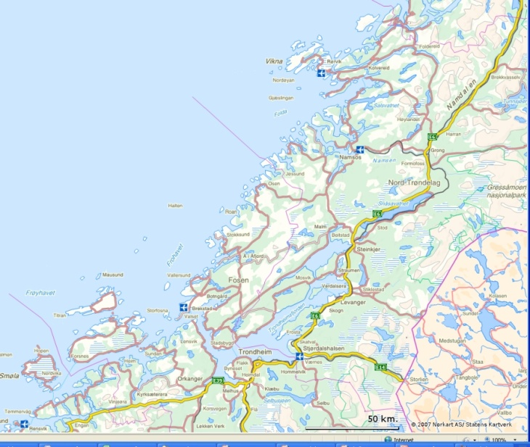
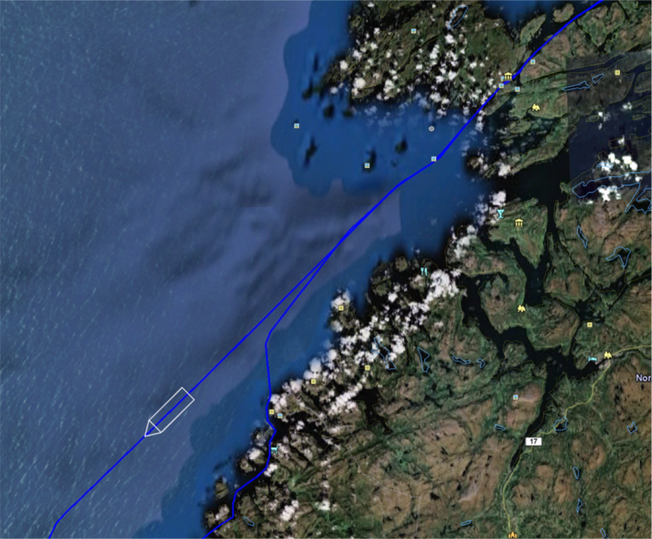
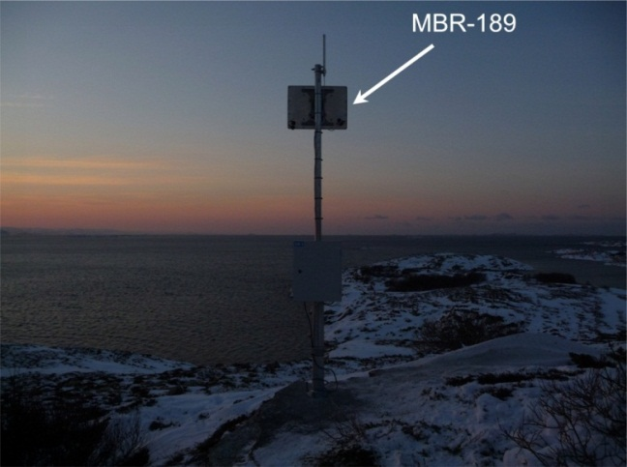
MBR 189 – Range test
MBR 189 vs. MBR 189
Rørvik – Coastal express

Slide 11
MBR 189 – Range test
0 – 53 km a highly stable link with 3.55 Mbps payload data

Slide 12

MBR 189 – Path loss test
Path loss measurements while large vessel passed

Slide 13
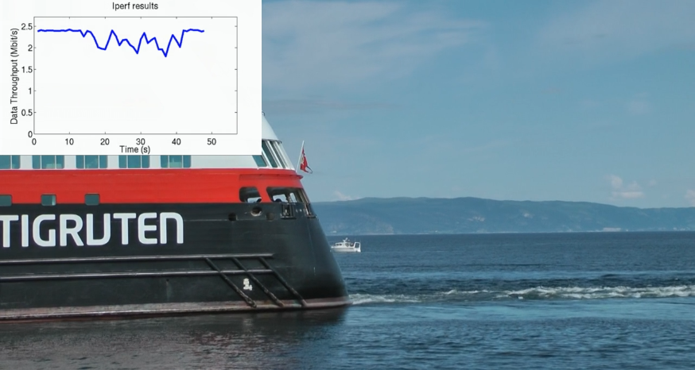
MBR 189 – Obstruction test
Throughput (payload data) while large vessel passed close by
Notes:
Link was from small boat towards where the photo was taken. Video from test is available
Iperf: Open source software for measuring throughput in a network. In short, iperf can be installed on two machines within your network. You’ll run one as a server, and one as a client. Iperf reports bandwidth, delay jitter and datagram loss.

Slide 14
MBR 179 – Test
User data throughput: MBR 179 vs. MBR 179
Y – axis: Payload data throughput [Mbps]
Passing island Tautra @ 37 km
Notes:
X-axis is not distance, probably samples

Slide 15
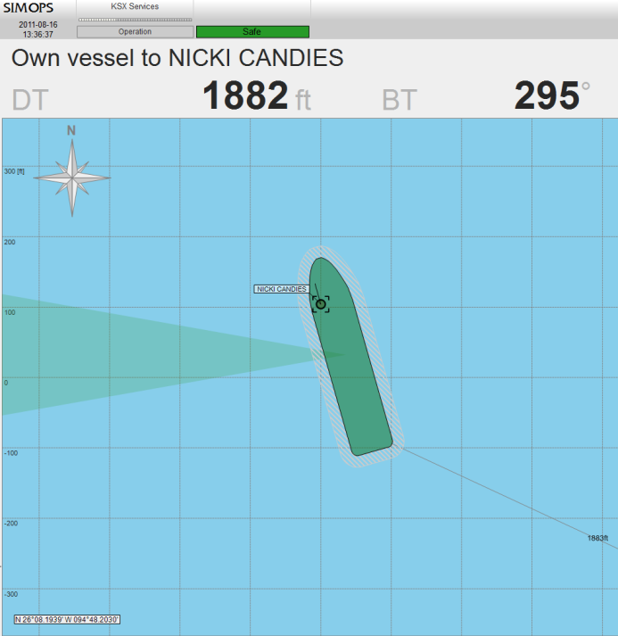
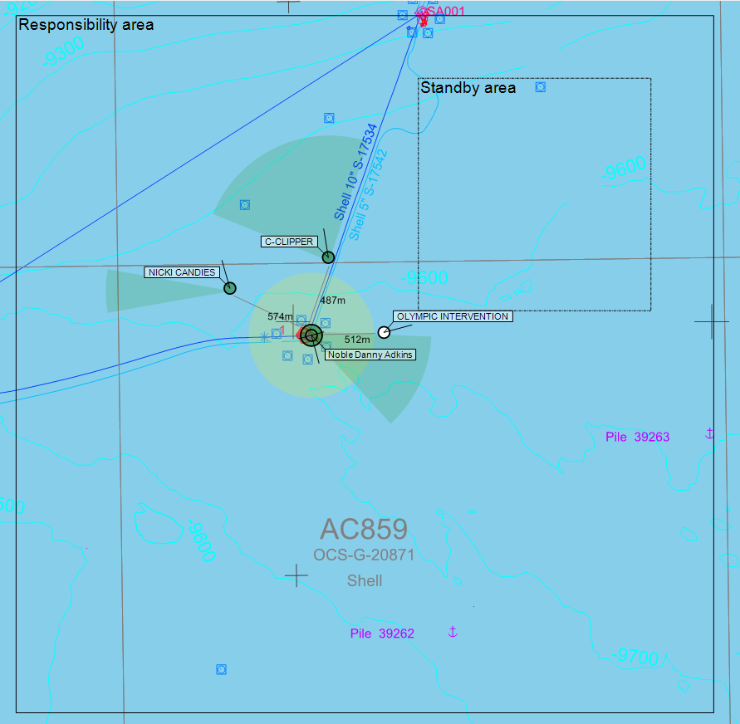
MBR – SIMOPS Management Tool
SIMOPS Management Tool
  Connecting vessels together in simultaneous operations
  Real time visual information for decision support
  Enhanced safety and managemet of close proximity vessels
  Communication essential part of system

Slide 16

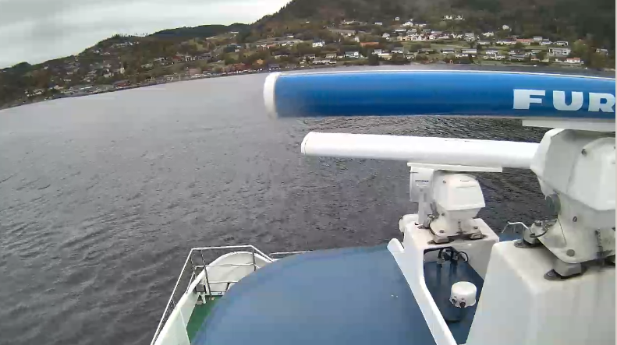
MBR – video feed
Coast guard Inspection team connected with mother vessel by MBR
  Live video feed from MBR 144
  Video recorded on mother vessel
Commuter boat with HD video at 15.3km
  MBR 144 on boat and MBR 189 on shore
Notes:
Communter boat from Trondheim to Vanvikan. Distance from Pirsenteret to Vanvikan is 15.3km

