Slide 1

Contributions to SE43 Group – 11th Meeting
SE43(11)Info15
SE43(11)65 – Reference spatial geometries between WSDs and DTT-Rxs for the calculation of the maximum permitted WSD EIRP
SE43(11)66 – Strategies to calculate the maximum permitted WSD EIRP
Nokia Institute of Technology - INdT

Slide 2
SE43(11)66 – Strategies to calculate the maximum permitted WSD EIRP
Main issue
  Adaptation of the location probability degradation according to the quality of the DTT signal in a given location
Different strategies concerning the operation of the data base
  Protecion criteria
    Protection ratio
    Overloading threshold
    Location probability degradation
    Interference to noise ratio
  Methodology (ECC Report 159)
    Calculate the location probability considering no interference from secondary system;
    Calculate the location probability considering the presence of WSD;
    Define the maximum accepted interference caused by WSDs to the DTT service according to the selected protection criteria;
    Use a reference geometry concerning the positioning of WSD transmitter and DTT receiver;
    Calculate the maximum permitted WSD EIRP for the reference geometry.

Slide 3
SE43(11)66 – Strategies to calculate the maximum permitted WSD EIRP
Database operation
  WSD sends information about its location to the database
  Database associates the WSD to a pixel
  Database has a Ewmed value associated to the pixel
  Database defines vacant channels and maximum EIRP power for the pixel according to Ewmed value and protection criteria
  Database provides this information to the WSD

Slide 4
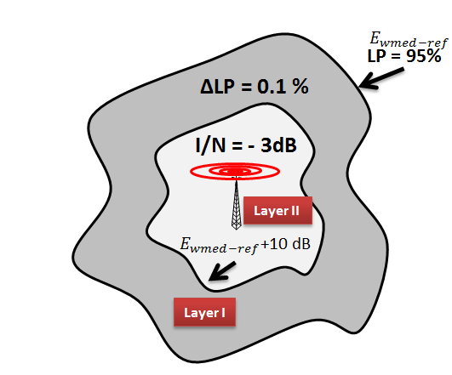
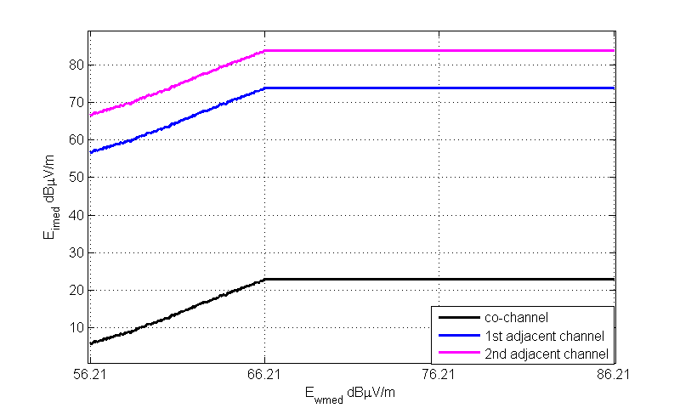
SE43(11)66 – Strategies to calculate the maximum permitted WSD EIRP
Strategy 1 – Two layers (proposed in SE43(11)12)
  Strategy 1 simultaneously considers two protection criteria over the DTT coverage area: the maximum interference-to-noise ratio and the maximum degradation in location probability

Slide 5
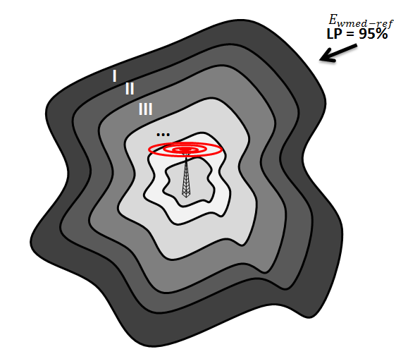
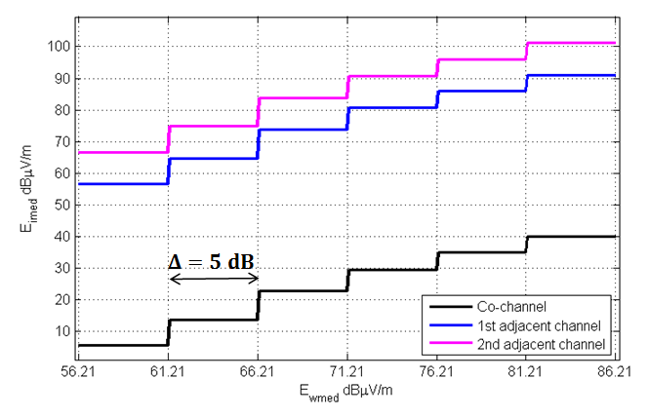



SE43(11)66 – Strategies to calculate the maximum permitted WSD EIRP
Strategy 2 – Multilayers (proposed in SE43(11)33)
  Strategy 2 divides the DTT coverage area in layers according to the received wanted field strength and apply a unique value of degradation in location probability in each layer. Overloading thresholds are respected.
Interference limitation inside a layer is defined at the external edge of the layer
$Δ_{dB}$
$$ΔLP=0.1 \%$$
* Layers are defined based on the planned Ewmed available at the database, and on a value of $Δ$.

Slide 6
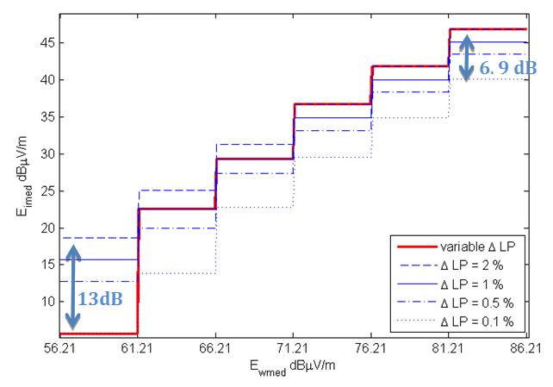




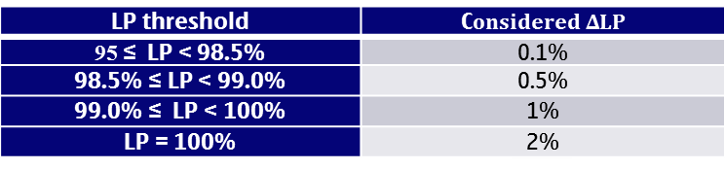


SE43(11)66 – Strategies to calculate the maximum permitted WSD EIRP
Strategy 3 – Multilayers and flexible $ΔLP$
  Strategy 3 uses the concept of layers presented in strategy 2, and varies the value of location probability degradation according to thresholds of the wanted DTT field strength. Overloading thresholds are respected.
$$ΔLP=0.1 \%$$
$$ΔLP=0.5 \%$$
$$ΔLP=1 \%$$
$Δ_{dB}$
$$ΔLP=2\%$$
LP threshold | C$onsidered ΔLP$
95 ≤ LP < 98.5% | 0.1%
98.5% ≤ LP < 99.0% | 0.5%
99.0% ≤ LP < 100% | 1%
LP = 100% | 2%
Notes:
LP threshold
Maximum permitted $ΔLP$
98.5% ≤ LP < 99.0%
0.5%
99.0% ≤ LP < 100%
1%
LP = 100%
2%

Slide 7
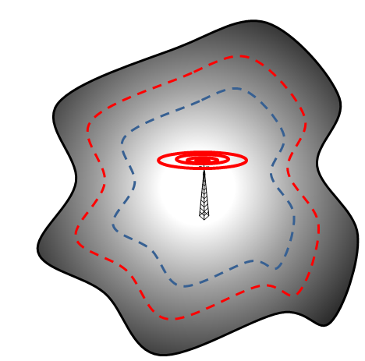
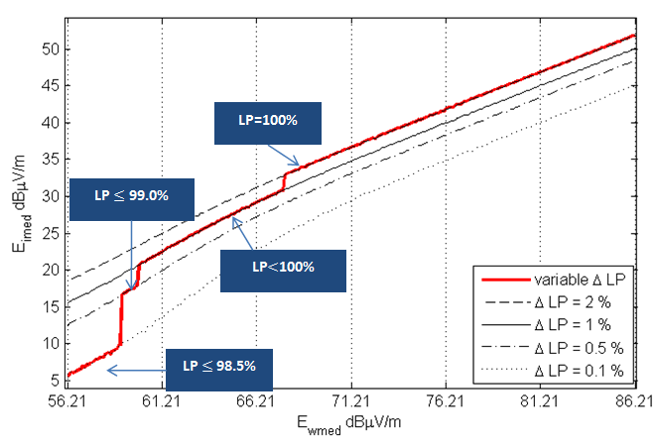




SE43(11)66 – Strategies to calculate the maximum permitted WSD EIRP
Strategy 4: Flexible $ΔLP$
  Select the level of location probability degradation $ΔLP$ according to the level of $LP$ at the location provided by the WSD
  Use the selected $ΔLP$ value as protection criterion until the interference level reaches the overloading threshold
$$ΔLP=0.1 \%$$
$$ΔLP=0.5 \%$$
$$ΔLP=1 \%$$
$$ΔLP=2\%$$
Notes:
LP threshold
Maximum permitted $ΔLP$
98.5% ≤ LP < 99.0%
0.5%
99.0% ≤ LP < 100%
1%
LP = 100%
2%

Slide 8

SE43(11)66 – Strategies to calculate the maximum permitted WSD EIRP
Limitation of WSD EIRP by the overloading threshold
  Interference in adjancet channel
  Limitation of interference by the overloading threshold Oth
$$I_{\left[dBm\right]}={E_{imed}}_{\left[dBμV/m\right]}−20\log_{10}\left(f_{\left[MHz\right]}\right)−77.2+\left(PR\left(0\right)−PR\left(Δf\right)\right) .$$
$$I_{\left[dBm\right]}<O_{th}− G_{a}$$
A margin can be considered to take into account interference signal variation
 | Fixed DTT-Rx |  | Portable DTT-Rx
 | 1st adjacent channel | 2nd adjacent channel | 1st adjacent channel | 2nd adjacent channel
Fixed WSD | -13 | -7 | -18 | -12
Portable WSD | -22 | -25.5 | -27 | -30.5
Interference at DTT receivers is strongly dependent on overloading threshold and protection ratio values. Values considered in this analysis are taken from the range of Oth presented in ECC Report 148.

Slide 9
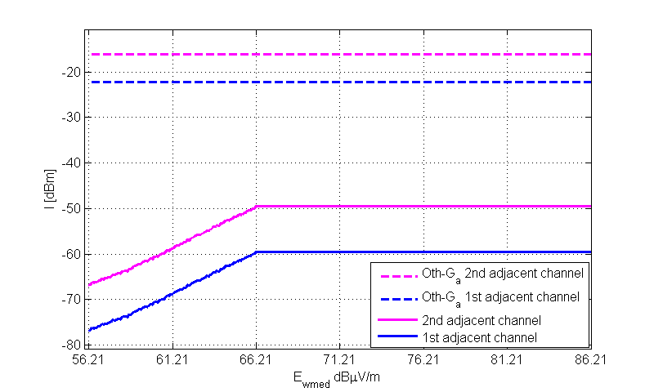
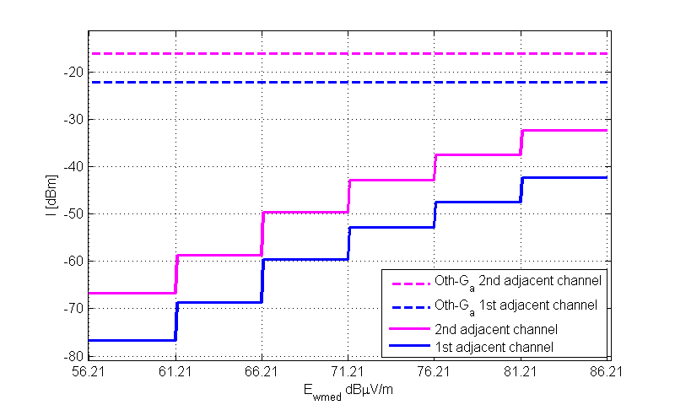
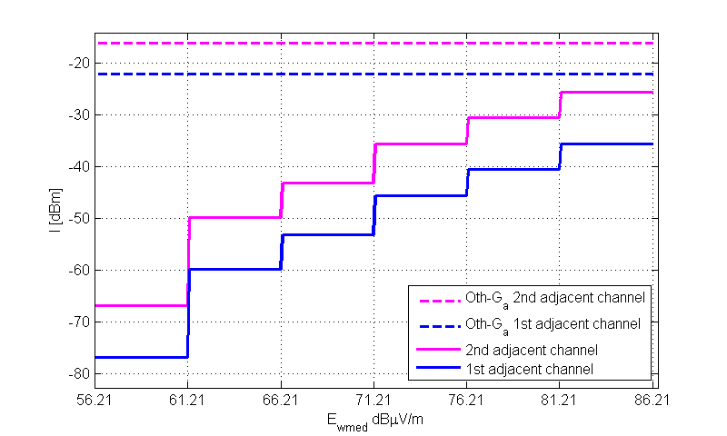
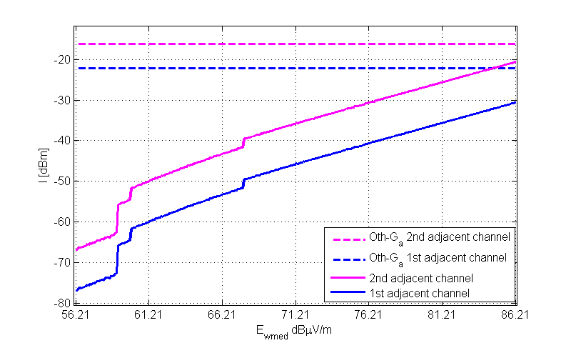
SE43(11)66 – Strategies to calculate the maximum permitted WSD EIRP
Fixed WSD to Fixed DTT-Rx
Strategy 1
Strategy 2
Strategy 3
Strategy 4

Slide 10
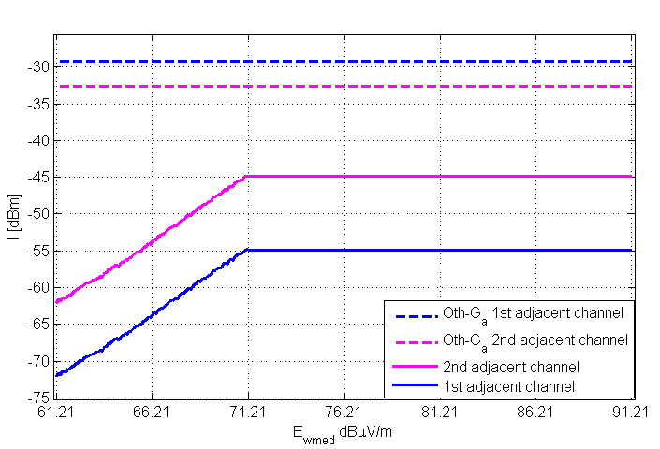
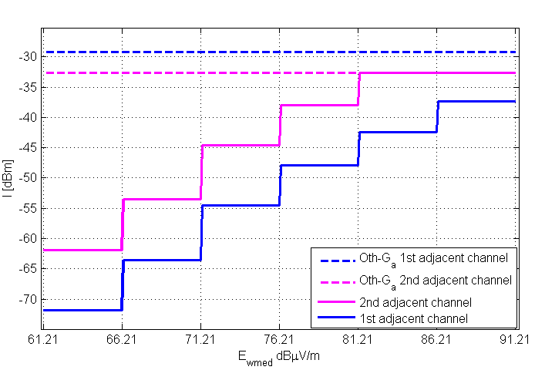
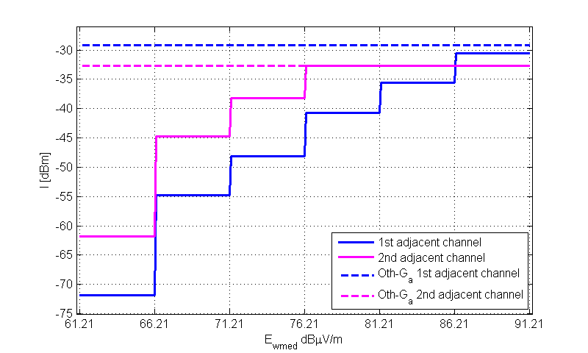
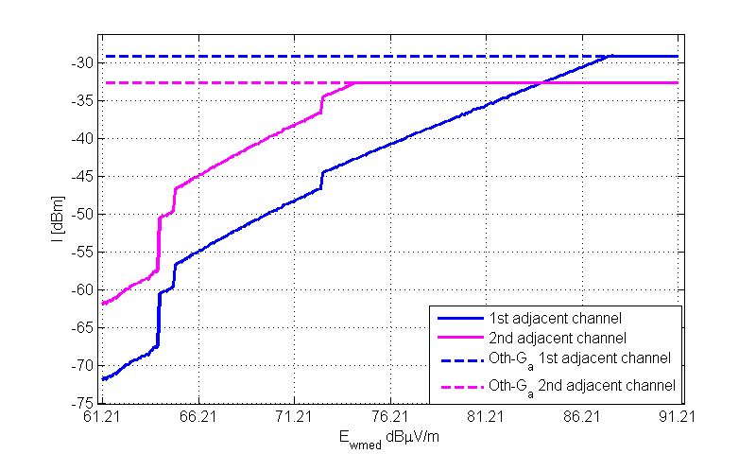
SE43(11)66 – Strategies to calculate the maximum permitted WSD EIRP
Portable WSD to Portable DTT-Rx
Strategy 1
Strategy 2
Strategy 3
Strategy 4

Slide 11

SE43(11)66 – Strategies to calculate the maximum permitted WSD EIRP
Maximum WSD EIRP calculation
Limiting scenarios
  Portable WSD – Portable DTT-Rx (Scenario 3)
  Fixed WSD – Fixed DTT-Rx (Scenario 4)
Reference geometries for the calculation of WSD EIRP
  Deterministic reference geometry
  Probabilistic reference configuration (SE43(11)65)
    Reference total loss = percentile of total loss cumulative distribution for different DTT-Rx
  Limitation of interference by the overloading threshold Oth
$$WSD EIRP_{\left[dBm\right]}=I_{\left[dBm\right]}+LOSS$$
Scenario | Distance [m] | Polarization discrimination [dB] | Rx Antenna discrimination [dB] | Tx antenna attenuation [dB] | Total Loss [dB]
Portable WSD @1.5m to Portable DTT @1.5m | 2 | - | - | - | 34.72
Fixed WSD @10m to Fixed DTT @10m | 20 | 3 | - | - | 57.72

Slide 12
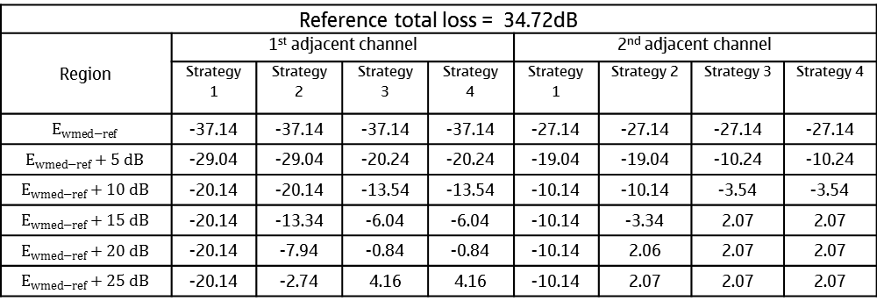
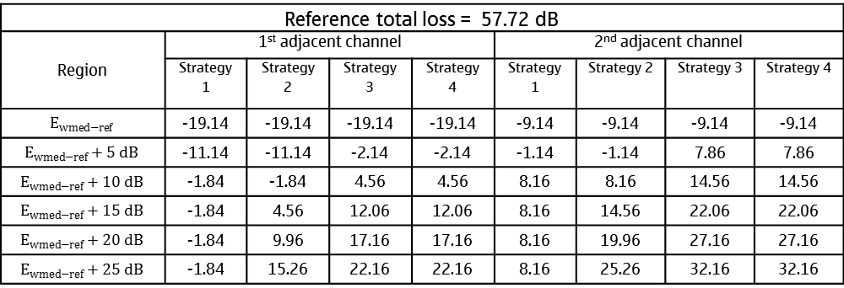
SE43(11)66 – Strategies to calculate the maximum permitted WSD EIRP
Maximum WSD EIRP calculation
Fixed WSD – Fixed DTT-Rx
Reference total loss = 57.72 dB
Region | 1st adjacent channel |  |  |  | 2nd adjacent channel
 | Strategy 1 | Strategy 2 | Strategy 3 | Strategy 4 | Strategy 1 | Strategy 2 | Strategy 3 | Strategy 4
$$E_{wmed−ref}$$ | -19.14 | -19.14 | -19.14 | -19.14 | -9.14 | -9.14 | -9.14 | -9.14
$$E_{wmed−ref}+5 dB$$ | -11.14 | -11.14 | -2.14 | -2.14 | -1.14 | -1.14 | 7.86 | 7.86
$$E_{wmed−ref}+10 dB$$ | -1.84 | -1.84 | 4.56 | 4.56 | 8.16 | 8.16 | 14.56 | 14.56
$$E_{wmed−ref}+15 dB$$ | -1.84 | 4.56 | 12.06 | 12.06 | 8.16 | 14.56 | 22.06 | 22.06
$$E_{wmed−ref}+20 dB$$ | -1.84 | 9.96 | 17.16 | 17.16 | 8.16 | 19.96 | 27.16 | 27.16
$$E_{wmed−ref}+25 dB$$ | -1.84 | 15.26 | 22.16 | 22.16 | 8.16 | 25.26 | 32.16 | 32.16
Portable WSD – Portable DTT-Rx
Reference total loss = 34.72dB
Region | 1st adjacent channel |  |  |  | 2nd adjacent channel
 | Strategy 1 | Strategy 2 | Strategy 3 | Strategy 4 | Strategy 1 | Strategy 2 | Strategy 3 | Strategy 4
$$E_{wmed−ref}$$ | -37.14 | -37.14 | -37.14 | -37.14 | -27.14 | -27.14 | -27.14 | -27.14
$$E_{wmed−ref}+5 dB$$ | -29.04 | -29.04 | -20.24 | -20.24 | -19.04 | -19.04 | -10.24 | -10.24
$$E_{wmed−ref}+10 dB$$ | -20.14 | -20.14 | -13.54 | -13.54 | -10.14 | -10.14 | -3.54 | -3.54
$$E_{wmed−ref}+15 dB$$ | -20.14 | -13.34 | -6.04 | -6.04 | -10.14 | -3.34 | 2.07 | 2.07
$$E_{wmed−ref}+20 dB$$ | -20.14 | -7.94 | -0.84 | -0.84 | -10.14 | 2.06 | 2.07 | 2.07
$$E_{wmed−ref}+25 dB$$ | -20.14 | -2.74 | 4.16 | 4.16 | -10.14 | 2.07 | 2.07 | 2.07

Slide 13
SE43(11)66 – Strategies to calculate the maximum permitted WSD EIRP
Conclusions
  Strategies 1, 2, 3 and 4 present an increasing level of flexibility on the determination of location specific WSD power limits
  Layers
    Reduced complexity of database operation
    Additional protection to DTT service (protection criterion considered at the external edge of the layer)
Proposal
  It is proposed to include the content of the attachment in Section 3 of the working document

Slide 15

SE43(11)65 – Reference spatial geometries between WSDs and DTT-Rxs
Motivation
  Maximum WSD EIRP inside a pixel is limited by the loss in a reference geometry
    Reference geometry is a single configuration between WSD transmitter and DTT receiver
  Questions
    How probable are the considered reference geometries ?
    Is the number of DTT-Rxs information relevant to the definition of a reference configuration to the calculation of WSD EIRP limits ?
  Remark
    If the reference geometry has very low probability of occurrence, WSD EIRP of an entire pixel is limited by such “improbable” situation
$$WSD EIRP_{\left[dBm\right]}=I_{\left[dBm\right]}+LOSS$$
Reference geometry
This analysis does not consider cumulative interference effects. They can be considered a posteriori over the reference configuration.

Slide 16
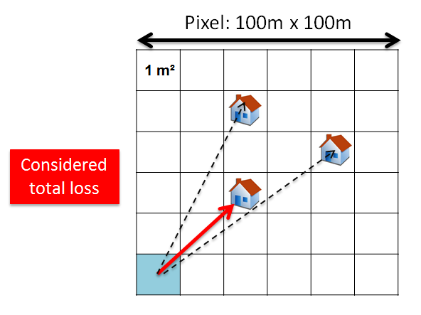
SE43(11)65 – Reference spatial geometries between WSDs and DTT-Rxs
Simulations
No minimum separation distance is considered
Evaluation of cumulative distribution of the limiting total loss
WSD
  Fixed WSD – antenna at 10 m agl. (ITU-R F. 1336-2); omnidirectional antenna also considered
  Portable WSD – Omnidirectional antenna at 1.5 m agl.
DTT-Rx
  Fixed DTT-Rx – antenna at 10 m agl. (ITU R BT. 419-3)
  Portable DTT-Rx – omnidirectional antenna at 1.5 m agl.

Slide 17
SE43(11)65 – Reference spatial geometries between WSDs and DTT-Rxs
Some results (1): fixed WSD – fixed DTT-Rx
20m
Slant-polar
H-polar
-
16 dB
+9.15
dBi
P
-
57.72 dB
IB
10 m
TV
Fixed WSD
Fixed rooftop DTT
reception
 | Values below 57.72 dB ( % )
Density of DTT-Rx | Omnidirectional antenna | Directional antenna with random azimuth | Directional antenna pointed to DTT-Tx
2 | 4% | 0.3% | 0.05%
10 | 17% | 0.1% | 0.02%
25 | 28% | 2% | 0.5%
35 | 32% | 4% | 0.7%

Slide 18
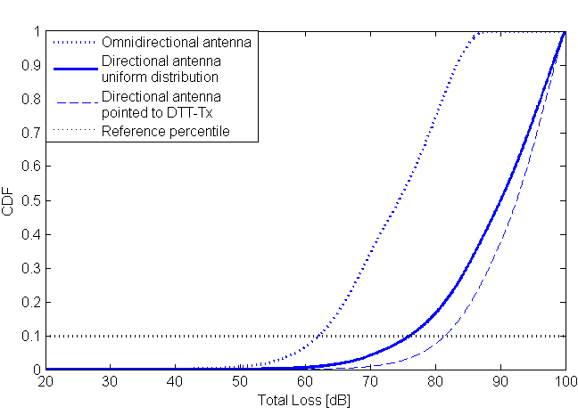
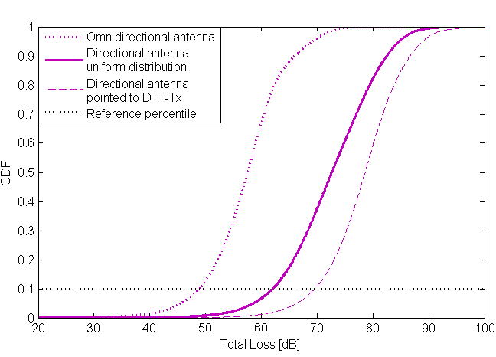
SE43(11)65 – Reference spatial geometries between WSDs and DTT-Rxs
Some results (1): fixed WSD – fixed DTT-Rx
2 DTT-Rx / pixel
35 DTT-Rx / pixel
 | 10th percentile
Density of DTT-Rx / pixel | Total loss [dB] Omnidirectional antenna | Total loss [dB] Directional antenna with random azimuth | Total loss [dB] Directional antenna pointed to DTT-Tx
2 | 62.1 | 76.1 | 81.5
10 | 54.5 | 68.4 | 75.3
25 | 50.4 | 63.7 | 71.2
35 | 48.9 | 62 | 69.6

Slide 19
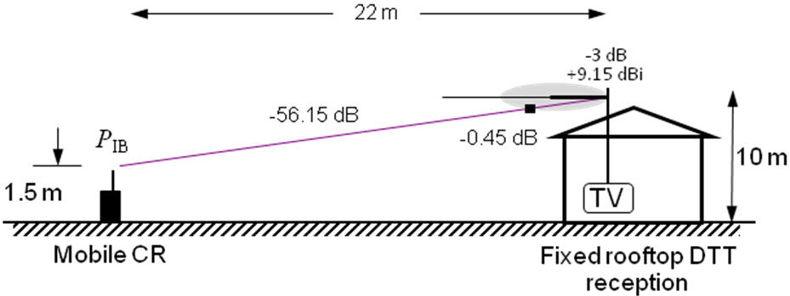
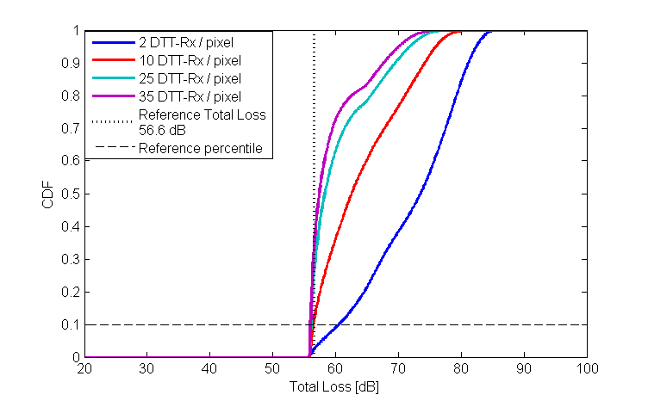
SE43(11)65 – Reference spatial geometries between WSDs and DTT-Rxs
Some results (2): portable WSD – fixed DTT-Rx

Slide 20
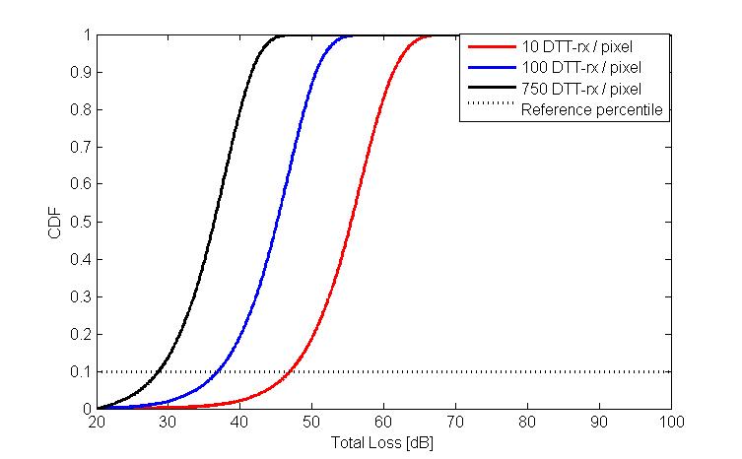
SE43(11)65 – Reference spatial geometries between WSDs and DTT-Rxs
Some results (3): portable WSD – portable DTT-Rx
-34.72 dB
WSD
2 m
DTT
1.5 m
1.5 m
DTT-Rx / pixel | Values below 34.72 dB ( % )
10 | 0.6 %
100 | 5 %
750 | 35%
Density of DTT-Rx / pixel | Total loss [dB] 10th percentile
10 | 47
100 | 36.9
750 | 28.7

Slide 21
SE43(11)65 – Reference spatial geometries between WSDs and DTT-Rxs
Conclusions
  DTT-Rx density and directivity of WSD antennas reduce the probability of occurrence of low values of total loss
Proposal
  It is proposed to create a new Annex about reference geometries in the working document and to include sections 1 to 4 of this document to provide additional information about the impact of the density of DTT-Rxs and directivity of WSD antennas in the maximum permitted WSD EIRP

