Slide 1
Control of aggregated interference from WSDs
Appendix 1 to
Document SE43(11)97
Riku Jäntti, Kalle Ruttik, Konstantinos Koufos
Department of Communications and Networking
Aalto University, Finland
<firstname.lastname>@aalto.fi
Maziar Nekovee
British Telecom, Great Britain
maziar.nekovee@bt.com
12th meeting of SE43, Cambridge, 14-16 December 2011

Slide 2
Outline
Interference margin vs total median nuisance field
Proposed area-based WSD power allocation scheme
Numerical examples

Slide 3
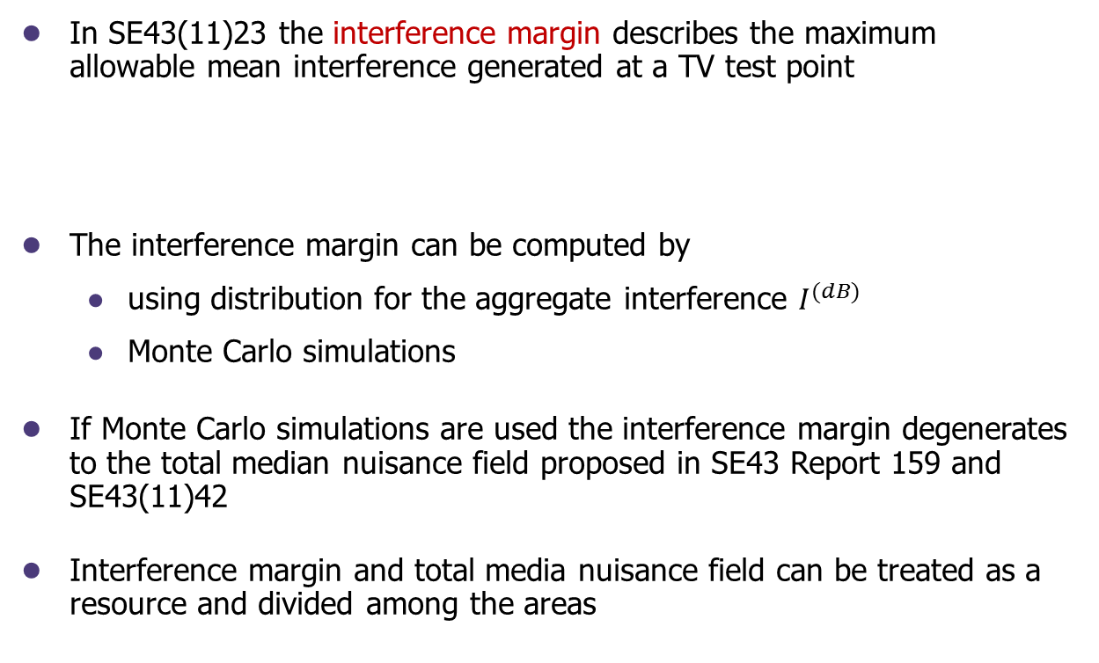
Interference margin vs nuisance field
In SE43(11)23 the interference margin describes the maximum allowable mean interference generated at a TV test point
  The interference margin can be computed by
  using distribution for the aggregate interference $I^{(dB)}$
  Monte Carlo simulations
If Monte Carlo simulations are used the interference margin degenerates to the total median nuisance field proposed in SE43 Report 159 and SE43(11)42
Interference margin and total media nuisance field can be treated as a resource and divided among the areas
$$E\left\{I^{\left(dB\right)}\right\}≤E\left\{S^{\left(dB\right)}\right\}−γ_{t}^{}+x_{q}\sqrt{var\left\{S^{\left(dB\right)}\right\}+var\left\{I^{\left(dB\right)}\right\}}+M≜I_{∆}$$

Slide 4
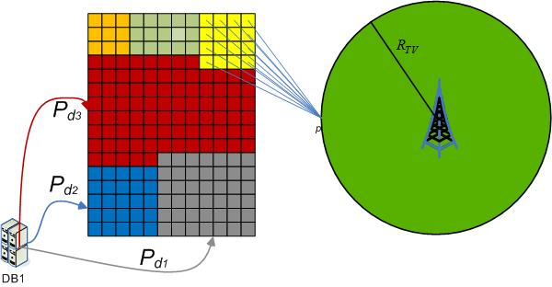
Area-based interference control
The database can group together secondary pixels that experience similar propagation pathloss to the TV protection contour.
Criterion to group multiple pixels into an area:
  The spatial power density emitted from the area sufficiently describes the generated interference.
  The database associates each area by a power density value and a fraction of the total interference margin
  signalling overhead is reduced
  distributed operation enabled (each
  area could be controlled by its own
  data base)

Slide 5
Area-based interference control
It is the terrain morphology that determines the amount of pixels that are grouped under the same area.
Pixels that face the same obstruction to the TV test points experience correlated pathloss values and tend to group together to form areas
We illustrate the feasibility of the proposed approach in two areas with different characteristics
  relatively flat terrain results in smaller number of areas (higher number of grouped pixels) in comparison to the hilly terrain

Slide 6
Relative flat area

Slide 7
Relative flat area
Distribution of the aggregate interference at the TV test points given that each area takes all the available interference margin
Protection criteria: 90% location probability and 15 dB target SIR

Slide 8
Relative flat area
Notice the high average correlation coefficient in propagation pathloss values to the TV test points between pixels belonging to the same area in the lower-right corner of deployment terrain

Slide 9
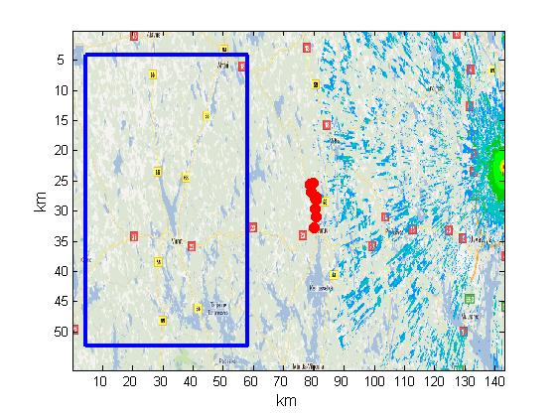
Hilly area

