Slide 1
Study on a) maximum transmit power for TVWS devices b) available amount of TVWS in Bavaria/Germany
Annex 1 to
SE43(11)28
Georg Schuberth
Radio Transmission Systems
Acknowledgement
The work leading to these results has received funding from the European Community's Seventh Framework Programme [FP7/2007-2013] under grant agreement n°248560.

Slide 2
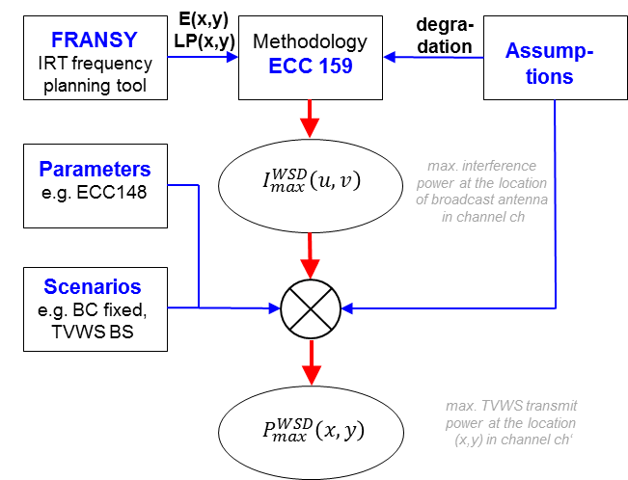
COGEU results
estimating P_{max}
To estimate Pmax and amount of available TVWS
methodology
parameters
assumptions
are required.

Slide 3
estimating P_{max}

Slide 4


estimating P_{max}
from ECC report 159, fmla. 4.3-4
Additional interference caused by a TVWS device can be included by an additional term:
assuming Gaussian signals (ECC report 159, fmla. 4.3-5:
$q_{1}=1−\frac{1}{2}erfc\left\{\frac{1}{\sqrt{2}} \frac{m_{S(dBm)}−m_{U1(dBm)}}{\sqrt{σ_{S(dB)}^{2}+σ_{U(dB)}^{2}}}\right\}$
allows to calculate I_{WSD}:
$$I_{WSD}= \left(m_{U2(dBm)}⊝m_{U1(dBm)}\right)− {PR}_{WSD}$$

Slide 5
estimating P_{max}
Parameters taken from ECC report 148 (DVB-T interfered by LTE):
 | BS |  | UE |  |  |  | BS |  | UE
PR_co | 22 | dB | 22 | dB
PR_1 | -33 | dB | -13 | dB |  | Oth_1 | -13 | dBm | -20 | dBm
PR_2 | -40 | dB | -41 | dB |  | Oth_2 | -8 | dBm | -18 | dBm
PR_3 | -39 | dB | -42 | dB |  | Oth_3 | -19 | dBm | -26 | dBm
PR_4 | -48 | dB | -49 | dB |  | Oth_4 | -13 | dBm | -20 | dBm
PR_5 | -49 | dB | -50 | dB |  | Oth_5 | -8 | dBm | -18 | dBm
PR_6 | -50 | dB | -49 | dB |  | Oth_6 | -6 | dBm | -18 | dBm
PR_7 | -50 | dB | -52 | dB |  | Oth_7 | -5 | dBm | -16 | dBm
PR_8 | -51 | dB | -52 | dB |  | Oth_8 | -5 | dBm | -15 | dBm
PR_9 | -39 | dB | -39 | dB |  | Oth_9 | -6 | dBm | -14 | dBm
average parameters

Slide 6
estimating P_{max}
Assumptions:
Only receivers within coverage areas are protected
channels 40-60 are considered; ch>60 are assumed to be free
minimum distance between TVWS transmitter and DVB-T receiver
multiple interference not considered
simple propagation model
acceptable degradation of location probability due to TVWS device: 1%
 | Broadcast
TVWS | fixed (FR) | portable (PO)
Base station (BS) | d_{min} = 30 m Yagi antenna | d_{min} = 10 m Dipole antenna
User equipment (UE) | d_{min} = 20 m Yagi antenna | d_{min} = 2 m Dipole antenna
Downlink only (DO) | Higher BS antenna d_{min} = 50 m | Higher BS antenna d_{min} = 50 m

Slide 7
estimating P_{max}
Analytical result: Overloading limits TVWS device transmit power:
In most of the European nations it can be assumed that there is at least one broadcast coverage within n±9 of each channel at any location. Under this assumption the overload threshold in combination with the shortest possible distance between TVWS device and TV antenna determines an upper limit for the possible transmit power for TVWS device:
 | BS – DVB-T fixed | BS – DVB-T port. | UE – DVB-T fixed | UE – DVB-T port.
O_{th} | -19 dBm | -19 dBm | -25 dBm | -25 dBm
Min. dist. | 30 m | 10 m | 20 m | 2 m
Antenna gain | 9.15 dB | 2.15 dB | 9.15 dB | 2.15 dB
→Coupl. gain | -49 dB | -46 dB | -45 dB | -32 dB
P_{max} | 30 dBm | 27 dBm | 20 dBm | 7 dBm

Slide 8
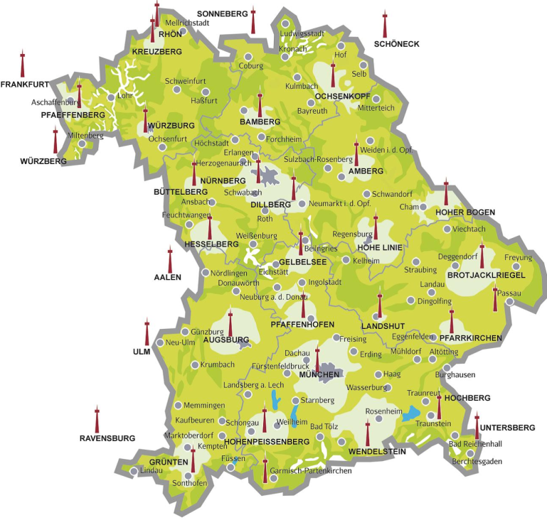
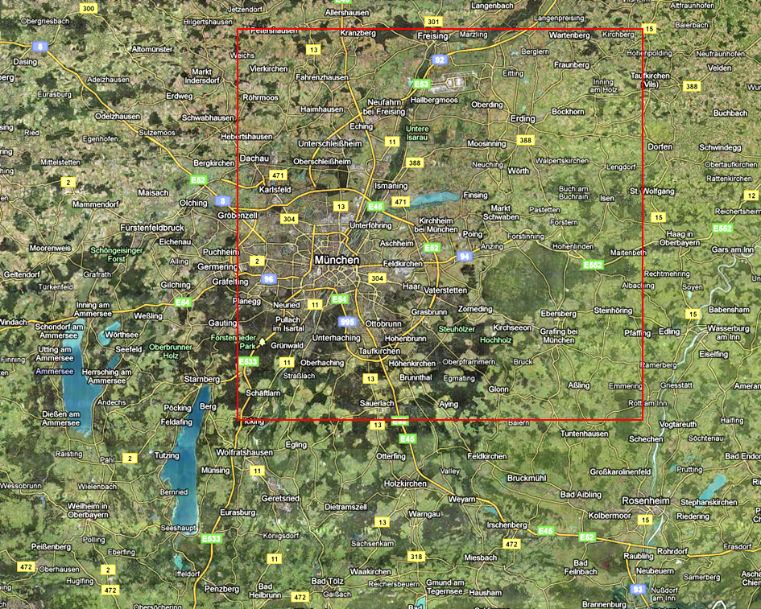
estimating P_{max}

Slide 9
estimating P_{max}
Location probability, ch. 36 … 44:
TVWS base station power map
ch 40, broadcast fixed reception:

Slide 10
estimating P_{max}

Slide 11
estimating P_{max}
Maximum TVWS Base Station transmit power at a location NE of Munich:

Slide 12
Amount of TVWS in Bavaria
The concept of safety distance for estimating the amount of available TVWS in Bavaria
In document SE43(10)17 EBU proposed an interference margin. As an intermediate solution -10 dB were assumed →
I_{WSD} = -98 dBm – 10 dB (noise limited)
P_{WSD} = I_{WSD} – coupling gain =
= -108 – path loss – 9.15 dB
Distance | Pmax
1 km | -18 dBm
2 km | -6 dBm
4 km | +5 dBm
5 km | 10 dBm
6 km | 13 dBm
10 km | 21 dBm
15 km | 28 dBm
20 km | 33 dBm

Slide 13
safety distances:
cyan: 1 km
green: 5 km
yellow: 10 km
orange: 20 km

Slide 14
safety
distance
1 km
TVWS mapped to area:
only channel 45:
safety
distance
5 km
for channels
40 … 60:
safety
distance
10 km
safety
distance
20 km

Slide 15
TVWS mapped to area / mapped to population density

Slide 16
Considering adjacent channels
FCC in the USA allows for white space devices a maximum transmit power of 40 mW (16 dBm), if operated in a channel adjacent to a used TV channel. If transmit power gets higher, up to 4 W EIRP (36 dBm), operation is only allowed in channels with at least one free channel separation to the next used TV channel.

Slide 17
Summary
Our investigations were performed with moderate values for protection ratios, overload threshold, etc. Even with these moderate parameters results show that
in portable broadcast areas TVWS device P_{max} is limited to below ~20 dBm (i.e. operational range of approx. 1 km).
outside portable broadcast areas P_{max} may be somewhat higher, however is finally limited by overloading threshold
So, viable scenarios for TVWS use could be:
In areas with portable broadcast coverage: low power transmit systems, like WiFi
In rural areas / isolated residential areas a downlink only concept (with some limitations) could provide a reasonable means to provide broadband internet supply to area.
Notes:
WiFi in urban areas:
Better penetration characteristics allow improved in house LAN operation
ISM bands are overstrained esp. in dense urban areas, where TVWS usage could bring a significant release
If –for low transmit power- operation at channels adjacent to TV used channels is possible, there is a reasonable amount of TVWS available
broadband internet provision in rural areas
If larger minimum distances can be assumed the downlink only (DO) concept could provide a reasonable means to provide broadband internet supply to area.
Usually the download traffic is much higher than upload traffic, so using TVWS for downlink and mobile communication bands for uplink seems reasonable.
Usually in rural areas wired broadband access is not available due to high infrastructure costs, so this TVWS usage is especially appropriate for rural areas.

Slide 19
Vielen Dank für Ihre Aufmerksamkeit.
[Name]
[Sachgebiet]
Institut für Rundfunktechnik
Floriansmühlstraße 60
80939 München
Tel. +49-(0)89-32399-0
Fax +49-(0)89-32399-351
E-Mail: name@irt.de
Die Folien/Dokumente sind durch das Urheberrecht geschützt.
Eine Vervielfältigung ist nur mit Genehmigung des Verfassers gestattet.
Dieser Urheberrechtshinweis darf nicht entfernt werden.

