Slide 1
Control of aggregated interference from WSDs
Riku Jäntti, Kalle Ruttik, Konstantinos Koufos
Department of Communications and Networking
Aalto University, Finland
<firstname.lastname>@aalto.fi
Maziar Nekovee
British Telecom, Great Britain
maziar.nekovee@bt.com
10th meeting of SE43, Bologna, Italy, 5-7 July 2011

Slide 2
Outiline
Comment on SE 43 proposal
Proposed Area Based WSD Power Allocation Scheme
Numerical Examples
Summary

Slide 3
Comment on SE 43 proposal (Section 4.3 in ECC Report 159)
According to the SE43 the interference from multiple WSD is avoided by using appropriate multiple margin MI.
  The SE43 approach does not explicitly specify how to allocate the transmission power if more than 4 WSD transmit simultaneously.
  In order to control the aggregate interference one has to search for the margin MI+SM that keeps the aggregate interference under certain limits.
    This is computationally complex and makes power allocation in real-time difficult.
  Another way is to set the SM equal to 0 and calculate the MI margin based on the amount of WSD that are active.
    This means that for each particular set of active WSD we have to select a different MI margin. In dynamic environment, the amount of WSD is changing. The variation in the number of WSD should be reflected in the change of the MI margin. Such changes have to be communicated to all the admitted WSD. For a large number of WSD, the margin-based power allocation becomes problematic.

Slide 4
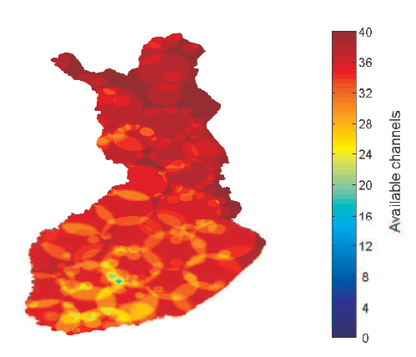
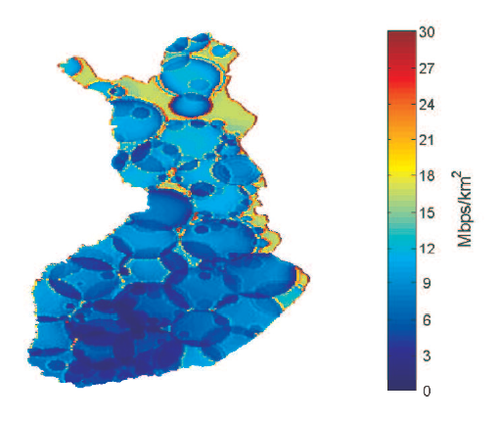
Example: Cellular WSD network in Finland
Hexagonal cellular layout
Cell radius d=2,5,10 km
Antenna height h=30 m
TV propagation model
= ITU-R P1546
WSD propagation model
=Okumura-Hata
WSD cellular network capacity
SINR at TV cell border

Slide 5
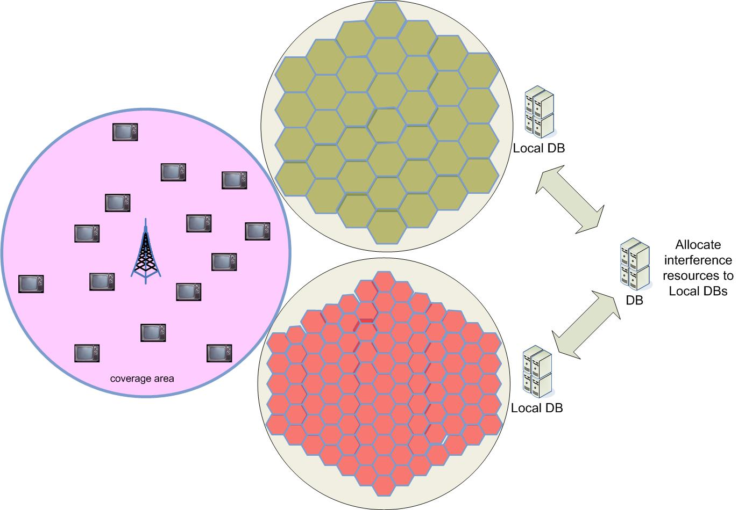
Proposed scheme:
Area based WSD power allocation
The multiple interference margin proposed by SE43 could be interpreted as a resource sharing scheme. The shared resource is the maximum allowable additional interference. The allowable interference is split and distributed among the active WSD.
In order to control the aggregate interference it is computationally complex to exchange and update the location for each active WSD between the two areas.
It is more convenient to devise a rule that controls the aggregate interference generated by each area – not per WSD transmitter.
The allocation of the interference resource among WSD managed by a database (DB) is based on some given fairness rules. (doesn’t have to be equal)
The power allocation inside an area would be based on the given aggregate interference level that the WSD inside the area are allowed to generate.

Slide 6
Area based WSD allocation
DB
Interference limit for given area probability q: I = I₁+I₂
Area 1
I₁
DB1
Power density P_{d1}
I₂
DB2
Area 2
Power density P_{d2}
pixel

Slide 7
Area based WSD power allocation
Power allocation within an area

Slide 8
Interference modelling from an area
The power allocation in an area requires identification of the power density level that satisfied the predefined mean and variance values. Such level can be found by Monte Carlo simulations or by an analytical interference modelling.
The analytical approach utilizes the property that even for moderate number of WSD in the area the generated interference is well approximated by a Gaussian distribution. In interference computation, the impact of the locations of particular WSD is averaged out.

Slide 9
Interference modelling from an area
The Monte Carlo simulation follow the steps outlined in the Rep159 A.6
Cellular downlink case
Cellular uplink case
PPP case

Slide 10
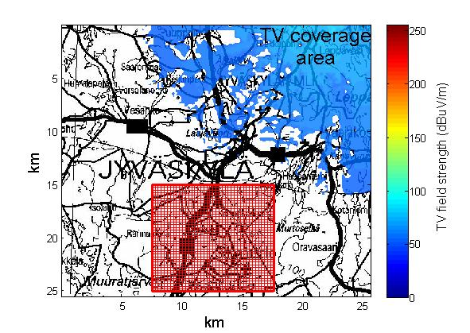

Numerical example I
TV coverage area in Jyväskylä area in Finland
Vihtavuori TV transmitter operating at frequency 546 MHz. The coverage area is defined by the minimum filed strength requirement 53.3 dBuV/m.
The standard deviation of the TV signal at the receiver is σ_{TV}= 5 dB
The standard deviation of the shadowing between WSD transmitter and TV receiver is σ_{SU} = 5 dB.
The location probability q=90%.
The resulting shadowing margin is
dB
D/U = 15 dB (SIR-target = 24 dB)
SU antenna height h=10 m
Pixel size 250 m x 250 m
Area size 5 x 5 pixels
Deployment area of
the secondary system
Area having
uniform WSD
density and local
power allocation

Slide 11
Numerical example I
ECC proposal.
Proposed
Equal power density in each area
Only part of the area active (Arbitrary)
Square regions
Only part of the area active (Random)

Slide 12
Numerical example I
By using the current ECC approach, in the worst case, all pixels contain one active transmitter. The aggregate interference from those transmitters will violate the SIR target (24 dB) at TV receivers. This violation is due to the fact that the ECC rules do not propose a method to set the protection margins when many WSD are simultaneously active.
Our proposed approach allocates at each location the power and at the same time controls the aggregate interference

Slide 13
Numerical Example II
Assume that an area is equal to a cell such that only single transmission can take place at the time.
Now the average power over all active pixels is equal to 20 dBm while by using the ECC proposal it is 12 dBm

Slide 14
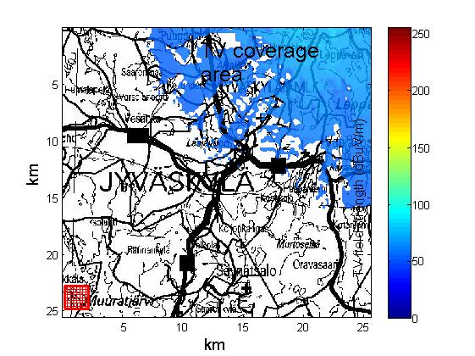
Numerical example III
The same example as before but now the WSD network deploiment area is farther away from the coverage area border of the TV
Deployment area of
the secondary system

Slide 15
Numerical example III
ECC proposal.
Proposed
Only part of the area active (Arbitrary)
Equal power density in each area
Square regions
Only part of the area active (Random)

Slide 16
Numerical example III
By using the ECC approach the SIR target is not violated if safety margin equal to 19 dB is selected. However the transmission power in the area has been conservatively allocated. The average allocated power is only 21.5 dBm
By using the proposed approach the average allocated power lies in the range 28.4 dBm to 40 dBm (see figure 19 and figure 20) which is considerably higher as compared to current SE43 method.

Slide 17
Summary
The SE43 gives the EIRP for particular location, pixel. It does not consider multiple interfering WSD. We propose to extend this approach in two directions.
  Create a bigger area where the EIRP is defined. EIRP is defined not as a power from one WSD in the pixel but as the power density from an area.
  Make the power allocation that controls the interference from multiple WSD.

Slide 18
Summary
The benefits of the proposed approach can be described as following
  We can consider aggregate interference from multiple WSD and still guarantee the reception quality of the incumbent receivers.
  Multiple DBs are allocating power to WSD based on the same resources (Interference margin at the BS receiver). The area-based method allows different DB to make the power allocation independently and still guarantee the BS receiver reception quality.
    Each DB is allocated the interference resource. The WSD allocation by the DB can fill only the interference resource allocated to that DB.
    If a DB runs off of its allocated interference resource it can negotiate with other DB to acquire more resources.
  The spectrum cannot only be allocated to a single WSD but it also can be allocated to a system that operates in certain area. The interference control is parameterized and those parameters are sent to the system. The interference control could be delegated to a RRM of the system.
The power allocation can be separated on an area basis. The power allocation in a smaller area than in the whole white space creates a hierarchical power allocation infrastructure. Such infrastructure simplifies the practical DB implementation

Slide 19
Discleimer
The views expressed in this presentation do not necessarily reflect the views of the QUASAR project consortia as whole.

Slide 20
Backup slides

Slide 21
Area based WSD power allocation
System model

Slide 22
Area based WSD power allocation

Slide 23
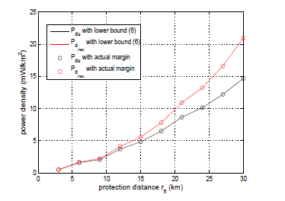


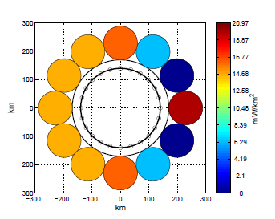


Interference control
Interference bound based on area location probability q=1-O:
Interference limit in location p
Instead of computing Ip for each transmitter we can utilize power density:
Example control scheme
.
P_{d1}=20 mW/km²

Slide 24
QUASAR
QUASAR is an FP7 targeted research project (STREP) that brings together a highly competent team of manufacturers, operators, regulators and universities with the aim at bridging the gap between the claims made in traditional cognitive radio research and practical implementation
Novel approaches are taken as we go beyond the traditional notion of detecting “spectrum holes”
Assessing the business and regulatory impact of secondary, opportunistic access is another key feature of the project.
http://www.quasarspectrum.eu/

