Slide 1

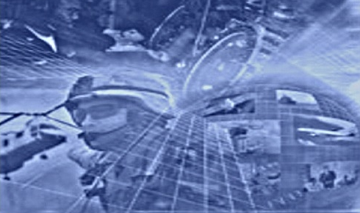

xMax Cognitive Radio Networks
Short Range Devices Management Group
27th March, 2012

Slide 2
Introduction
xMax - the world’s first wide area cellular cognitive wireless broadband network solution
  advanced sensing: DAA, interference tolerance and DSA
  all IP: application and service neutral – enables enhanced functionality , features and performance
  cognitive capabilities offer flexible, future proofed solutions
  adds capacity by opening access to shared spectrum with high QoS
870-876/915-921 bands - outstanding physical qualities of spectrum
  excellent propagation and penetration
  upper band falls within the 902-928MHz light licensed ISM band in the United States within which xMax is already operating
xMax can enable delivery of increased economic value – e.g.,
  mobile ‘throughhaul’ for a mesh network of alarms, SM/SG, RFID, asset tracking
  public safety network
  ‘enhanced’ White Spaces

Slide 3
xMax features
Fully mobile (highway speeds) as well as fixed applications
High QoS, carrier-grade voice, data and video on single integrated network; fixed OTA latency
Low cost: no spectrum licence fees; self planning network; lower network engineering and management costs
Frequency agnostic; multi band to suit availability and application
Rapidly deployable – leverages existing WiFi devices (smartphones, tablets etc.) and Internet infrastructure; satellite/microwave/fibre backhaul
Highly scalable – coverage and capacity can be tailored to market demand and business model
End-to-end Internet Protocol (IP) system – can be integrated into any IP service and device

Slide 4



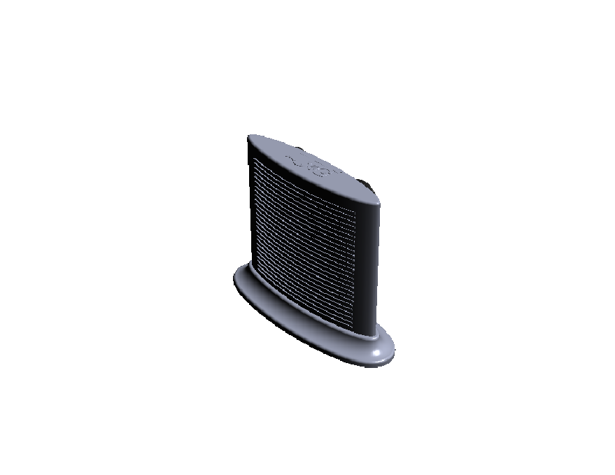

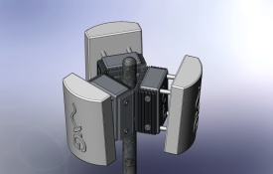
The xMax system
xMax Wireless Network
VoIP CORE
Public or Private Internet
xMSC
Ethernet
Wi-Fi Network
SMS server
xMod is a seamless mobile bridge between WiFi and xMax networks
xMSC has COTS equipment for network management, firewall, SIP Proxy and SMS server
xAPs provide wired network/microwave backhaul to xMax network conversion. They can be tower, pole or strand mounted. xAPs are Ethernet IP connected.
COTS smart phones, laptops, tablets or any device with USB or WiFi can connect to the xMod
WiFi Network
xMax Radio Network (RAN)
Core Network
Public Network

Slide 5
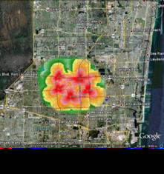
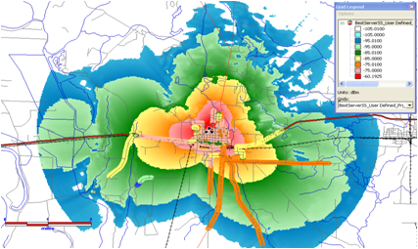

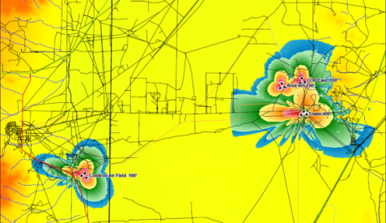


xMax trials
Urban/Suburban - Ft. Lauderdale, Florida
fully mobile 32 mile² network
densely populated
interference-rich environment
extensive testing has allowed continual system performance enhancement and development of robust system
data system being tested OTA outdoors
Rural – Lewisville, Arkansas
underserved market
low noise, excellent range (3-5 miles)
100 sq. mi. rural with 2 towers
1,150 pops covered
Military - US Army - TX, NM, NJ
lab validated (CERDEC)
garrison enterprise solution
tactical cellular – austere desert
Ft. Lauderdale, FL
Lewisville, AR
White Sands, NM

Slide 6
Regulatory compliance
FCC Part 15 Rules apply to users of the 902-928MHz ISM band in the United States
  transmit average power = 1W conducted power per channel (4W EIRP)
  adjacent channel power = -40dBc
  6dB Bandwidth = ≥500kHz, FCC 15.247(a)(2)
  radiated emissions = -30dBc, FCC 15.247(d)
  emissions in restricted bands = 500µV/m @ 3 meters, FCC 15.209
  power spectral density = ≤8dBm in any 3kHz band, FCC 15.247(e)
Other specs for compliance
  transmit power adjustment range = 15dB (1dB steps)
  transmit power accuracy = ±1dB
  transmit output linearity = 5% EVM, 30dBm average, 9dB peak-to-average ratio
  adjacent channel selectivity = -40dBc
  alternate channel selectivity = -54dBc
  Rx maximum input signal = -25dBm

Slide 7
xMax cognitive radio approach
xMax layered cognitive approach
  spectrum sensing: interference based detection of transmitters – every 100s µs
  spatial processing: MIMO technologies allow resistance to interferers
  spectrum sharing
  spectrum management
  spectrum mobility
  Incorporates OFDM and 2x4 MIMO, enabling multi-dimensional signal processing
  outstanding interference rejection, high mobility and resistance to fading; increased range
  redundant coding to remove short burst interference
  spatial processing to remove longer burst interference
  NLOS
  Mesh (MANET) networking capabilities
Notes:
spatial processing: MIMO technologies allow resistance to interferers. Optimize SNR using multiple antenna processing to improve link budget and data rates. Also used to track and cancel interference from multiple mobile transmitters using sophisticated signal processing algorithms
spectrum sharing: able to operate in crowded shared spectrum (ISM, UNI II etc.). Detect interferers, mitigate them or avoid them by changing operating parameters or frequencies
spectrum management: capture the best available spectrum for use at any time. Can add capacity anywhere, any time without using existing frequencies
spectrum mobility: use spectrum dynamically (DSA). Mobile user stations and base stations can decide to change bands where they operate. xMax’s software defined radios are inherently frequency-agile
allowing network access points and user devices to automatically retune and operate on clearer channels within the band

Slide 8
Roadmap
Dynamic Spectrum Access (DSA) is key
BUT xG’s Cognitive Network solution, xMax, delivers much more than just DSA
System on a Chip:
Moves xMax functionality to chip level
Installation by any OEM
MANET:
Mobile mesh networks
Every user makes the network stronger
Self-Organising Networks:
Automatic networking & optimization
No wireless experience needed
Interference Mitigation:
xMax works where other radios can’t
Higher capacity and reliability
MIMO:
Extends range and throughput
Lower cost per bit & per customer
Dynamic Spectrum Access:
Finds & uses available frequencies
Saves $ billions in spectrum costs
Interference Mitigation
MIMO
Dynamic Spectrum Access
Self Organising Networks
MANET
System on a Chip
2014
2013
2012
2011
xG’s Complete
Cognitive Network Solution
Extent of Competitors
Cognitive Radio Technology
Notes:
Theme: We have gone beyond the rest of our competition in terms of key technologies and capabilities because we have real deployments and experience no one else has.
Current state of the market is to focus on Dynamic spectrum access. While this is key it is not enough. DSA relies on the flawed assumption that there is “white spaces” (clean, unused spectrum) out there waiting to be used by cognitive radios. However our deep experience gained from actual deployments shows that there is no white spaces, only gray space (i.e. there is always some level of interference)
From this xG discovered that not only was interference mitigation was needed, we also figured out how to implement it cost effectively and in a way that the core technology could be leveraged to bring other benefits to the platform - for no additional cost.
By implementing sensing, MIMO and advanced (and patent pending) signal processing we extended the range, reliability and throughput of the xMax system far beyond what competitors have and were just starting to think about.
These same capabilities form the key enablers for self-planning, self organizing and mobile mesh networking that are required in key military and commercial markets.

Slide 9
xMax in the 870-876/915-921 bands
Upper band falls within the 902-928MHz light licensed (Part 15) ISM band in the United States within which xMax is already operating
UK pilot network to demonstrate cognitive capabilities of xMax and how spectrum efficiency can be increased and usage optimised (subject to successful Ofcom application)
Trial will allow assessment of any potential interference/coexistence/coordination problems in adjacent bands: (GSM)/UMTS900 and GSM-R and impact analysis
Results of trial will
  inform spectrum compatibility studies
  demonstrate alternative uses for spectrum and services and applications that can be delivered by cognitive radio
  give an indication of the potential value that can be created by use of the bands

Slide 10
Potential use cases
Wide area ‘throughhaul’ for a mesh network of alarms, SM/SG, RFID, asset tracking
  SRDs integrated with xMax to achieve high thoughput, mobility, NLOS and increased range
  own network allows increased capacity at low cost
  self organizing network allows for lower-cost IT technician vs. expensive RF engineering skill level
Public safety market
  no dedicated spectrum
  requires robust, resilient, flexible, on-demand coverage and service in wireless-impaired environments. Voice can be tagged and prioritized end-to-end through network for high reliability
  wireless broadband and software-defined radios are becoming public safety standards
‘Enhanced’ White Spaces
  extends White Spaces networks into (largely urban) areas otherwise blocked by the database
  low cost solution
  prioritised for voice, with other higher bandwidth unlicensed bands (2.4GHz, 5.8GHz) for data

