Slide 1
SEAMCAT 4 status and demo
Jean-Philippe Kermoal
61th Meeting of WG SE
Åre, Sweden, 26 – 30 March 2012

Slide 2
What’s new + Demo
Welcome
Front page
New display
Library
New features
issues

Slide 3
Welcome
Welcome greetings
History
Short cuts + mouse over
News
Further capability (for 2003):
  Tip of the day
  remote database upgrade (without new release)
  Version number detection ......

Slide 4
Front page – To the point
Full use of the space.
Display of the dRSS and iRSS live
Save of the summary
Mouse over on the x/y panel to get the element characteristics
Save stamp
Duplication of workspace
Cloning and deep compare implemented

Slide 5
New display – New pleasure
Harmonisation in the display between traditional (generic) and CDMA/OFDMA module (Panels and Units)
Terminology
Easier access to the data
  Direct to the system to simulate
  no more double click for the interfering links
  Huge reduction in number of tabs for CDMA/OFDMA
Easier glance to the data
Mouse over for graphic and data
Information with symbols

Slide 6
Library – So EASY
Import/export directly from the workspace
Import of antenna library directly to the workspace
Filter of link level data per direction
Harmonise display between library and workspace
New Spectrum mask library
List approach of libraries
Easy to access, Easy to edit, Easy to export
Easy to use

Slide 7
… and the new toys
Propagation plugin…. Yes we dared !!!
Propagation model → reset button
Compare propagation models
Compare vectors facilities (from workspace and external)
Antenna pointing
Migration rules to ease the backward compatibility

Slide 8
Under progress (1/2)
Save – new format (separate input from data in a .zip)
xls/xlsx
Merging victim and interfering link dialog into the workspace
Batch

Slide 9
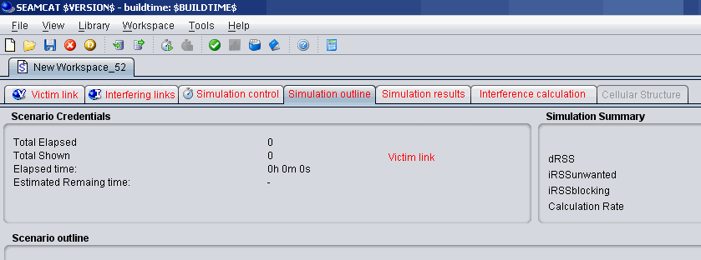
Under progress (2/3) - Mergure
[mock-up , not implemented yet]

Slide 10
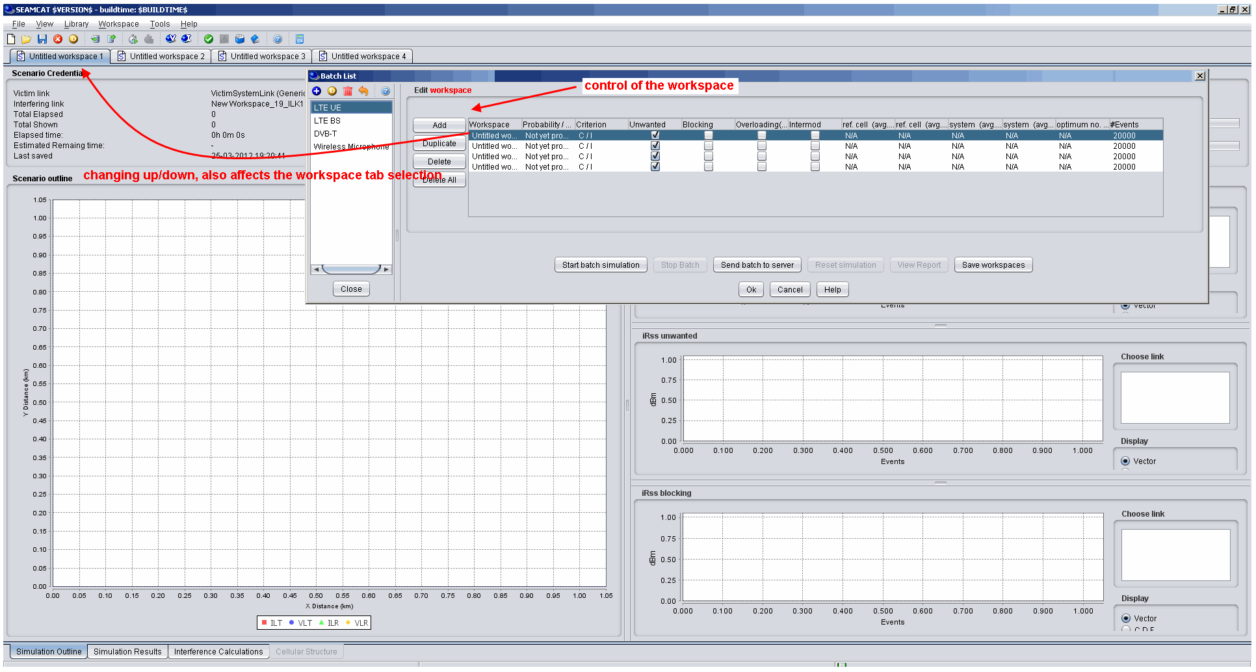
Under progress (3/3) - Batch
[mock-up , not implemented yet]

Slide 11
Issue
Remote computing to be disabled due to the new save format
Drastic changes: Need as much feedback as possible from the dialog display (save/load)
JAVA 7 compatibility
Release of Official: tentative end of April

Slide 12
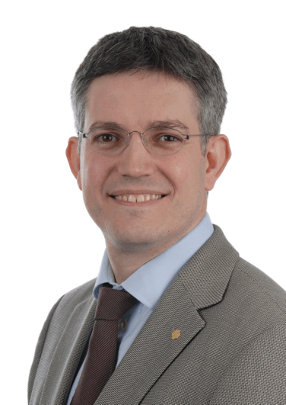
CONTACT ECO
ECO
Nansensgade 19-3
1366 Copenhagen
Denmark
Tel: +45 33 89 63 00
Fax: +45 33 89 63 30
eco@eco.cept.org
Jean-Philippe Kermoal
Spectrum Engineer
jean-philippe.kermoal@eco.cept.org

