Slide 1
Spectrum Regulations for Short Range Devices in Europe
Bruno ESPINOSA, ECO
bruno.espinosa@eco.cept.org
www.cept.org/eco
www.cept.org/ecc
Radio Solutions 2017 LPRA, Nedap, Groenlo,
17th May 2017

Slide 2
Overview
CEPT, ECC, ECO, who are we?
European Frequency Management Framework
Regulations applicable to Short Range Devices (ECC, EC)
Recent developments on regulations for SRD
Planned activities
EFIS – Information on national use for SRD

Slide 3
CEPT, ECC and ECO
regulatory agencies and/or ministries
The ECC is the part of the CEPT that deals with radio spectrum.
ECO: permanent office in Copenhagen.

Slide 4
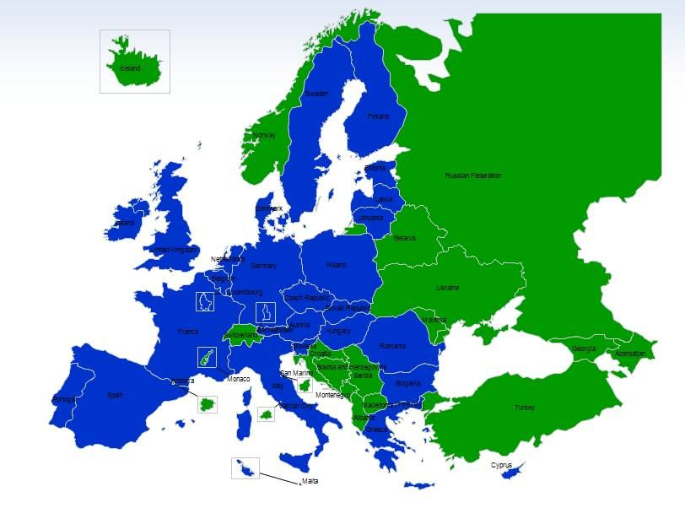
Three main players in spectrum regulation in Europe
ECC:
Spectrum allocation and technical conditions for its use
48 member countries acting together
Technical and regulatory expertise used by EC (Mandate to CEPT)
European Commission:
Single market issues
Binding regulations through specific procedures with MS
ETSI:
Equipment and system specifications: including ‘spectrum use’ characteristics
Recognised standards body for ‘harmonised standards’
Makes ‘System Reference Documents’ which inform and trigger much of the ECC work
Largely industry-driven;

Slide 5
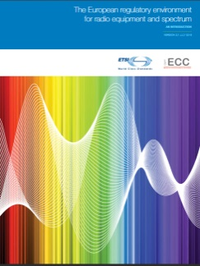
European Frequency Management Framework
2002 Radio Spectrum Decision
Read more at
http://cept.org/ecc/ecc-and-etsi /

Slide 6
Role of the ECC in Europe
Consensus and voluntary character: flexible instrument of the national administrations
4 types of deliverable
ECC Decisions
ECC Recommendations
ECC Reports
CEPT Reports
http://www.ecodocdb.dk/
Activities triggered by the national administrations, the EC (Mandate) and ETSI (System Reference Documents)

Slide 7
Regulations applicable to Short Range Devices (SRD)
“Short Range Device” (SRD) is intended to cover the radio transmitters which provide either unidirectional or bi-directional communication which have low capability of causing interference to other radio equipment.
SRD are not considered a “Radio Service” under the ITU Radio Regulations (Article 1);
SRD in general operate in shared bands and are not permitted to cause harmful interference to radio services;
SRD in general cannot claim protection from radio services;
SRD are normally exempted from individual licensing.
Spectrum for SRD: one of the major topics identified in the ECC strategic plan for 2015-2020.

Slide 8
Regulations applicable to Short Range Devices
Recommendation 70-03 on the use of SRD in Europe:
general position on common spectrum designations,
developed and maintained within the ECC.
Describes the spectrum management requirements for SRD:
identified frequency bands,
maximum power levels,
Spectrum access and mitigation requirements (duty cycle, LBT…),
Modulation/bandwidth.
Basis for the technical Annex of the EC Decision on Short Range Devices
Current trend: promote as far as possible technology and application-neutral solutions to keep flexibility, avoid spectrum fragmentation and foster innovations. Reduce the application specific bands.

Slide 9
Recommendation 70-03
Identifies frequency bands for a wide range of applications
Annex 1: Non-specific SRDs
Annex 2: Tracking, tracing and data acquisition
Annex 3: Wideband data transmission systems
Annex 4: Railway applications
Annex 5: Transport and traffic telematics
Annex 6: Radio determination applications
Annex 7: Alarms
Annex 8: Model control
Annex 9: Inductive applications
Annex 10: Radio microphones, ALDs, wireless audio multimedia applications
Annex 11: Radio frequency identification (RFID) applications
Annex 12: Active medical implants
Includes also information on national implementation status (Appendix 1) and national restrictions (Appendix 3).

Slide 10
EC Decision on SRD
EC Decision on harmonisation of the radio spectrum for use by SRD:
harmonises for EU and EEA Member States the technical conditions for use of spectrum for a wide variety of SRD applications.
Commission Decision 2006/771/EC amended by Commission Implementing 2013/752/EU (updated Technical Annex).
Technical Annex updated on a regular basis: permanent Mandate from EC to CEPT/ECC
Latest response: CEPT Report 59 (06/2016) and its Addendum (03/2017)
Basis for the new update under completion by EC and the Radio Spectrum Committee

Slide 11
Recent developments (UHF, 1/3)
Extensive activities carried out in ECC in response to a set of requests (System Reference Documents) from ETSI to identify new opportunities for SRDs, RFID and Smart Metering applications.
Identified opportunities dominantly for new types of M2M/IoT applications in SRD networks.
Main challenges:
Coexistence between various SRD applications, technologies;
Adjacent band compatibility with LTE below 862 MHz;
Compatibility with other uses in the bands 870-876/915-921 MHz (military applications, ER-GSM) and in adjacent bands (GSM-R).
Relevant reports on compatibility studies:
ECC Report 200: Co-existence studies for SRD and RFID in 870-876 MHz/915-921 MHz;
ECC Report 246: Wideband and Higher DC SRDs in 870-875.8 MHz and 915.2-920.8 MHz;
ECC Report 207: Adjacent band co-existence of SRDs in 863-870 MHz and LTE below 862 MHz;
ECC Report 261: Short Range Devices in the frequency range 862-870 MHz.

Slide 12
Recent developments (UHF, 2/3)
863-870 MHz:
spectrum for wideband SRD in data networks (e.g. IEEE 802.11ah or equivalent) in 863-868 MHz: 25 mW e.r.p in channels ≤ 1 MHz + techniques to access spectrum and mitigate interference (e.g. duty cycle).
WAN NBN SRDs: 4 channels of 200 kHz in 865-868 MHz. Can be used for 500 mW data networks. Technical requirements, including APC and duty cycle.
Harmonised opportunities included in the latest version of the draft revised EC Decision.
862-863 MHz: draft proposal for new entry for non-specific SRDs with 25 mw e.r.p in channels ≤ 350 kHz and 0.1% duty cycle.
870-876 MHz:
Existing use by other applications (military applications, ER-GSM) in some CEPT countries may lead to additional requirements (incl. individual authorisation) or limited availability.
1.6 MHz, preferably in 874-875.6 MHz for 500 mW data networks (WAN NBN SRD) in channels ≤ 200 kHz. Additional requirements compared to 865-868 MHz. Under consideration by EC for possible harmonisation.
Additional opportunities for 25 mW e.r.p. non-specific SRD in 200 or 600 kHz with corresponding limits in duty cycle and transmit time.

Slide 13
Recent developments (UHF, 3/3)
915-921 MHz:
Existing use by other applications (military applications, ER-GSM) in some CEPT countries may lead to additional requirements (incl. individual authorisation) or limited availability.
2.8 MHz for wideband SRD in data networks (e.g. IEEE 802.11ah or equivalent) preferably in 918-920.8 MHz. 25 mW e.r.p + techniques to access spectrum and mitigate interference (e.g. duty cycle). Additional requirements compared to 863-868 MHz. Under consideration by EC for possible harmonisation.
3 x 400 kHz (917.3-917.7 MHz, 918.5-918.9 MHz and 919.7-920.1) for 500 mW data networks (WAN NBN SRD) in channels ≤ 200 kHz. Under consideration by EC for possible harmonisation. Additional consideration for NBN SRDs around 916.3 MHz.
4x400 kHz (916.3 MHz, 917.5 MHz, 918.7 MHz and 919.9 MHz) can be used for 4W RFID with higher performance. Techniques to access spectrum and mitigate interference. Under consideration by EC for possible harmonisation.
Non-specific SRD in data networks (more professional use): 918-920.8 MHz in channels ≤ 600 kHz, 25 mW e.r.p. + techniques to access spectrum and mitigate interference (e.g. duty cycle). Under consideration by EC for possible harmonisation.

Slide 14
Recent developments (Others)
Transport applications:
Update of the conditions of road tolling applications in the 5795-5815 MHz;
Update of the conditions for ITS in the bands 5875-5925 MHz (ECC Decision(08)01) and 5855-5875 MHz (ECC Recommendation(08)01);
Band 76-77 GHz identified for obstacle detection radars for rotorcraft use (ECC Decision(16)01);
Proposal for technical conditions for fixed transportation infrastructure radars in 76-77 GHz.
New bands for audio applications:
174-216 MHz for Assistive Listening Devices (ALD), 10 mW e.r.p. in channels ≤ 50 kHz + requirements for T-DAB protection;
1350-1400 MHz and 1518-1525 MHz for radio microphones.
Data acquisition for medical purposes:
Band 2483.5-2500 MHz identified and proposed for EU harmonisation (EC Decision) for Medical Body Area Network Systems (MBANS), used for medical data acquisition, with adequate technical conditions and spectrum sharing mechanisms;
Draft proposal for Ultra-Low Power Wireless Medical Capsule Endoscopy in 430-440 MHz with -50 dBm/100 kHz max e.r.p. density and not exceeding a total power of -40 dBm/10 MHz.
Update of the definition of duty cycle: in cooperation with ETSI (Appendix 5 to ERC Recommendation 70-03) - more flexible duty cycle definitions are possible.

Slide 15
Current and planned activities
UWB applications:
New permanent mandate from EC to CEPT
Address new demands and industry developments on UWB-based medical applications, vehicular access systems and new or amended mitigation techniques for UWB devices. Will lead to update the relevant ECC Deliverables.
Review the regulation for wideband data transmission systems in 57-66 GHz (e.g. more attractive regulation for access systems and 5G backhauling of small cells).
Address in cooperation with ETSI:
Opportunities for cognitive radio SRD,
Further sharing opportunities through thorough investigations in duty cycle mechanisms,
Rules for channel access and occupation for SRD.
Potential future items, subject to demand:
Opportunities for SRD in 1900-1920 MHz;
SRD use below 9 kHz and above 120 MHz – mostly sensor applications

Slide 16
EFIS (ECO Frequency Information System)
Developed by the ECO recognised by the EC as the tool on the harmonized availability of information regarding spectrum use in Europe
Tables of frequency available in EFIS (www.efis.dk):
45 countries, including all EU member states
ITU-R Region 1
European Common Allocation (ECA) Table (also available as document or Excel: ERC Report 25)
Data types in EFIS:
Allocations (RR, ECA and all the National Tables of Frequency Allocation)
Applications (National Frequency Utilisation Plans)
Radio interfaces (mostly ECS and reference documents for unlicensed usage)
Documents (related to spectrum usage)
Right of use info (individual authorisations, mostly for ECS bands)

Slide 17
EFIS for SRDs
Specific module on the implementation of SRD spectrum regulations.
http://www.efis.dk/sitecontent.jsp?sitecontent=srd_regulations
Electronic version of Recommendation 70-03 and its annexes.
For each Annex:
Implementation status for each entry in the 48 CEPT countries;
Map of the implementation;
Information on the national restrictions, where appropriate.
Possibility for user to export the information (excel, maps).
Similar type of information developed for Asia-Pacific countries (APT)
http://www.aptafis.org/sitecontent.jsp?sitecontent=srd_regulations

Slide 18
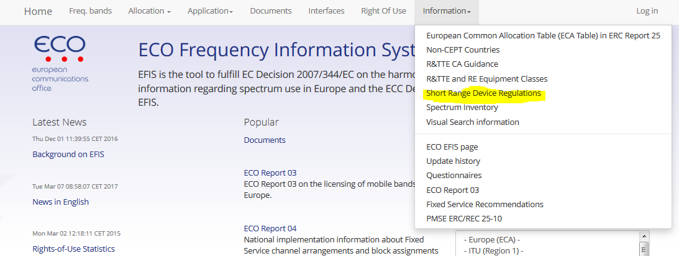
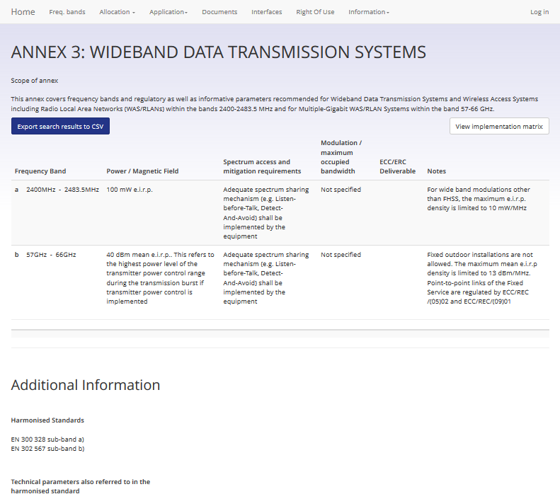
EFIS for SRDs

Slide 19
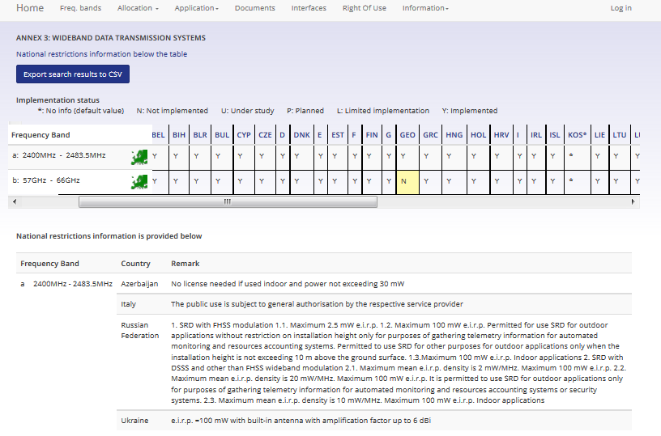
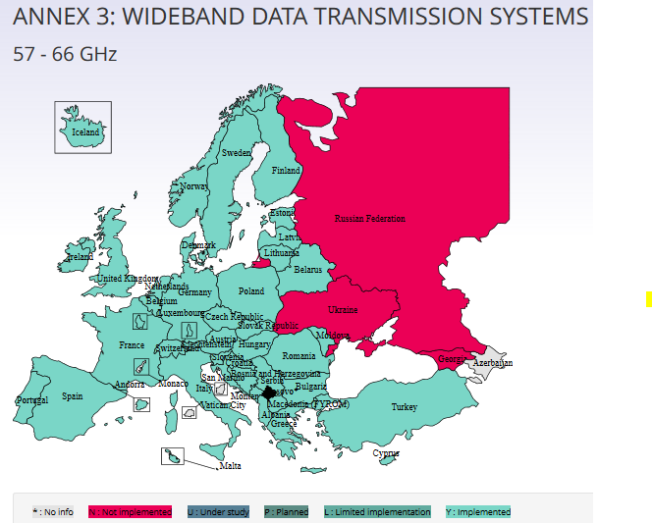
EFIS for SRDs

Slide 20
Helpful links
ECC: http://www.cept.org/ecc
Strategic plan: http://www.cept.org/ecc/ecc-strategic-plan
ECC-ETSI cooperation: http://www.cept.org/ecc/ecc-and-etsi
Participation in ECC work: http://www.cept.org/ecc/participation-in-ecc-work
Short Range Devices Maintenance Group: frequency management group maintaining Recommendation 70-03 and developing spectrum regulations for SRDs
http://www.cept.org/ecc/groups/ecc/wg-fm/srdmg/
Work Programme: http://eccwp.cept.org/default.aspx?groupid=24
SE24: spectrum engineering group responsible for compatibility studies on SRDs
http://www.cept.org/ecc/groups/ecc/wg-se/se-24
Work programme: http://eccwp.cept.org/default.aspx?groupid=47
ECO Documentation database: http://www.ecodocdb.dk/
ECO Frequency Information system (EFIS): http://www.efis.dk/
SRD use in EFIS: http://www.efis.dk/sitecontent.jsp?sitecontent=srd_regulations

Slide 21
Thanks for your attention
bruno.espinosa@eco.cept.org
www.cept.org/eco
www.cept.org/ecc

