Slide 1
Introduction to CEPT, its committees and ECO
Bruno Espinosa, ECO Deputy Director
CEPT Workshop on European Spectrum Management and Numbering
5th April 2016

Slide 2
European Conference of Postal and Telecommunications Administrations - CEPT
CEPT established in 1959 by 19 countries as voluntary association.
Original members were the monopoly-holding postal and telecommunications administrations.
Organisation gathering policy makers and regulators from 48 countries across Europe:
Promote cooperation between Members
Contribute to creating a European dynamic market
Promote harmonisation of telecommunication, radio spectrum and postal regulations
http://cept.org/cept

Slide 3
CEPT framework
CEPT: all EU states (blue) and rest of Europe
Framework: Arrangement and Rules of Procedure (2009)
CEPT Assembly: Ad hoc (December 2011)
http://www.cept.org/cept/framework/arrangement-and-rop

Slide 4
CEPT - Priorities
Focusing leadership on:
telecommunications (with a strong emphasis on spectrum management);
electronic communications and postal services regulation;
engagement by CEPT members with the International Telecommunication Union (ITU) and the Universal Postal Union (UPU).
Strengthening cooperation with partners

Slide 5
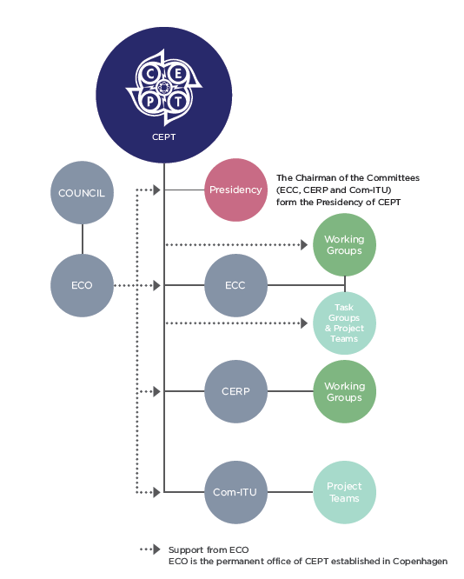
CEPT - Organisation
ECC: Electronic Communications Committee –telecommunications harmonisation and European co-ordination and preparation for ITU-R meetings http://cept.org/ecc
Com-ITU: Committee for ITU Policy – European co-ordination for ITU meetings http://cept.org/com-itu
CERP: European Committee for Postal Regulation –postal regulation, as well as European co-ordination and preparation for meetings of the Universal Postal Union (UPU) http://cept.org/cerp

Slide 6
CERP: European Committee for Postal Regulation
Role of CERP:
To examine postal regulatory affairs in a European context taking into account the changes in the borderlines between regulatory aspects and operational aspects.
To assess the influence of international regulatory policies in all CEPT countries and to establish the necessary contacts with the European Union.
To establish and maintain relations with representatives of relevant bodies and associations concerned with postal regulation issues.
http://www.cept.org/cerp
CERP
Chairperson: L. Mitevski (MKD)
Vice-Chairpersons: A. Karolak-Woźniak (POL)
E. Thorstensen (NOR)
WG Policy
WG UPU
Chairperson:
A. Hach (AUT)
Chairperson:
E. Thorstensen (NOR)

Slide 7
Com-ITU: Committee for ITU Policy
Co-ordination of CEPT actions for preparation for and during the course of the following ITU meetings:
ITU governance: Council, Plenipotentiary Conferences;
ITU-D: World Telecommunication Development Conferences (WTDC)…;
ITU-T: World Telecommunication Standardisation Assemblies (WTSA), World Conference on International Telecommunications (WCIT) …;
Develop and approve European Common Proposals (ECPs) and Briefs (positions) for the work of these ITU meetings
Cooperate with various organisations inside or outside the CEPT and Administrations outside the CEPT
Interact with ECC on general ITU matters
ECC deals with ITU-R issues
http://www.cept.org/com-itu

Slide 8
ECC: Electronic Communications Committee
Work towards common regulatory policies in Europe
Harmonise efficient use of the radio spectrum, satellite orbits and numbering resources
Develop European common positions and proposals, for use in the framework of ITU-R (WRC) to promote the European interests on a worldwide basis
Maintain a level of technical expertise.
Provide a focal point for information (EFIS etc.)
Cooperation with other bodies
http://www.cept.org/ecc
http://cept.org/ecc/who-we-are/what-we-do

Slide 9
ECC - Structure
Electronic
Communications Committee
Chairman: E. Fournier (F)
Vice-Chairmen: S. Pastukh (RUS) J. Afonso (POR)
Steering Group
European
Communications Office
Director: P. Christensen (DNK)
Deputy Director: B. Espinosa (F)
WG CPG
WG FM
WG SE
WG NaN
ECC PT1
Conference
Preparatory Group
Frequency
Management
Spectrum
Engineering
Numbering
and Networks
IMT-Matters
Chairman:
A. Kühn (D)
Vice-Chairmen:
To be decided
Chairman:
T. Weilacher (D)
Vice-Chairmen:
C. Reis (POR)
S. Talbot (G)
Chairman:
K. Loew (D)
Vice-Chairmen:
J. Duque (POR) k. Bejuk (HRV)
Chairman:
J. Vallesverd
(NOR)
Vice-Chairmen:
E. Greenberg (G)
F. Dragomir (ROU)
Chairman:
D. Chauveau (F)
Vice-Chairmen:
P. Toivonen (FIN)
S. Green (G)
Updated: March 2016

Slide 10
ECO (European Communications Office) - Mission
Permanent office of the European Conference of Postal and Telecommunications Administrations (CEPT);
Provide a centre of expertise in electronic communications;
Advice and support to the CEPT committees, in particular the ECC;
To support and work together with CEPT member countries and other stakeholders providing a forum to debate and advance European communications policy for the benefit of all Europe’s citizens.

Slide 11
ECO - History
European Radiocommunications Office (ERO) was established in 1991
1991
2001
2009
The European Radiocommunications Office (ERO) and the European Telecommunications Office (ETO) merged
The European Communications Office (ECO) was formally established on 1 July 2009

Slide 12
ECO – Support to ECC strategic plan
ECC strategic plan: defines key actions and challenges for ECC. New version for 2015-2020.
Identifies tasks for the ECO as support for ECC in its focal point role:
explore relationships with universities, relevant scientific institutes and European research programmes,
ensure proper maintenance and development of EFIS,
assist Administrations in making proposals for studies,
promote ECC deliverables and activity,
develop a communication programme (e.g. electronic newsletters) to support the promotion of ECC achievements,
develop training sessions and materials for newcomers,
support ECC in developing close relations with industry and other external organisations,
support ECC in organising workshops on thematic issues.

Slide 13
ECO – operational services
Manage CEPT family of websites
Conduct, on behalf of ECC, consultations on draft deliverables and questionnaires on specific topics
Publish CEPT deliverables and keep a record of their implementation: http://www.ecodocdb.dk/
Develop and maintain online information systems:
EFIS, http://www.efis.dk/
ECC Work Programme database, http://eccwp.cept.org/
Information repository for coordination at 700 MHz, http://700mhz.cept.org/countries
Develop and maintain SEAMCAT Spectrum Engineering tool, http://www.seamcat.org/
Provide a central source of information:
http://www.cept.org/ecc/topics

Slide 14
ECO
12 employees
7 experts
5 general staff
http://cept.org/eco/about-eco/eco-annual-report
http://cept.org/eco

Slide 15
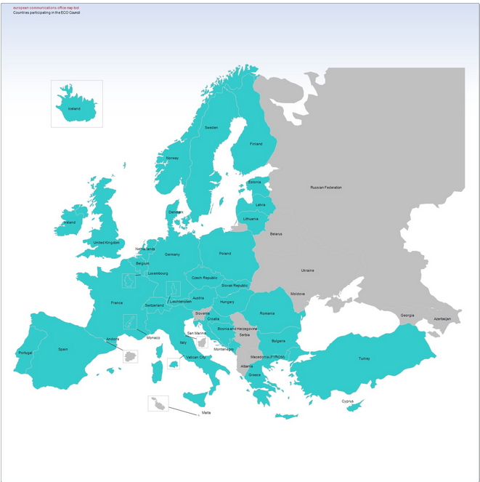
ECO Council
.
ECO Council – 35 CEPT countries:
Austria, Belgium, Bosnia and Herzegovina, Bulgaria, Croatia, Cyprus, Czech Republic, Denmark, Estonia, Finland, France, Germany, Greece, Hungary, Iceland, Ireland, Italy, Latvia, Liechtenstein, Lithuania, Luxembourg, Monaco, Montenegro, the Netherlands, Norway, Poland, Portugal, Romania, Slovak Republic, Spain, Sweden, Switzerland, Turkey, the United Kingdom and Vatican City.

Slide 16
Thanks for your attention!!
Questions ??

