Slide 1
NaN#26 Meeting
20 – 22 June 2023
Title: Introduction of Upcoming all IP Network and related numbering issues in Japan
Source: NTT
Contact: Koji Isshiki <koji.isshiki@as.ntt-at.co.jp>, NTT
This document introduces upcoming all IP Network (migration from PSTN to IP network) and related numbering issues in Japan. Major topics related to all IP Network and numbering in Japan are number portability, quality of service and emergency call services. Also issues of interworking to Internet is mentioned.
0

Slide 2
Guideline and Schedule for IP migration of fixed telephony service in Japan
In Japan, the guideline and schedule (below) have been discussed by major telecom operators and Japanese Numbering Authority. Although some part of it are still under discussion, most providers will follow them towards the completion in 2025 of migration from PSTN to all IP networks.
Early 2021
Early 2024
Early 2025
Start of IP connection using POI
Providers are gradually ready for receiving IP calls
Start of routing calls from remaining metal subscriber to the local IP network
Completed
Phase I
Phase II
Phase III
Phase I ：Physical settlement of POI(Point of Interface) at Tokyo and at Osaka
Phase II ：Opening of IP-IP connection to the operators which are ready for migration
Phase III ：Calls from remaining metal subscribers will be routed to local IP network.
1

Slide 3
Change to IP Interconnection in Japan
In Japan, interconnection of networks has been non-IP interconnection using ISUP protocol through incumbent/dominant PSTN (NTT) as hub function.
This connection will be changed to IP interconnection using SIP protocol through POI (Point Of Interconnection at Tokyo and Osaka) by 2025.
There are two kinds of SIP interconnections, one with ENUM and another without ENUM depending on whether the terminating number has number portability or not.
Non-IP Interconnection(using CCS Protocol: ISUP) through Hub function of PSTN (NTT)
IP Interconnection(Two kinds of SIP protocol*) through POI.
*Two kinds of SIP protocol:
SIP with ENUM for geographical/mobile/free call number which has number portability.
SIP without ENUM for non geographical number and other numbers which do not have number portability.
Assignee of numbers
(Over 30 telecom providers)
Hub function of NTT
Geographical number
POI
Mobile number
By 2025
Non geographical number
Free call number
Other numbers
(Emergency call, Network selection, others)
2

Slide 4
Phone number and quality classification in Japan(1)
In Japan, the Authority regulates the required quality of services for each number category.
At the time, IP telephony appeared, the quality did not satisfy the requirement of regulated quality for voice telecommunication. So, new number range of 050 is allocated to VoIP service for users to recognize the quality with numbers.
Thus, the communication quality specified in the telecommunication regulation is related to number allocation in Japan. (Please see Page 6 “Telecommunication Regulation of Japan” )
Network
(Phone type)
Number
[number of numbers assigned and used]
Quality regulation value
Quality class
Geographic number
PSTN
(Fix Phone)
0AB～J
[60million]
Packet delay : lower than 100 ms,
R value : more than 80
Quality Class A
Mobile number
PLMN
(Mobile Phone)
070-CDEF-GHJK
080-CDEF-GHJK
090-CDEF-GHJK
[175million]
Quality Class B
Packet delay : lower than 150 ms,
R value : more than 70
Non geographic number
Packet delay : lower than 400 ms,
R value : more than 50
(Page 4 “050 VoIP NW quality measurement model in Japan” )
050 VoIP NW
(050 IP Phone)
050-CDEF-GHJK
[10million]
Quality Class C
Internet
(Internet Phone)
Number are not assigned.
No quality regulation
3

Slide 5
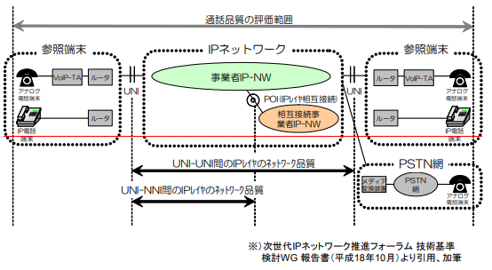
050 VoIP NW quality measurement model in Japan
Evaluation range for Class C
(Packet delay :lower than 400 ms, R value : more than 50)
reference terminal
IP network
reference terminal
router
IP-NW operator
router
Analog terminal
POI
Analog terminal
router
intermediate operator
router
VoIP terminal
VoIP terminal
Network quality in IP layer between UNI-UNI
PSTN
Network quality in IP layer between UNI-NNI
media equipm’t
PSTN
Analog terminal
(Figure) 050 VoIP NW quality measurement model in Japan
4

Slide 6
Phone number and quality classification in Japan(2)
The new number 050 is initially allocated to VoIP to recognize the quality with numbers. As the VoIP has been improved, it became qualified to assign 0ABJ to IP phones satisfying the quality as well.
In addition to quality issues, the operators providing 050 IP telephony do not have responsibility for connection of an emergency call. It is based on the decision that it is even better than sending wrong location information.
Number portability is also not obligated for the 050 providers.
Network
(Phone type)
Items with # are required for number assignment.
Number
Quality
By 2025
Geographic number
Emergency call service(#)
Number portability (#)
Interconnection between all parties (#)
PSTN
(Fix Phone)
0AB～J VoIP NW
(0AB～J IP Phone)
0AB～J
A
Under the trend of improving packet network quality
No emergency call service connection
No number portability
Limited interconnection between contractors
050 VoIP NW
(050 IP Phone)
Non geographic number
050 VoIP NW
(050 IP Phone)
050-CDEF-GHJK
C
Internet
(Internet Phone)
Number are not assigned.
No quality regulation
Mobile number
Emergency call service(#)
Number portability (#)
Interconnection between all parties (#)
PLMN
(Mobile Phone)
070-CDEF-GHJK
080-CDEF-GHJK
090-CDEF-GHJK
B
5

Slide 7
Telecommunication Regulation of Japan
In Japan, there are regulation provisioned for service quality of voice service on PSTN, on mobile network and on VoIP network respectively. In addition to difference of required service quality, there are different obligations for emergency service and number portability depending on the services. Requirements for providers therefore vary depending on numbers they use for their services and are regulated in each numbering categorie in Telecommunication numbering plan.
When IP telephony first appeared, it was not satisfied with the quality required in the regulation. So, new number range of 050 is allocated to VoIP service for users to recognize the quality from numbers. As the quality of the Internet/VoIP has improved, it became possible to assign 0ABJ (Japanese geographic number) to IP phones satisfying the quality as well. Thus, the communication quality specified in the regulation is related to number allocation in Japan.
In addition to quality issues, there are regulations specific to operators assigned 050. The operators providing 050 IP telephony do not have responsibility for connection of an emergency call. It is based on the decision that it is even better than sending wrong location information. Also number portability is not obligated for the 050 providers.
On the other hand, in the EU and US code, quality of services is not mentioned in relation to numbering. Also number portability service and emergency service are required irrelevant to numbering. (page 7 and 8)
Note: The word of “service quality” is used here for the quality of telecommunication, which is calculated with packet delay, packet loss.
6

Slide 8
Telecommunication Regulation of EU
In the EU code, quality of services is not mentioned in relation to numbering. Also number portability service and emergency service are required irrelevant to numbering.
Studies about numbering for VoIP in ECC report
ECC report 59 is the output of the studies for VoIP numbering by CEPT ECC. Following the result of the studies, there is no specific number for VoIP service in any countries in EU. This report concluded that Voice quality should not be associated with numbering. This report also mentioned the difficulty of implementation of emergency service. The problems of the use of VoIP for calls to emergency services are listed and those are still under study for implementation in EU. It said that number portability has no implication for the choice of number ranges for VoIP services. So, if a number can be imported for a service, it also can be ported out and vice versa. (https://docdb.cept.org/document/169)
DIRECTIVE (EU) 2018/1972 is the regulations common to the telecommunications services in European countries. The telecommunication codes of each country are aligned with the EU Directive considering the situation of each region/country. The directive stipulates the obligation to provide emergency services and number portability. There is the code for quality of service in Article 104 titled as “Quality of service related to internet access services and publicly available interpersonal communications services”. And the Quality-of-Service Parameters are defined in Annex X. They are the directives for end-users right and not relevant to number space.
7

Slide 9
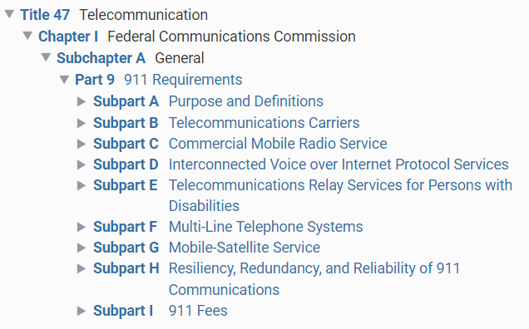
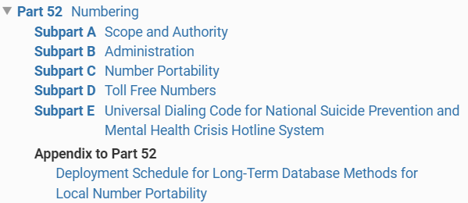
Telecommunication Regulation of US
In the US code, quality of services is not mentioned in relation to numbering. Also number portability service and emergency service is required irrelevant to numbering.
In the US, telecommunication regulations are in title 47 telecommunication of the Code of Federal Regulation. 911 requirements are regulated in 47 CFR Part 9. And there is Subpart C: Number Portability in Part 52 of Numbering. There is no requirement for telecommunication quality.
Emergency service and number portability obligation in CFR Title 47
Extracted from
https://www.ecfr.gov/current/title-47/chapter-I/subchapter-A/part-9
https://www.ecfr.gov/current/title-47/chapter-I/subchapter-B/part-52
8

Slide 10
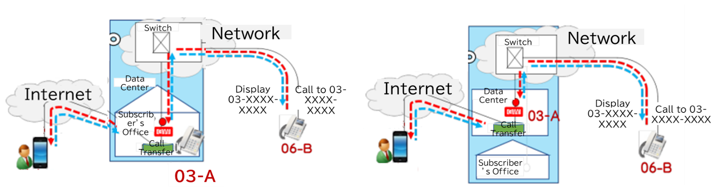
Issues under consideration and background
Background of the issues
0AB-J VoIP NW is a fixed network, and the service of it has high voice quality (Quality Class A) and high reliability (calling number is strictly checked and spoofing of number is difficult to occur). However, due to the increase in telecommuting and business trips of telephone users, the demand for services such as cloud PBX via the Internet is increasing, and it is necessary to consider the issue of nomadic use of 0AB-J numbers.
Examples of the issues
Interworking between 0AB-J NW and the Internet described in the following figures are some of the examples of the issues under consideration.
Provision of requirements for nomadic use of 0AB-J numbers. (issue1)
Service providers are required to comply with the voice quality regulations (Quality Class C), but there is a demand for simplified measurement methods. (issue2)
A method of guidance informing the call forwarding to the Internet that the quality is degraded or that the number and the caller's geographical area are different. (issue3)
Provision of emergency call service. (issue4)
[Figure in the right]
Cases such as cloud PBX by service providers
[Figure in the left]
Cases such as enterprise-owned cloud PBX
issue2 : Quality Class C should be met and easily measured.
issue3 : guidance to end users
issue4: emergency call service
issue1 : Gateway should be located in the 0AB-J geographic area.
issue3 : guidance to end users
issue4: : emergency call service
issue1 : Gateway should be located in the 0AB-J geographic area.
9

