Slide 1

Introduction to ECC PT1
January 2023

Slide 2
ECC PT1 is the lead group on mobile in CEPT
ECC PT1 is responsible for mobile broadband issues in CEPT
European harmonisation of spectrum identified for MFCN
Sharing and compatibility studies in MFCN spectrum
CEPT preparation for WRC-23 agenda items 1.2, 1.3, 1.4 and Article 21.5
MFCN: mobile/fixed communications networks – terminology used in ECC
MFCN includes IMT and other communications networks in the mobile and fixed services (which include fixed wireless access but not point-to-point links)
IMT: international mobile telecommunications – terminology used primarily in the ITU

Slide 3
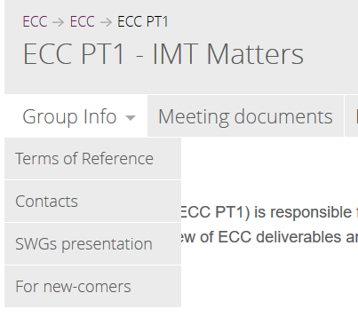
ECC PT1 Terms of Reference
The Project Team shall be responsible for implementing the WAPECS concept as appropriate in the context of MFCN and in frequency bands identified by ECC, including collaborating with WG FM on frequency management issues.
1
See the full ECC PT1 Terms of Reference on the
ECC PT1 webpage
WAPECS: Wireless Access Policy for Electronic Communications Services

Slide 4




ECC PT1 Officials
Chair
Steve Green
Ofcom UK
Tel: +44 207 7834 384
E-mail:
steve.green@ofcom.org.uk
Secretary
Faye Tendall
Ofcom UK
E-mail:
faye.tendall@ofcom.org.uk
Vice-chair
Christoph Hildebrand
BNetzA
Germany
Tel: +49 6131 18 3111
Email:
christoph.hildebrand@bnetza.de
Vice-chair
Claudia Carciofi
Fondazione Ugo Bordoni
Italy
Tel: +39 051 846854 Email: ccarciofi@fub.it

Slide 5
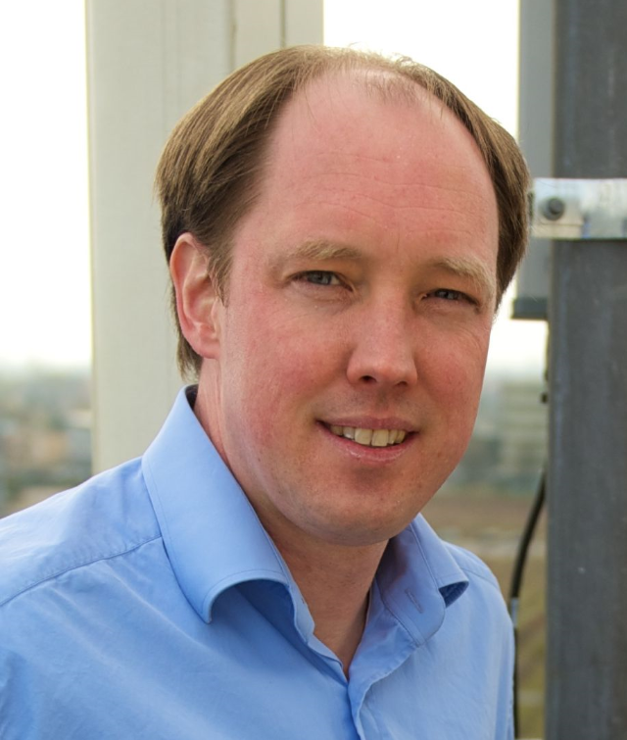



ECC PT1 Sub working groups
SWG-A – Spectrum Issues
Chair: Michael Kraemer (Germany)
michael.kraemer@intel.com
SWG-C – Compatibility and Sharing Issues
Chair: Šarūnas Oberauskas (Lithuania)
sarunas.oberauskas@rrt.lt
SWG-WRC-23 AI1.2 – CEPT Preparation for WRC-23 Agenda Item 1.2: IMT mid-band
Chair: Robert Cooper (UK)
robert.cooper@ofcom.org.uk
SWG-WRC-23 AI1.3 – CEPT Preparation for WRC-23 Agenda Item 1.3: 3600-3800 MHz
Chair: Claudia Carciofi (Italy)
ccarciofi@fub.it
SWG-WRC-23 AI1.4 – CEPT Preparation for WRC-23 Agenda Item 1.4: HIBS
Chair: Tobias Vieracker (Germany)
tvieracker@apple.com

Slide 6
ECC PT1’s role within ECC
Steering Group
ECC
ECO
WG FM
Frequency
Management
WG SE
Spectrum
Engineering
CPG
Conference
Preparatory Group
WG NaN
Numbering and
Networks
ECC PT1
IMT
Matters

Slide 7











Co-operation with external entities
ECC
ECC PT1
European Commission
Other regional organisations

Slide 8
Main ECC PT1 activities
Harmonisation of spectrum in CEPT for MFCN – sharing/compatibility studies (ECC Reports) and technical conditions (ECC Decisions)
CEPT preparation for World Radiocommunication Conferences (WRCs) on mobile-related agenda items/issues on request from CPG
Response to EC Mandates on mobile related issues (CEPT Reports)
Development and update of cross-border coordination ECC Recommendations
CEPT Contributions to ITU-R WP 5D
Liaison with ETSI on standardisation issues
Studies on sector specific issues (UAS, railways, mobile communications on aircraft/vessels)
See the current Work Programme for ongoing activities
A List of IMT deliverables is maintained by ECC PT1 summarising the completed activities (see also DocDB)

Slide 9
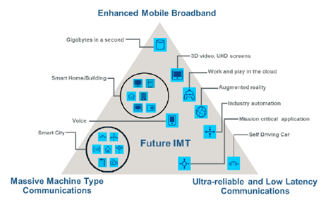

5G activities
ECC PT1 is the main group responsible for 5G (IMT-2020) in CEPT
A summary of the main activities in ECC PT1 in response to the CEPT 5G roadmap is available here

Slide 10
WRC-23 preparation
CPG-23 (Conference Preparatory Group for WRC-23) in April 2020 tasked ECC PT1 to lead CEPT preparation for the following agenda items/issues for WRC-23:
1.2 – IMT mid-band: to consider identification of frequency bands for the future development of IMT on a regional basis – including 3300-3400 MHz and 6425-7025 MHz within Region 1, and 7025-7125 MHz globally (other bands considered for other Regions)
1.3 – 3600-3800 MHz: consider upgrade of mobile allocation to primary in Region 1
1.4 – HIBS: the use of high-altitude platform stations as IMT base stations (HIBS) in certain bands below 2.7 GHz
9 – Article 21.5 – applicability of limits to active antenna systems (AAS)
ECC PT1 is developing CEPT briefs and draft European Common Proposals (ECPs) accordingly
9

Slide 11
Response to EC Mandates
ECC PT1 drafts CEPT Reports in response to EC Mandates. These CEPT Reports are the basis either for the update or the development of EC framework. Recent examples are presented below.
  Harmonised spectrum for 5G
    Existing bands below 3 GHz: CEPT Report 72 and CEPT Report 80
    3.4-3.8 GHz: CEPT Report 67
    24.25-27.5 GHz: CEPT Report 68
    40.5-43.5 GHz: CEPT Report 82
  Mobile communications on-board aircraft: CEPT Report 81
  Mobile communications on-board vessels: Draft CEPT Report 83
  ECC PT1 has started work on a Mandate on shared use of 3800-4200 MHz by terrestrial wireless broadband systems providing local-area network connectivity

Slide 12
Correspondence groups
Correspondence Groups (CGs) dedicated to specific topics are active between ECC PT1 plenary meetings
Discussions take place on the ECC PT1 forum and through dedicated meetings/webmeetings
The number and scope of CGs varies between meetings, see the webpage for the latest list

Slide 13
Work item and deliverable approval procedure
Work items (WIs) are initiated at the ECC plenary with the support of 5 administrations, usually based on a proposal originating in PT1
Deliverables are developed over a number of PT1 meetings and submitted to ECC Plenary for approval for public consultation (PC)
Following 6 week public consultation PT1 reviews comments and submits final version to ECC Plenary for approval for publication
2 meeting cycle (typically 3-4 months) between approval for public consultation and publication
Procedure for ECC Reports, ECC Recommendations and ECC Decisions:

Slide 14
Approval procedure for CEPT Reports
CEPT Reports developed in response to EC Mandates follow a specific procedure:

Slide 15
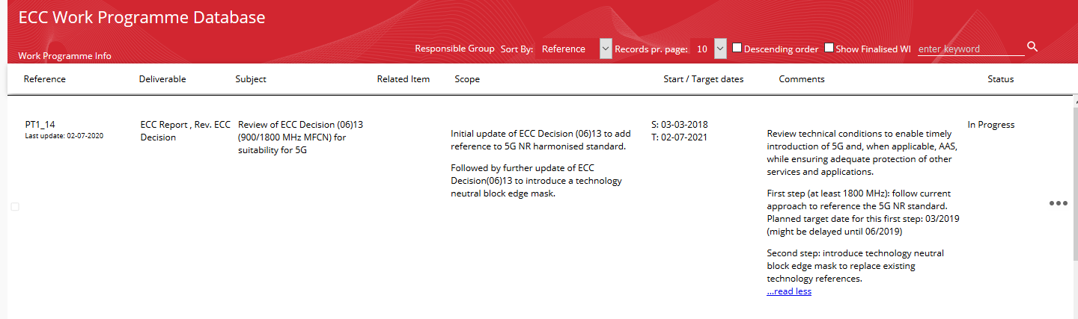
Work item example
Work items are recorded in the ECC Work Programme Database:
New or revised deliverable
Multiple deliverables can be captured in a single WI
Target date denotes final approval (publication) by ECC Plenary following public consultation

Slide 16

Work item planning
The detailed approval schedule can be seen in the WI planning chart submitted to each meeting (ECC PT1#73 January 2023 example):

Slide 17
Further information
ECC PT1 webpage
ECC PT1 contacts

